Slide 1
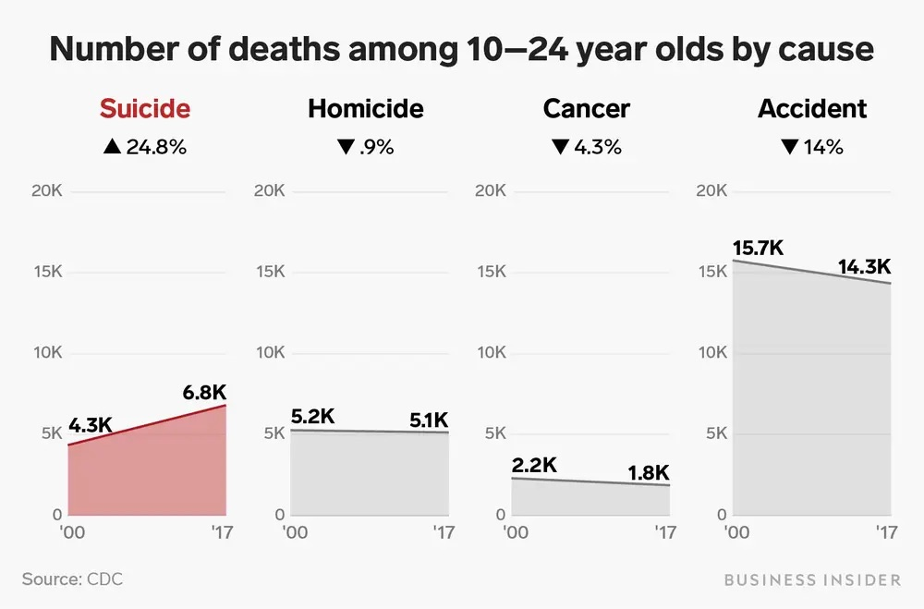
Policy Priority: Mandating Annual Suicide Prevention Training for School Personnel in New Jersey (K-12)
REPLACE THIS BOX WITH YOUR ORGANIZATION’S
HIGH RESOLUTION LOGO
Amanda M. Ricci, BSW Student
Georgian Court University
Abstract
Social Problem
Why should this policy be
reintroduced?
Strengths & Weakness of the Policy
According to the American Foundation for Suicide Prevention (2022), suicide is classified as a public health crisis, as it is the third leading cause of death for individuals aged 10-24 in the state of New Jersey. Due to a large percentage of this age range spending a significant amount of their lives in school, teachers are in a prime position to recognize mental health concerns or suicide risks and make appropriate referrals for help. School personnel would benefit from regular trainings to help build the skills and confidence to identify and assist vulnerable youth in seeking help. This poster addresses related policy passed in several U.S. States, as well as the need for the reintroduction of NJ Bill S2584 regarding mandated annual suicide prevention trainings in New Jersey K-12 public schools.
According to the Center of Disease Control and Prevention (2021), in 2020, adolescents accounted for a larger proportion of all suicides in several states, including New Jersey, when compared to previous years. Teachers have reported several barriers in intervening with students at risk of suicide, such as limited education or training and concerns that they will make the crisis worse (Hatton et al., 2017; Ross et al., 2017). Research suggests that most young individuals who are suicidal are ambivalent about dying and often project signals or statements that they are contemplating taking their life (AFSP, 2022). This not only displays the crucial role teachers play in identification and prevention, but places emphasis on their need for annual training on the topic to address specific barriers.
If teachers are expected to play a significant role in school-based suicide prevention, it is imperative that they are trained regularly in the identification of students at risk for suicide, how to provide immediate support, and how to refer at-risk students to appropriate mental health professionals. Mandated training yearly is one way to ensure that all school personnel have a baseline understanding of suicide risk, especially as numbers continue to increase among youth.
According to the 2019 Youth Risk Behavior Survey, 18.8% of high school students in the U.S. reported having considered attempting suicide,15.7% planned about how they would attempt suicide, and 8.9% of students reported having attempted suicide (CDC, 2020). These statistics indicate the severity of suicide as a health concern among youth, and the need to address suicide prevention legislation as a priority. This bill would better equip educators with training and protocol on helping get at-risk youth connected to the help they need.
Strengths:
1. By equipping our educators with the information, tools, and resources to help identify and assist at-risk youth, lives will be saved!
2. Assists schools with ensuring legal responsibilities. Lawsuits against educators, schools, and school districts concerning suicides/suicide attempts of students are increasing yearly (JFI, 2021).
Weaknesses:
Fear that time spent completing mandated trainings would take away time needed for teachers to work on instruction.
Individuals are unclear on whether suicide prevention trainings are definitively effective in preventing suicide.
How has the problem been
addressed before?
Currently, New Jersey mandates two hours of suicide prevention training for school personnel as a part of professional development, but with no specification that it must be done annually. Twenty-one states (over 40% of all states) have passed The Jason Flatt Act, which requires all educators to complete two hours of youth suicide awareness and prevention trainings each year in order to be licensed to teach within the state (JFI, 2021).
In 2014, former NJ Senator, Diane Allen introduced Bill S2584 to the Senate, which fit the description of the Jason Flatt Act, requiring public school teachers to receive yearly suicide prevention trainings as a part of professional development requirements. Although this was a great first initiate for suicide prevention policy in New Jersey, this bill did not receive enough votes and was not passed.
References
Hatton, V., Heath, M. A., Gibb, G. S., Coyne, S., Hudnall,
G., & Bedsoe, C. (2017). Secondary teachers’
perceptions of their role in suicide prevention and
intervention. School Mental Health, 9, 97
116. https://doi.org/10.1007/s12310-015-9173-9
K-12 school suicide prevention. (2022, September 22). American
Foundation for Suicide Prevention.
https://afsp.org/suicide-prevention-in-k-12-schools/
Mental Health and Youth. (2020, August 20). Centers for Disease
Control and Prevention.
https://www.cdc.gov/healthyyouth/data/yrbs/feature/ind
ex.htm
Suicide Rates by State | Suicide | CDC. (n.d.).
https://www.cdc.gov/suicide/suicide-rates-by-state.html
The Jason Foundation, Inc. (2021, July 12). Jason Flatt Act.
https://jasonfoundation.com/about-us/jason-flatt-act/
.

