Slide 1
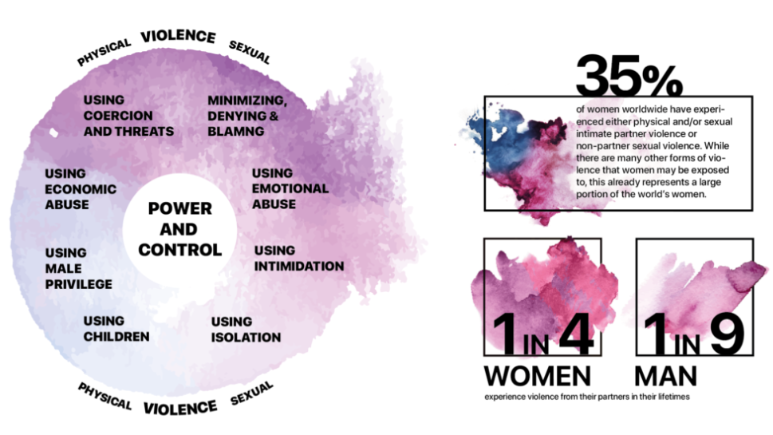
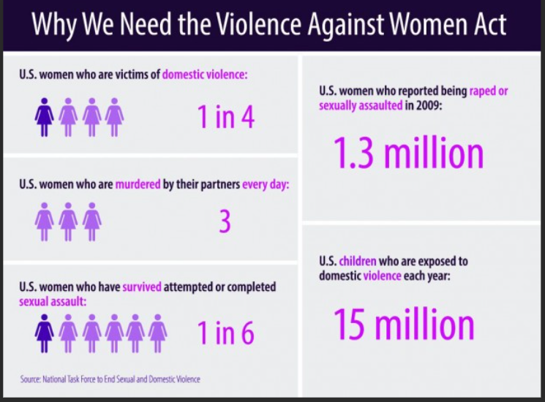
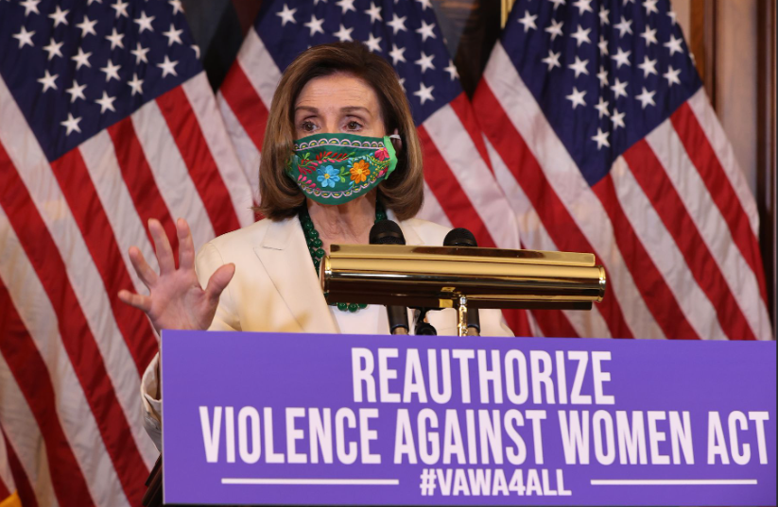
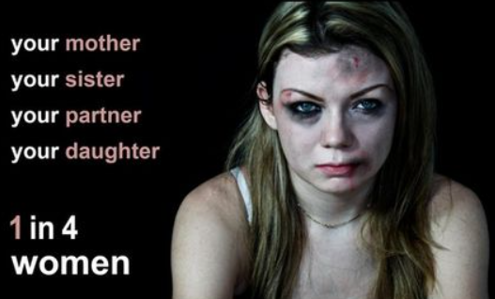
S.3623 (117th): Violence Against Women Reauthorization Act (VAWA) of 2022 This bill modifies and reauthorizes through Fiscal Year 2027 programs and activities under the Violence Against Women Act that seek to prevent and respond to domestic violence, sexual assault, dating violence, and stalking.
The bill also authorizes new programs, makes changes to federal criminal laws, and establishes new protections to promote housing stability and economic security for victims of domestic violence, sexual assault, dating violence, and stalking.
--------------------------------------------------------------------------------------------------
Non-Cognitive Predictors of Student Success: A Predictive Validity Comparison Between Domestic and International Students
Non-Cognitive Predictors of Student Success: A Predictive Validity Comparison Between Domestic and International Students
Title: S.3623 Reauthorization of the Violence Against Women Act (VAWA) of 2022
Introduction:
This bill is to Reauthorize the previous Violence Against women Act of 1994.
Increase services & support for:
Women
Survivors of domestic violence
Dating violence
Sexual assault
Stalking
Increase funding for DV
LGBTQ+
Summary of the Bill:
Improves criminal justice response
Responds to needs of diverse populations
Improves services for survivors
Addresses survivors' economic needs
Invests in prevention in young population
Increase victim access to safe housing
Improves the civil legal response
Promotes quicker response time for DV calls to the police department
Resources:
S.3623 - 117th Congress (2021-2022): Violence Against Women Act Reauthorization Act of 2022 | Congress.gov | Library of Congress
Senate+VAWA+Two-Pager+.pdf (squarespace.com)
Domestic violence and abusive relationships - signs, effects and support | healthdirect
Some helpful Domestic Violence Resources:
ACT: Domestic Violence Crisis Service ACT – (02) 6280 0900
NSW: Domestic Violence Line – 1800 656 463
QLD: DV Connect – 1800 811 811
Victoria: Safe Steps Family Violence Response Centre – 1800 015 188; or Domestic Violence Resource Centre Victoria
WA: Women’s Domestic Violence Helpline – 1800 007 339 or (08) 9223 1188; Men's Domestic Violence Helpline – 1800 000 599 or (08) 9223 1199
SA: Domestic Violence Crisis Service Line – 1800 800 098
Tasmania: Family Violence Response and Referral Line – 1800 633 937; or Family Violence Counselling and Support Service – 1800 608 122
NT: Dawn House – (08) 8945 1388 or find help near you, including shelters, on the NT Government website
Dori Sabik - Rutgers University,
MSW Student
Dr. DuWayne Battle, Rutgers University, BASW Program Director
Notes:
Notes:
In Powerpoint, click View > Guides
Keep text within gutter guides.
Author list: Don’t split names onto two lines (e.g., “Jimmy [break] Smith”). If that happens, use a new line, unless you need the space. Bold the first names of anybody who’s presenting in person.
Intro/methods/result: Do not drop below font size 28, but if you have extra space, jack up the font size until the space is full.
Do not use color in the sidebars except in graphs/figures. It’ll pull attention from the center and slow interpretation for passersby.

