Slide 1
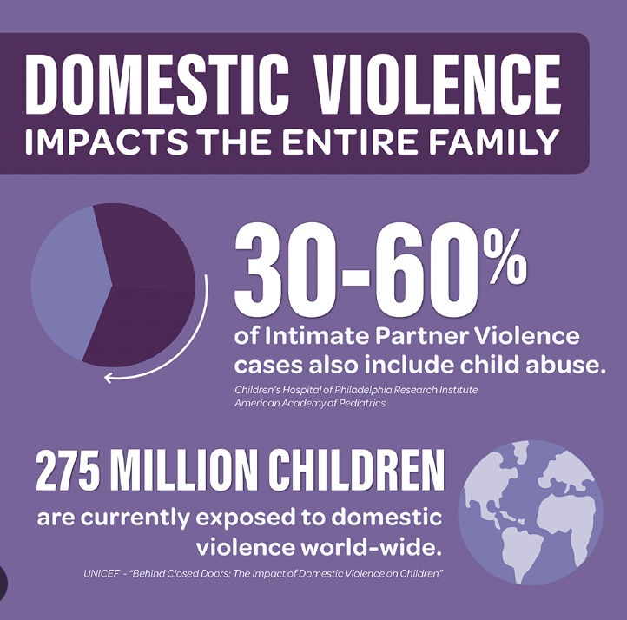
Children Exposed to Intimate Partner Violence: Long-Term Effects Elizabeth Lloyd Georgian Court University
Policy
CPP-VIII-B-1-100
Abstract
Strengths
Social Problem
Recommendations
When a referral is made regarding the accusation of a child or children's involvement with intimate partner violence in NJ, The Division of child protection and permanency is required to go out and assess the situation. “The mission of the Division is to ensure the safety, permanency, and well-being of children and to support the families”(DCF). However, when a child is exposed to stress and trauma from IPV, it can lead to developmental and physical health challenges down the road.
When there is concern regarding the welfare of a child and the referral does not meet CPS criteria, a child welfare assessment is conducted to assess the well-being of the child/children in the household to determine what services are needed. The evaluation begins with the first contact with the family and ends when the case is closed.
Regarding the health and development of the child, instead of “assessments being revised and updated periodically throughout the child's involvement with the child welfare agency,” it should be revised and updated long-term to look for potential health implications that may strive from the early exposure of IPV.
We provide services not only to children but also to families or caretakers
Provides grants to a wide range of services and resources.
The goal of permanency and strengthening family systems.
Intimate Partner Violence has an impact on children and mothers prenatally and perinatally.
Childhood exposure to IPV and other psychosocial traumas can result in negative adult physical behaviors and health consequences such as heart disease, cancers, diabetes, obstructive pulmonary disease, and early death.
IPV interrupts the caretaker's ability to meet the basic needs for safety and security in infants and young children if not addressed early enough.
Early exposure to IPV is associated with an increased risk of asthma.
“When children experience stressful events, the hypothalamic-pituitary-adrenal axis is activated, releasing cortisol from the adrenal glands. Repeated activation may lead to dysregulation and increased risk for disease”(Blair et al., 2015).
Exposure to IPV leads to an increased risk of obesity among preschool-aged children.
“Witnessing family violence may be associated with emotional distress, and emotion-focused coping using food to self-soothe and address negative emotions”(Boynton et al., 2010).
Medical and pediatric providers should be screening for IPV exposure health implications long–term, especially after a case is closed and out of the agency’s hands.
If IPV is suspected, referrals should be made immediately.
Advisory of potential risk factors impacting a child's health and development from early exposure to IPV.
Pediatric healthcare providers must understand knowledge and competency in identifying IPV, ensure the safety of children or IPV victims, and provide resources for survivors or exposed children.
Weaknesses
Not everyone utilizes services provide
Not all health services provide or recommend IPV screenings
Resources
Bair-Merritt, M. H., Voegtline, K., Ghazarian, S. R., Granger, D. A., Blair, C., Johnson, S. B., & Family Life Project Investigators. (2015). Maternal intimate partner violence exposure, child cortisol reactivity and child asthma. Child Abuse & Neglect, 48, 50–57.
Boynton-Jarrett, R., Fargnoli, J., Suglia, S. F., Zuckerman, B., & Wright, R. J. (2010). Association between maternal intimate partner violence and incident obesity in preschool-aged children: Results from the Fragile Families and Child Well-Being Study. Archives of Pediatrics & Adolescent Medicine, 164(6), 540–546.
Breiding, M. J., & Ziembroski, J. S. (2011). The relationship between intimate partner violence and children’s asthma in 10 US states/territories. Pediatric Allergy and Immunology, 22(1pt2), e95–100

