Slide 1
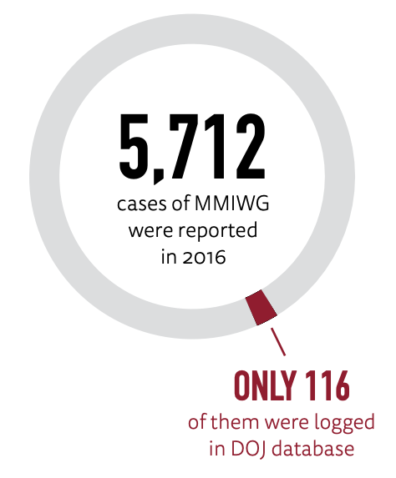
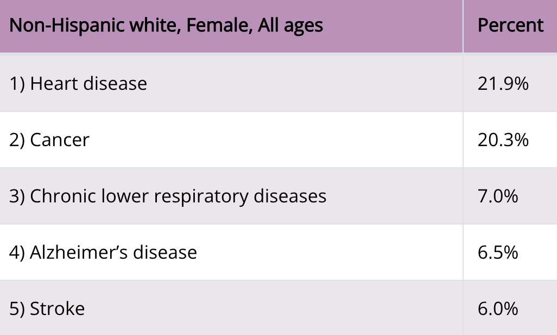
HB 1177 - Creating a MMIWG2S Cold Case Investigations Unit
Washington State, 68th Legislature
(2023-2024)
There are over 2,000 unsolved homicides in Washington. Indigenous women make up nearly 5% of these cases, despite being less than 2% of the state's population. (AG Office, 2023)
Institutional racism and Colonialism: why so many cases of MMIWG2S are ignored by the government, media, and public. We can compare the significance of the disappearance of Gabby Petito in 2021, a young white woman, or the 2022 University of Idaho murders. Both became a national news frenzy. Although these stories are valid, traumatic, and heartbreaking, they highlight the neglect and invisibility of the thousands of MMIWG2S; the preference of the public’s sympathy and outrage for white faces over Black and brown faces.
This bill will not only further investigate cold cases among MMIWG2S, but also implement an advocate to consistently work and communicate with the victims’ families while respecting and valuing both their culture and their trauma.
Non-Cognitive Predictors of Student Success: A Predictive Validity Comparison Between Domestic and International Students
Non-Cognitive Predictors of Student Success: A Predictive Validity Comparison Between Domestic and International Students
No More Forgotten Sisters: A cold-case unit for MMIWG2S
INTRODUCTION:
This January, the Washington State legislature proposed to create a missing and murdered indigenous women and people cold case investigations unit as an upgrade for the original Missing and Murdered Unit (MMU). There are thousands of MMU cases, but so many are still unsolved. This policy proposes to reopen and re-investigate cold cases within the state of Washington.
Cold cases: unsolved homicides, sexual offenses, sexually motivated offenses, missing persons, and cases of unidentified remains
SIGNIFICANCE:
Indigenous families have resorted to their own means and resources when their loved one’s case has gone cold; developing this unit can keep these families out of danger and assure their already little (yet warranted) trust in the U.S. government instead of damaging it further.
Most WA law enforcement don’t have cold case agencies, so they could benefit from the assistance of the attorney general’s office.
“A cold case unit should use a culturally attuned, trauma-informed, and family and victim-centered approach in assisting local law enforcement agencies; and a cold case investigation unit will expand resources available to law enforcement, coroners, and other agencies” (HB 1177, 2023).
Urban Indian Health Institute (2016)
CDC (2019)
References
HB 1177, 2023 Biennium, 2023 Reg. Sess. (Wash. 2023) https://app.leg.wa.gov/billsummary?BillNumber=1177&Year=2023&Initiative=false
Leading causes of death-non-hispanic white females - United States, 2017. Centers for Disease Control and Prevention. (2019, November 20). https://www.cdc.gov/women/lcod/2017/nonhispanic-white/index.htm
Missing and murdered Indigenous People Crisis. Bureau of Indian Affairs. https://www.bia.gov/service/mmu/missing-and-murdered-indigenous-people-crisis
Mullins, E. (2023, January 26). New Senate bill to create Cold case unit for missing and murdered indigenous women and people. The Daily Evergreen. https://dailyevergreen.com/150168/news/new-legislation-to-create-cold-case-unit-for-missing-indigenous-people/
Reyna, L. (2023, January 27). WA may launch a cold-case unit for missing, murdered indigenous people. Crosscut. https://crosscut.com/news/2023/01/wa-may-launch-cold-case-unit-missing-murdered-indigenous-people
Secretary Haaland creates new missing & murdered unit to pursue justice for missing or murdered American Indians and Alaska natives. U.S. Department of the Interior. (2021, April 1). https://www.doi.gov/news/secretary-haaland-creates-new-missing-murdered-unit-pursue-justice-missing-or-murdered-american
Urban Indian Health Institute Report (2016) https://www.uihi.org/wp-content/uploads/2018/11/Missing-and-Murdered-Indigenous-Women-and-Girls-Report.pdf
Angelina Gassaway
Rutgers University, BASW Student
Dr. DuWayne Battle, Faculty Advisor

