Slide 1
ELMP Research Methods Seminar Series
Data Cleaning and Data Management in Stata
Dr. Jason Burns, Assistant Professor ELMP

Slide 2
About the seminar series
Faculty in the K-12 and Higher Education programs will be hosting a series of brief seminars, each roughly 60 minutes in length, on a range of research methodologies to support students as they work to employ these methodologies in their research, namely in their dissertations.
These seminars are open to all students from any of the programs in the Department of Educational Leadership, Management, and Policy. Seminars are oriented toward students planning and conducting independent research, such as a dissertation. As such, the content of these seminars will assume that students are familiar with the core concepts from their coursework on research methods, such as what is found in: Qualitative Methods, Advanced Qualitative Methods, Intro. to Statistics, Intermediate Statistics, and Data Analysis

Slide 3
About me
Dr. Jason Burns is an Assistant Professor in SHU’s K-12 program in Educational Leadership, Management, and Policy.

Slide 4
Data Cleaning and Data Management in Stata: Agenda
What is data cleaning and data management?
Stata vs SPSS
Working with data in Stata
Transforming and recoding variables
Creating new variables
Deduplicating data
Merging data: adding variables
Appending data: adding observations

Slide 5
Quantitative Data Terms
Data: Quantitative data most often exists in the form of a spreadsheet, which is important into statistical software for analysis
Observation: a row in the dataset that represents one unit, such as a student, teacher, school, household, etc. It is important to know the unit of observation of one’s data both when preparing for analysis and in interpreting results
Variable: a column in the dataset that represents some piece of information across observations, such as names, ID numbers, test scores, race/ethnicity, attendance, etc.
Cross-sectional data: a dataset that is taken from one point in time and in which each unit has only one observation
Panel data: a dataset that contains observations of units from multiple points in time

Slide 6
1. What is data cleaning and management?
There is much data available for use, but it is often not in a format that is ready for analysis when it is downloaded
Cleaning/managing data is the process of manipulating a dataset to prepare it for analysis
This is an important, and often time-consuming, step in the research process as many errors can arise from issues with data management
Data cleaning/management can involve:
Transforming or recoding variables
Creating new variables
Adding variables from another dataset (merging)
Adding observations from another dataset (appending)

Slide 7
2. Stata vs SPSS
ELMP is switching over to Stata for quantitative methods courses
Stata, like SPSS, is a statistical software package that allows one to manipulate and analyze quantitative data
Stata is also free to SHU students
The Stata interface allows one to use menus to enter commands (like SPSS), but also allows one to type commands into Stata more easily, and save one’s commands/code, which allows more efficiency
Faculty within ELMP are more proficient with Stata and so can provide more support with this package

Slide 8
2. Stata vs SPSS
Stata Resources
Stata cheat sheets: https://www.stata.com/bookstore/stata-cheat-sheets/
UCLA IDRE Statistical Consulting: https://stats.idre.ucla.edu/stata/modules/
University of Wisconsin SSCC: https://www.ssc.wisc.edu/sscc/pubs/sfs/
Dr. Burns’ YouTube Channel of Instructional Videos on Stata: https://youtube.com/playlist?list=PLe9Xrkxtpzshne1JfeHxQ4mLQ8Wnya3W7

Slide 9
3. Working With Data in Stata
Stata can automate many data manipulation tasks to avoid the need to hand-enter or edit data.
Stata variable names cannot begin with a number and cannot contain spaces
Stata recognizes two basic variable formats: numeric and string
Numeric variables contain only numbers, which Stata uses to compute statistics
String variables contain text and cannot be used to compute statistics
In Stata, when referring to the contents of a string variable, it should be surrounded by quotes, which are not needed when referring to the contents of a numeric variable
When data is imported into Stata, the software will automatically import variables as numeric or string based on their contents
It is possible to convert variables from string to numeric or vice versa, though numeric is often required for many tasks

Slide 10
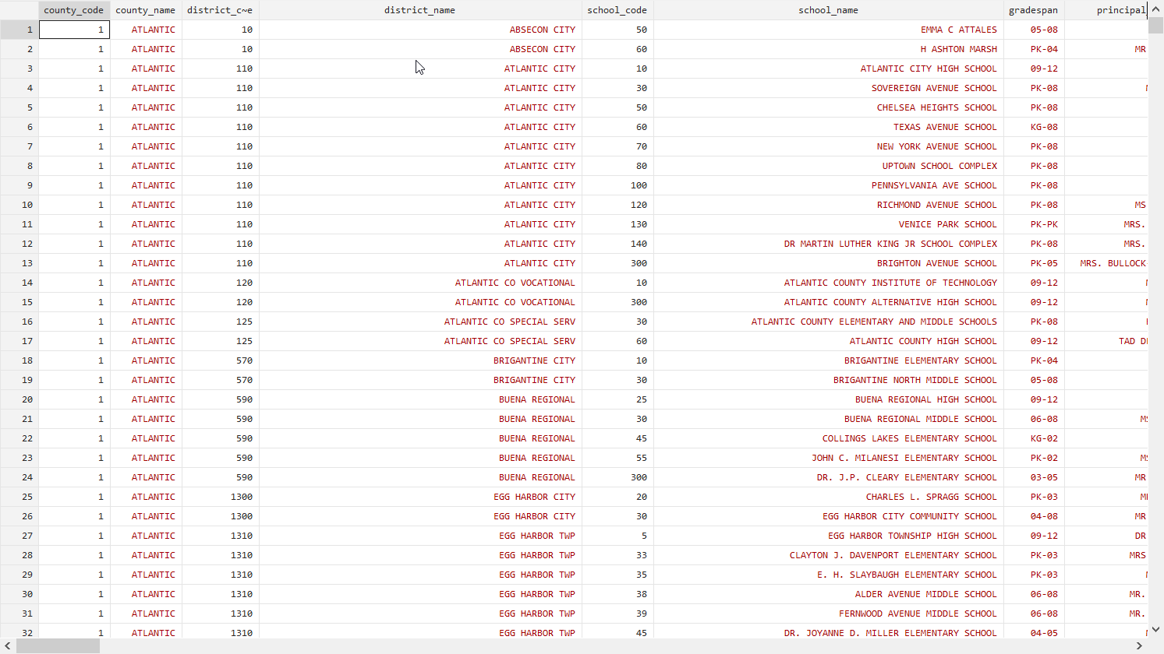
3. Working With Data in Stata

Slide 11
4. Transforming and Recoding Variables
When working in Stata, all commands have the same basic structure:
Command variable(s) conditional, options
Commands can create variables, run analyses, etc.
Depending on the command, at least one and sometimes multiple variables are used
Conditional statements instruct Stata to perform the command on/using only certain observations, such as observations in a specific county or state.
Options vary across commands but give Stata more specific instructions on what to do.

Slide 12
4. Transforming and Recoding Variables
Destringing a variable: converting a variable from string (text) to numeric. To do this, all values of the variable must contain only numbers.
Stata code:
Destring variablename(s), replace
This code will convert the values of a variable from string to numeric and replace the existing values of a variable

Slide 13
4. Transforming and Recoding Variables
Recoding/replacing a certain value of a variable with another value: can be used to recode a variable for any reason, but is helpful to remove text from variables so that the destring command can be used
Stata code:
Replace variablename = “newvalue” if variablename == “old_value”
This replaces specific values of a string variable with a different value for all observations of the value “old_value”
Conditional statements like this allow one to perform a command only on observations that meet certain criteria

Slide 14
4. Transforming and Recoding Variables
Renaming a variable: renaming a variable can help to make variable names more intuitive and is also sometimes needed for tasks like merging and appending
Stata code:
Rename oldvariablename newvariablename

Slide 15
5. Creating New Variables
New variables can be created with a specific value or as a combination of the values of other variables for a given observation and can be created as either string or numeric. Conditional statements can be used when creating new variables. There are many different options/formulas that can be used, type “help generate” into Stata for documentation.
Stata code:
Generate newvariable = 2021
Generate st_ratio = enrollment/teacher_fte

Slide 16
Practical Tip
When transforming, recoding, or creating new variables, always check them to make sure that what you intended to happen actually happened, either by looking at the data itself or using descriptive statistics.

Slide 17
6. Deduplicating Data
When working with cross-sectional data, each unit should only be in the dataset one time. With panel data, each unit should be in the data only once per time period. Duplicated observations are a source of error because it leads to a unit being counted twice when computing statistics.
However, it sometimes happens that data contains duplicates.
When a dataset contains duplicates, it is important to remove duplicates and retain the “right” one.

Slide 18
6. Deduplicating Data
First, generate a variable called “duplicates” that indicates the number of times a specific value of a variable, or combination of values from multiple variables, is duplicated in the dataset. Then, tabulate that variable. If there are any observations with a value greater than 0, there are duplicates.
Stata code:
Duplicates tag variable(s), gen(duplicates)
Table duplicates

Slide 19
6. Deduplicating Data
If your data contains duplicate observations, you will need to determine which observation to keep
If the values of all variables are the same across all duplicated observations, it doesn’t matter which observation is kept
If the values of variables across duplicates does differ, you will need to assess why there is conflicting information and determine which observation to keep
To examine duplicated observations, first sort the data so that duplicates appear in successive rows, then examine the values of relevant variables
Stata code:
Sort identification_variable(s)
Browse if duplicates >0

Slide 20
6. Deduplicating Data
There are several ways of removing duplicates, depending on why there may be duplicate observations.
Observations can be manually deleted using the data editor, though this is inefficient for removing many duplicates
Duplicate observations can be dropped at random to retain one, though this should only be done if the values for all variables are the same. The Stata code for that is:
Duplicates drop variable(s), force
Duplicates can be dropped using some rules. There are different ways of doing that, but for those new to Stata, a straightforward way is to create a variable called “keep” and give it a value of 1 for all observations that should be kept using the replace command. Once that is done, the following code will drop all unwanted observations:
Keep if keep == 1

Slide 21
7. Merging Data: Adding Variables
Sometimes one has different information about the same units in different datasets. In these instances, variables from multiple datasets can be joined together by using Stata to merge them. To merge datasets, a few things are needed:
One or more variables of the exact same name in both datasets that identifies observations
The values of the identifying variables need to be the same and be in the same format in both datasets
One needs to know the file paths for the datasets that need to be merged

Slide 22
7. Merging Data: Adding Variables
To merge data, one first loads into Stata one of the datasets that need to be merged, which is called the master data
One then identifies the variable(s) that link units or observations in both datasets
There are three different ways of merging data and the type of merge that is needed depends on the unit of observation in each dataset (see next slide)
The file path for the other data set, called the using data, is used to add variables to the master dataset

Slide 23
7. Merging Data: Adding Variables
The type of merge is determined by whether there are duplicates of the identifying variable in either dataset. The three types of merges are:
1:1, or one-to-one: this type of merge is used when the observations are unique on the variable(s) used to match them in the master and using data represent. In this type of merge, observations in the using data are matched to the corresponding observation in the master data and new variables from the using data are added to the master data.
m:1, or many-to-one: this type of merge is used when observations in the master data are not unique on the variables being used to match them, but observations in the using data are. In this type of merge, observations in the using data are associated with all corresponding observations in the master data and variables from the using data are added to the master data.
1:m, or one-to-many: this type of merge is similar to a m:1 merge above except that observations in the master data are unique on the matching variables while there are duplicate observations in the using data on the matching variables. In a 1:m merge, observations may be added to the master data

Slide 24
1:1 Merge
No duplicates
ID | Name | Height
1001 | Marquise | 61
1002 | Sally | 63
1003 | Ariel | 61
1004 | Bart | 65
ID | Name | Weight
1001 | Marquise | 140
1002 | Sally | 110
1003 | Ariel | 145
1004 | Bart | 138
merge 1:1 ID using (filepath)
ID | Name | Height | Weight
1001 | Marquise | 61 | 140
1002 | Sally | 63 | 110
1003 | Ariel | 61 | 145
1004 | Bart | 65 | 138

Slide 25
m:1 Merge
Duplicates In Master Data
School_ID | District_ID | Proficiency
1001 | 111 | 68
1002 | 112 | 67
1003 | 112 | 72
1004 | 113 | 80
District_ID | State_Revenue
111 | 3600000
112 | 14000000
113 | 18600000
merge m:1 District_ID using (filepath)
School_ID | District_ID | Proficiency | State_Revenue
1001 | 111 | 68 | 3600000
1002 | 112 | 67 | 14000000
1003 | 112 | 72 | 14000000
1004 | 113 | 80 | 18600000

Slide 26
1:m Merge
Duplicates In Using Data
Student_ID | University_ID | Financial_Aid
1001 | 1111 | 15.4
1002 | 2222 | 2.3
1003 | 2222 | 4.6
1004 | 3333 | 5.1
1005 | 4444 | 3.7
University_ID | Tuition
1111 | 24.1
2222 | 12
3333 | 18
merge 1:m University_ID using (filepath)
University_ID | Student_ID | Tuition | Financial_Aid
1111 | 1001 | 24.1 | 15.4
2222 | 1002 | 12 | 2.3
2222 | 1003 | 12 | 4.6
3333 | 1004 | 18 | 5.1
4444 | 1005 |  | 3.7

Slide 27
7. Merging Data: Adding Variables
Other notes on merging data
Errors are generally the result of either not deduplicating or using the wrong merge command (e.g. 1:1 instead of m:1)
By default, Stata will merge all variables from the using data onto the master data
If there are variables of different names in both datasets, the merged dataset will have two redundant variables
There is an advanced option that allows one to merge in only specific variables from the using dataset
If some variable names are the same in both datasets but the values differ, conflicts can arise, for which there are advanced options in the merge command
Check the merged data, by looking at it or by running analyses/descriptives, to make sure that the data are correct
Don’t merge using names (string variables) if it can at all be avoided

Slide 28
8. Appending Data: Adding Observations
Sometimes one does not have complete data on the population one wishes to study, but complete data exists across multiple datasets. In these cases, the observations from two datasets can be combined by using Stata’s append command. To append data, a few things are required:
The variables in both datasets must be named exactly the same
The variables in both datasets need to be in the same format (string or numeric)
One must know the file paths for the two datasets that are being appended
Stata code:
Append using filepath

Slide 29
8. Appending Data: Adding Observations
Sometimes one does not have complete data on the population one wishes to study, but complete data exists across multiple datasets. In these cases, the observations from two datasets can be combined by using Stata’s append command. To append data, a few things are required:
The variables in both datasets must be named exactly the same
The variables in both datasets need to be in the same format (string or numeric)
One must know the file paths for the two datasets that are being appended
Stata code:
Append using filepath

Slide 30
8. Appending Data: Adding Observations
School_ID | Student_ID | Absences | Test_Score
1111 | 1001 | 3 | 1310
1111 | 1002 | 6 | 1280
1111 | 1003 | 12 | 1330
1111 | 1004 | 1 | 1290
School_ID | Student_ID | Absences | Assessment
2222 | 2001 | 4 | 1270
2222 | 2002 | 1 | 1260
2222 | 2003 | 13 | 1180
2222 | 2004 | 0 | 1390
School_ID | Student_ID | Absences | Test_Score | Assessment
1111 | 1001 | 3 | 1310
1111 | 1002 | 6 | 1280
1111 | 1003 | 12 | 1330
1111 | 1004 | 1 | 1290
2222 | 2001 | 4 |  | 1270
2222 | 2002 | 1 |  | 1260
2222 | 2003 | 13 |  | 1180
2222 | 2004 | 0 |  | 1390
Variable not consistently named between datasets

Slide 31
8. Appending Data: Adding Observations
School_ID | Student_ID | Absences | Assessment
1111 | 1001 | 3 | 1310
1111 | 1002 | 6 | 1280
1111 | 1003 | 12 | 1330
1111 | 1004 | 1 | 1290
School_ID | Student_ID | Absences | Assessment
2222 | 2001 | 4 | 1270
2222 | 2002 | 1 | 1260
2222 | 2003 | 13 | 1180
2222 | 2004 | 0 | 1390
School_ID | Student_ID | Absences | Assessment
1111 | 1001 | 3 | 1310
1111 | 1002 | 6 | 1280
1111 | 1003 | 12 | 1330
1111 | 1004 | 1 | 1290
2222 | 2001 | 4 | 1270
2222 | 2002 | 1 | 1260
2222 | 2003 | 13 | 1180
2222 | 2004 | 0 | 1390

Slide 32
Final Tips on Data Cleaning/Management
When retrieving secondary data, always gather the technical documentation and codebook
Cleaning can be a tedious process, but it helps get to know the data
Always keep a record of what you are doing in your data (journal, log, annotated code, etc.)
Have an analysis plan and use that to guide data preparation
Putting in the time on data cleaning and management will pay off during analysis
Most any repetitive task can be automated using code

Slide 33
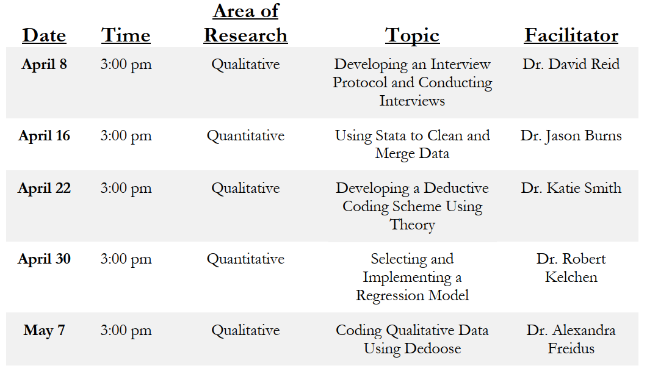
Thank you
Thanks for attending!
Email me: jason.burns@shu.edu and consider attending future seminars

