Slide 1
ELMP Research Methods Seminar Series
Developing an Interview Protocol and Conducting Interviews
David B. Reid, Assistant Professor ELMP

Slide 2
About the seminar series
Faculty in the K-12 and Higher Education programs will be hosting a series of brief seminars, each roughly 60 minutes in length, on a range of research methodologies to support students as they work to employ these methodologies in their research, namely in their dissertations.
These seminars are open to all students from any of the programs in the Department of Educational Leadership, Management, and Policy. Seminars are oriented toward students planning and conducting independent research, such as a dissertation. As such, the content of these seminars will assume that students are familiar with the core concepts from their coursework on research methods, such as what is found in: Qualitative Methods, Advanced Qualitative Methods, Intro. to Statistics, Intermediate Statistics, and Data Analysis

Slide 3
About me
Dr. David Reid is an Assistant Professor and Director of SHU’s K-12 doctoral program in Educational Leadership, Management, and Policy.

Slide 4
Developing an Interview Protocol and Conducting Interviews: Agenda
What are interviews?
Types of interviews
Constructing an interview
Process of interviewing
Should I use interviews in my research?
Q & A

Slide 5
1. What is an interview?
At the most basic level, interviews are conversations (Kvale, 1996).
More specifically, interviews are purposeful, structured interactions in which the researcher asks questions relating to the phenomenon of interest.
An attempt to understand individual perspectives, points of view, and lived experiences.

Slide 6
1. What is an interview?
Interviews for research differ from other kinds of interviews
Job interviews
Legal interrogations
Clinical/Threptic interviews
While interviews for research or evaluation purposes may also promote understanding and change, the emphasis is on intellectual understanding rather than on producing personal change (Kvale, 1996).

Slide 7
2. Types of Interviews
Unstructured
Semi-Structured
Structured

Slide 8
2. Types of Interviews
Unstructured Interviews
No predetermined questions (your research question(s) is your guide)
Let the participant guide the direction
PROS: Participants are not influenced by particular questions; if the researcher does not know a lot about the phenomenon s/he can learn.
CONS: Can go in many directions; might not get good data to help answer RQs.

Slide 9
2. Types of Interviews
II. Semi-structured Interview
Researcher interested in eliciting answers about specific set of topics/themes
Similar questions often used but researcher may introduce new questions as themes of interest emerge in course of interview
PROS: Consistent information and some flexibility to explore other themes/ideas
CONS: Coding/Making sense of the data is difficult

Slide 10
3. Types of Interviews
III. Structured Interviews
Specific set of questions to elicit same information from multiple respondents
PROS: Consistent information/easier to code
CONS: No flexibility/might miss important/interesting information

Slide 11
3. Constructing Interview Questions
Open-ended questions are best (although you can use close-ended)
Keep your questions simple
Avoid using ambiguous words and questions
Don’t ask more than one question at a time
Avoid asking leading questions
Don’t make any assumptions/suggest answers

Slide 12
3. Constructing Interview Questions
Open-ended questions: Advantages
Allows the respondents to answer in his or her own words
Respondents are not influenced by pre-determined answers
Often reveals data that were not originally anticipated
Nuanced and rich in details

Slide 13
3. Constructing Interview Questions
Open-ended questions: Disadvantages
Difficult to compare/analyze the responses. Lots of people can produce lots of different answers, which can be difficult and time consuming to code.
Respondents may find it difficult to 'articulate' their responses or to properly and fully explain their attitudes or motivations.
Respondents may not give a full answer simply because they may forget to mention important points. Some respondents need prompting or reminding of the types of answer they could give.

Slide 14
3. Constructing Interview Protocols
In general, start from the broad to the specific:
(broad) Describe your program’s attendance policy.
(more narrow) In what ways has your program’s attendance policy impacted your life?
(most narrow) Describe a time when you did not adhere to your program’s attendance policy.

Slide 15
3. Constructing Interview Protocols
Main Questions:
Ensures that the RQ is addressed
Sheds light onto the problem/phenomenon of study
Sub/Follow-Up Questions:
Can be planned or unplanned
Probes:
Used to keep the conversation going
Used to provide clarification
Used to get detailed/specific information

Slide 16
3. Constructing Interview Questions & Protocols
***Ask yourself: is the question helping me achieve the goal of “answering” my research question? In other words, is it necessary?***

Slide 17
4. The process: Pre-interview
Piloting your interview
Tests whether the questions capture what the researcher wants to know
Tests whether the questions have been placed in the best order
Tests whether the questions are clear/understood by the participant
Tests whether additional or specifying questions are needed or whether some questions should be eliminated
Tests whether the instructions to participant are clear
***Usually a small number of participants are selected for the pilot. The participants selected for the pilot interview should be broadly representative of the type of participant that you will use in your research***

Slide 18
4. The Process: Pre-Interview
Pre-Interview
Have a good recorder (or two)
Be prepared
Be flexible
Be considerate

Slide 19
4. The Process: During the Interview
During
Find a quiet, confidential space
Take notes
Stick to the script
Avoid being too conversational
Check the recorder

Slide 20
4. Post-Interview
After the interview
Make sure the interview is saved in multiple places (the cloud is your friend).
It is good practice to get in the habit of transcribing the interview (or at least listening to it) shortly after recording the interview.
Follow-up with participants regarding any questions or areas of the interview that are unclear.

Slide 21
5. Should I collect interview data?
There are many types of qualitative data sources (interviews, observations, documents, artifacts, open-ended survey data, focus groups, etc.). Before selecting one or more always ask yourself:
What data do I need to collect to address my research questions?
Will I be able to feasibly access the data?
If yes, what will that process look like?

Slide 22
Should I Collect Interview Data?
Ask yourself…
What is my problem statement/phenomenon I want to study/understand?
What are my research questions?
Will interview data help me answer these RQs?
Will I have access to these data?
Will I have the resources to complete/analyze these data?

Slide 23
Questions from the survey
What should I consider when crafting an interview protocol?
How do I decide which qualitative method to use?
3. Strategies for transcribing interviews/focus groups
I have several questions concerning the utilization of both qualitative and quantitative methods together.
Is it ideal to think about analysis planning before gathering your research data?
How do I ensure that my interview questions will help me collect relevant data?
Is there a strategic approach in anchoring questions from the interview protocol in the Research Question(s) of the study?

Slide 24
Additional resources
The Qualitative Report
https://tqr.nova.edu/tqrresources/
Qualitative Online Interviews
https://us.sagepub.com/en-us/nam/qualitative-online-interviews/book241778

Slide 25
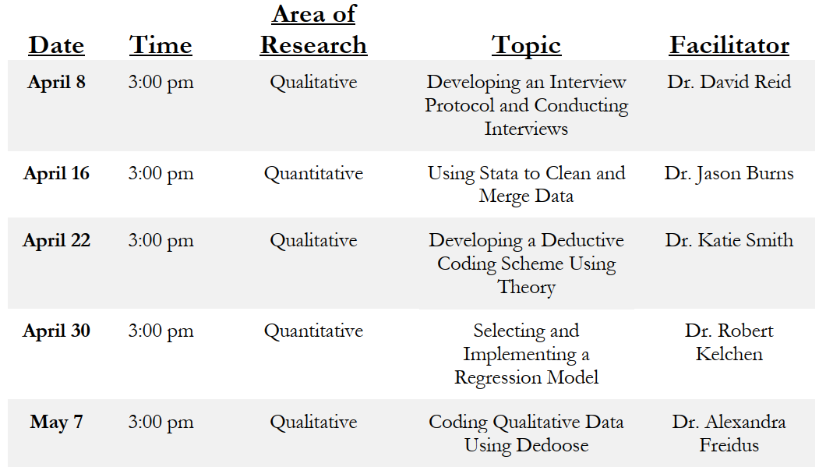
Thank you
Thanks for attending!
Email me: david.reid@shu.edu and consider attending future seminars

