Slide 1
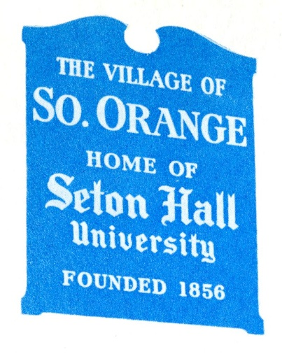
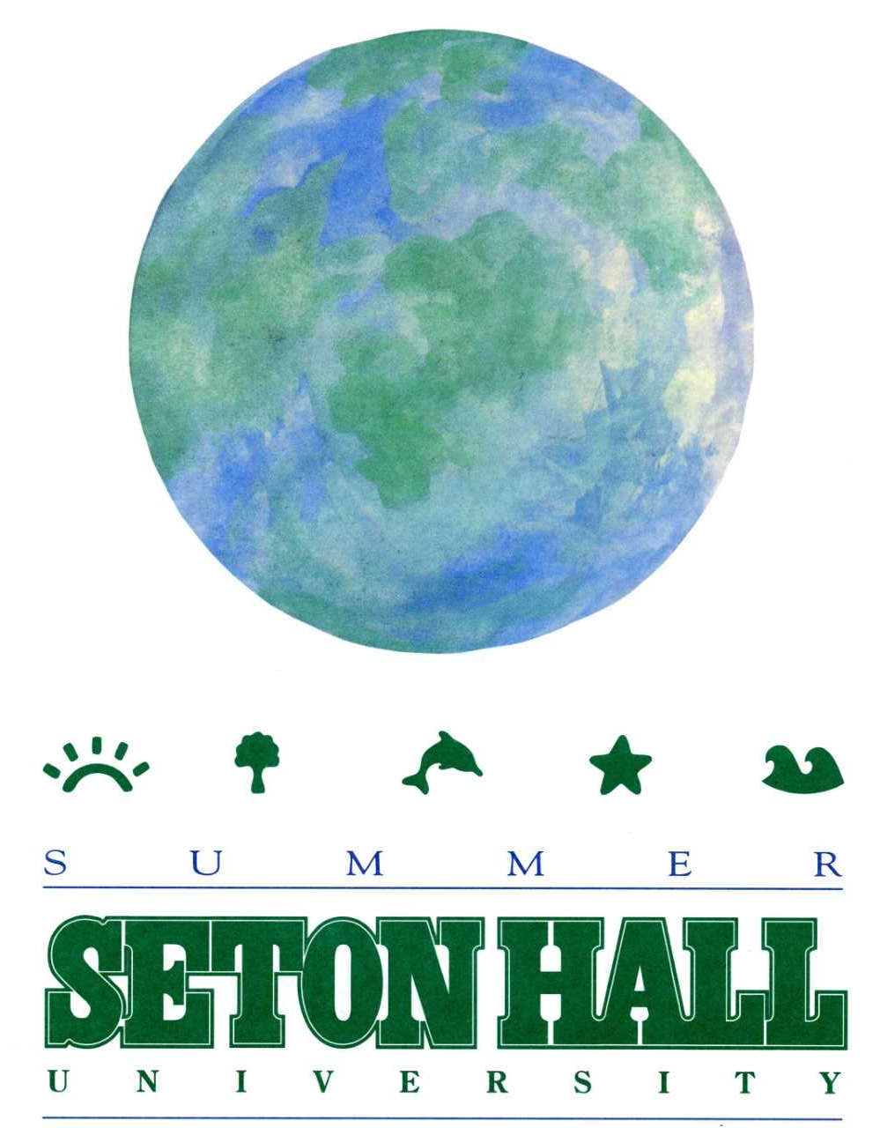
Teaching Beyond the Classroom: The University Archives and the Walsh Gallery Center for Faculty Development Presentation
Alan Delozier – University Archivist/Education Coordinator

Slide 2
What We Do – Archives & Special Collections
The Msgr. William Noé Field Archives & Special Collections Center located on the first floor of the University Libraries at Seton Hall University serves as the central repository for informational records created by, for and about the institution proper. The Center exists to identify, collect and preserve records of enduring value not only to Seton Hall University, but also the Archdiocese of Newark and/or Catholic New Jersey community which delivers a useful research service for its constituency and the public at large…Through its professional and service-related activities, the Center aims to achieve the ultimate goal of advancing the educational and research mission of Seton Hall University and promote inquiry regarding those who have built and sustained the institution from its founding to the present day.

Slide 3
Collecting Focus - Archival
Seton Hall University (1856-Present)
Archdiocese of Newark (1853-Present)
Catholic New Jersey (1680-Present)
Manuscript Collections
Political (Hughes, Shanley, Others)
Religious (Seton Family, Jewish-Christian)
Cultural (Global Constituencies)
Archives & Special Collections Homepage
https://library.shu.edu/archives

Slide 4
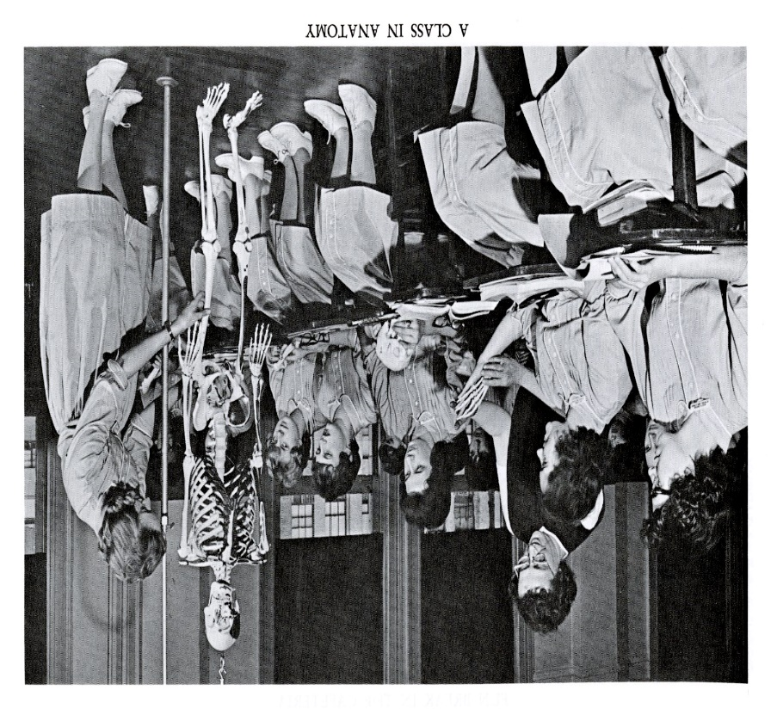
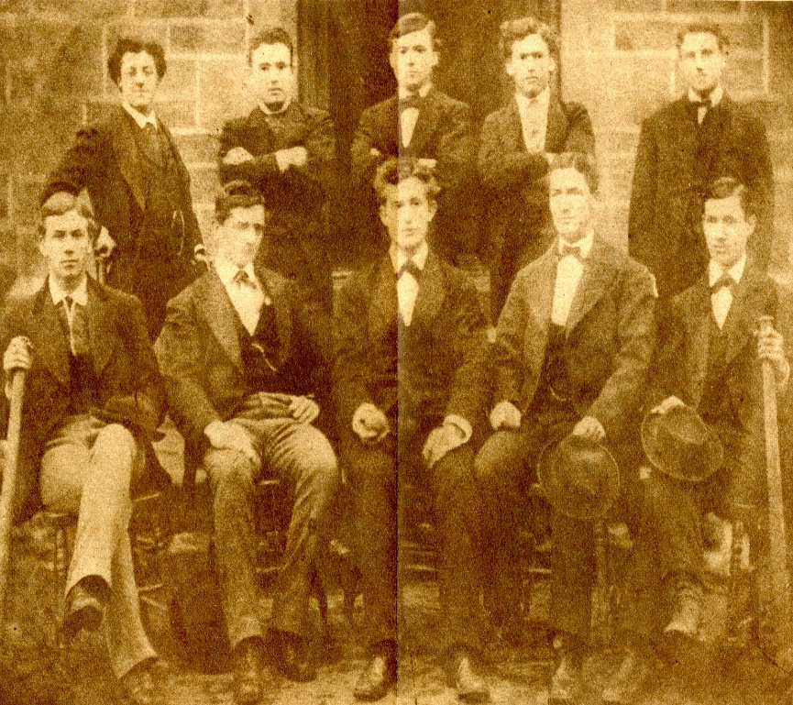
Resource Types – Traditional . . .
Photographs, Diaries, Correspondence/Letters, Scrapbooks, Bibles, Anthologies, Artifacts, Additional Materials . . .

Slide 5
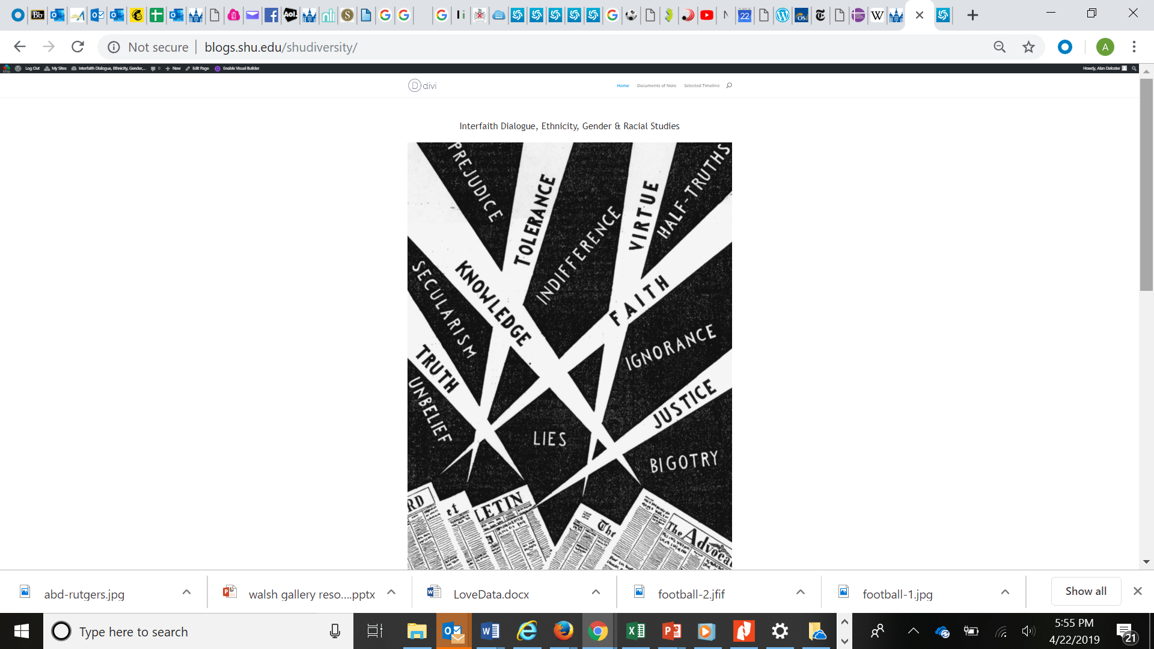
. . . To Digital & Beyond
Photographs

Slide 6
Philosophy of Archival Association
Within the traditional framework of classroom instruction, research methodology, public programming, and other means of dedicated outreach, finding unique ways in which to further expose the defining work of professionals and encourage a new generation of historians remains a constant. Included within this presentation are different examples of connecting to the wider community outside of a university setting alone. Always in mind when working with any individual or group are the following ideals . . .
True Collaboration and Partnership
Mutual Learning and Sharing
Continued Exposure and Opportunity

Slide 7
Goals of Mutual Archival Association
Encourage usage of primary source materials either as part of a required assignment, independently as option for other projects, and/or just awareness of the types of resources that we can offer the research community.
Regular Affiliation/Embedded Content from Archives with different courses where possible, applicable and mutually beneficial to the professor and students for classes in any subject area or discipline.
Working with the entire University community to promote our services and work towards helping researchers to the best of our ability.
The seal

Slide 8
Research Commonweal – An Overview
We average between 900-1100 research projects per year covering a range of topics with most connected to Seton Hall, Archdiocese of Newark, and/or Catholic New Jersey. With this said, we also work collaboratively with other repositories to help the researcher find the best possible potential for finding various resources of note to aid their respective goals.
Help is provided to those affiliated with Seton Hall and those who are off-site representing other institutions of higher education and the general public alike. Specific project types we have worked with individuals on such major projects as faculty book background, dissertation and master’s thesis assistance, senior capstone projects, digital humanities, exhibit/display creation, symposium/conference presentations (Charter Week, Petersheim, Women’s Conference, etc.) among others.
Even though we have specially focused archival collections, we also strive not only to highlight our unique holdings, but also promote the profession, career development, wider research and accessibility, collection development, preservation goals, and other aspects of the work being done within the field in general and our operations in particular.
The

Slide 9
Special Initiatives – Part I
Immaculate Conception Seminary – Msgr. Raymond Kupke (Orientation and introduction to archival sources for the seminarian community)
Essex Vocational Tech (High School) – (Twin projects utilizing the Congressman Donald Payne Papers for a special class on local history (production of short films on photographs and text found) and another celebrating the life and legacy of Congressman Payne for a dedication ceremony)
Introduction to Archives (Museum Studies) – Various (Class discussing the details centered on a working archival repository and connections to museum studies and their wider applications)
Monthly Orientation Session – “An Introduction to Seton Hall History” sponsored by Human Resources to provide newcomers to campus with more information on the evolution of the institution and its varied traditions and orient them to the Archives & Special Collections Center.
The

Slide 10
Special Initiatives – Part II
Communication & The Arts – Dr. James Kimble (Finding a primary source – typically a speech or related text from an archival repository. It can be ours or another chosen by the student)
History of Higher Education [Graduate] – Dr. Joseph Stetar (Introduction to primary source research techniques and resources to help with Master’s Thesis and Doctoral Dissertation projects)
Anthropology – Dr. Cherubim Quizon (Working on a group project that tied into the curriculum and makeup of departmental history and student work in field over time)
Communication & The Arts – Dr. B.J. Schecter (Introduction to primary source materials that can be used in relation to journalistic investigation and fact finding)
The

Slide 11
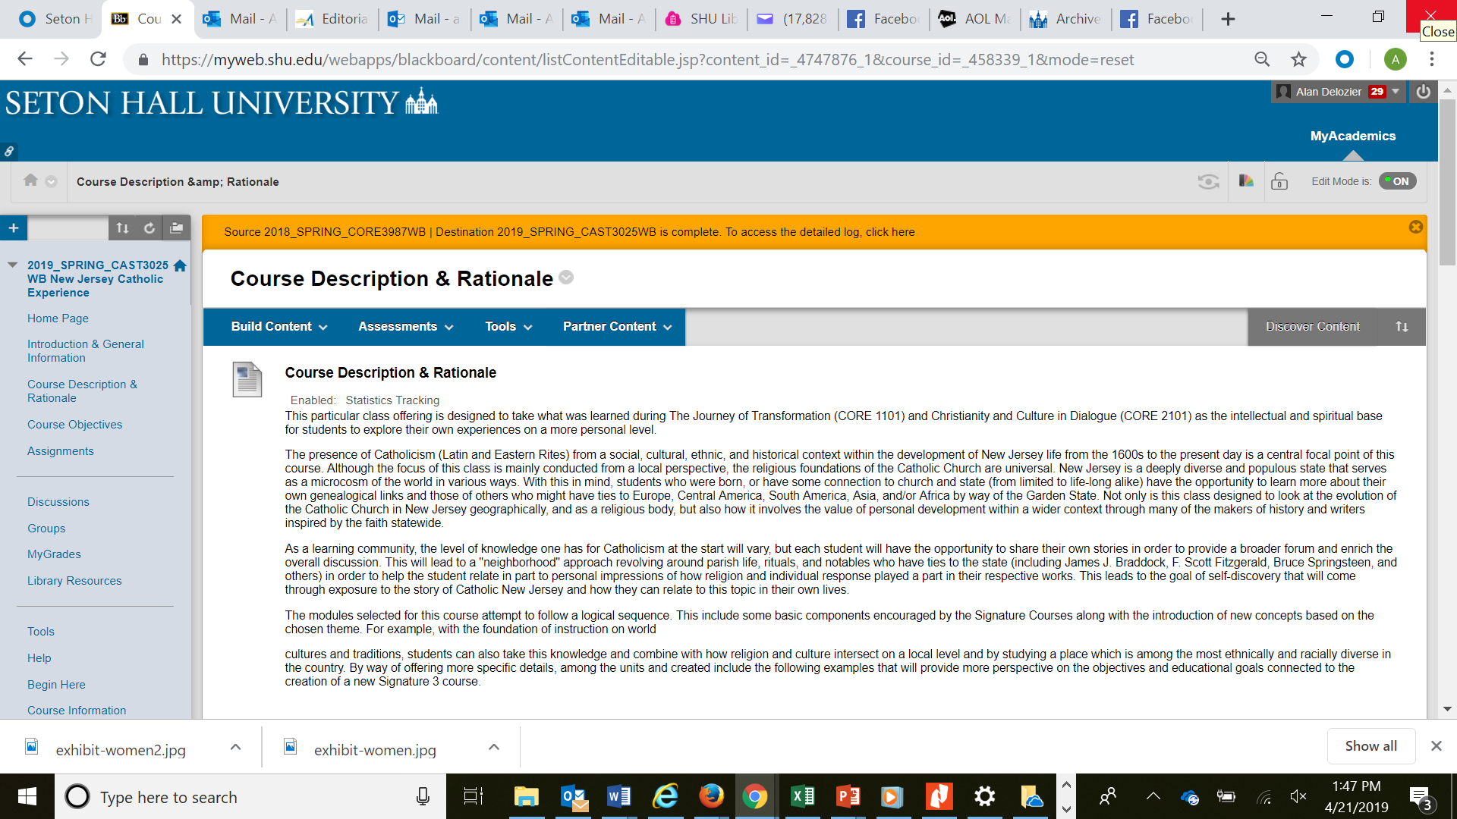
Example – New Jersey Catholic Experience (From Spiritual Settlement to Songs of Springsteen)
Curriculum

Slide 12
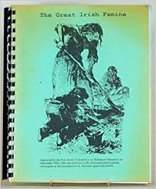
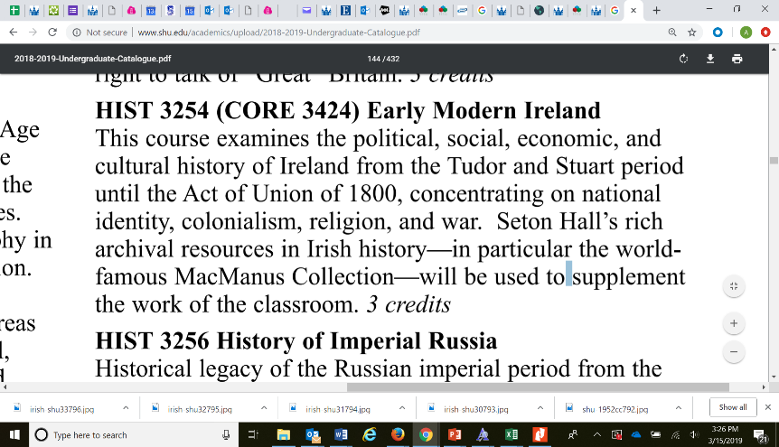
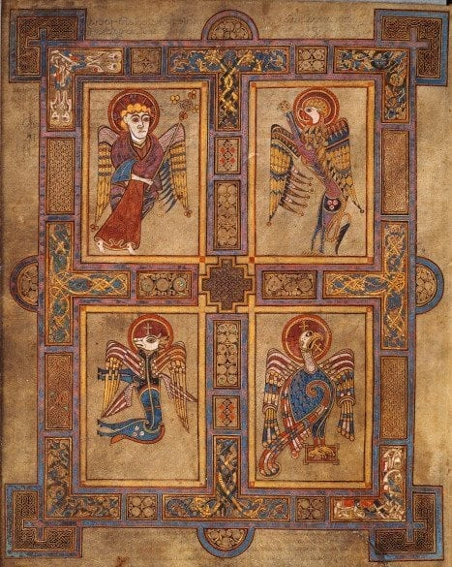
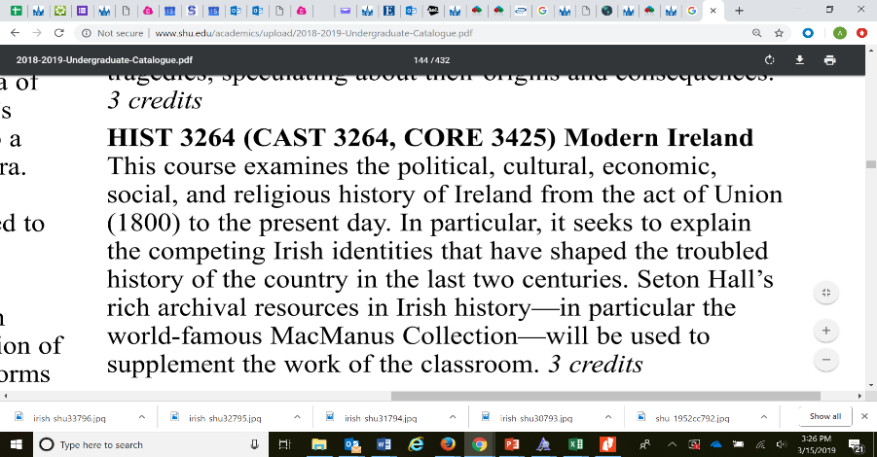
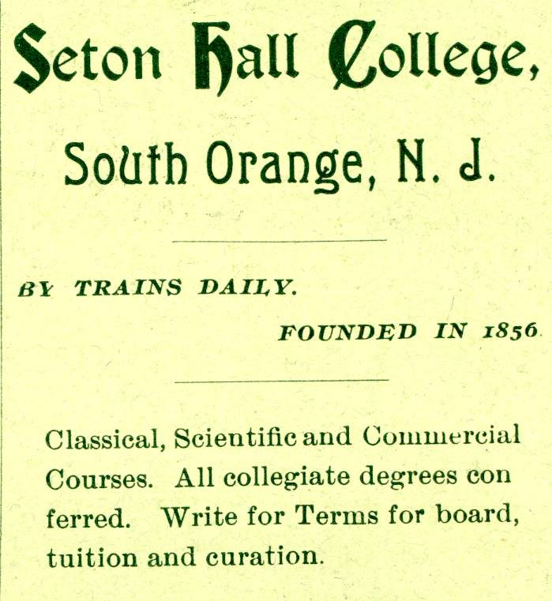
Special Classroom Instruction & Support (Irish Studies Examples)

Slide 13
History Department – Collaboratives, Part I
Bibliographic Instruction – Course support offered in various forms including class visits to introductory information on primary source documents to short-term, or semester-long projects connected to a specific theme, era, or project focus. Undergraduate or graduate level participation welcome . . .
Various w/ History Department (Introduction to Historical Research (HIST 2180), History Colloquium, and Senior Seminar (HIST 5199) among other specialized ones with Dr. Lurie, Dr. Molesky, Dr. Quinn, etc. and Museum Studies in particular.
United States Since 1945 (History) – Dr. Sara Fieldston (Finding a primary source(s) for a period in American History that mirrors what was going on at Seton Hall for context between 1945 and 1965)
Research Opportunities – All types of reference assistance and collaboration provided including University History, Manuscript Collections, Rare Books, Genealogy, and other types of inquires are encouraged and received on a regular basis. Our primary mission is to support the community and encourage learning opportunities in all forms.

Slide 14
History Department – Collaboratives, Part II
Independent Study – Student opportunities to explore detailed research options based on a particular assignment(s) that require specialized archival resources. Arising out of favorite course, interest, interdisciplinary focus, etc.
Internships – Research or Collection Processing based volunteer projects offered to allow students to partake in practical experience related to archival science applications. A number of students have enrolled in graduate programs as a result of participation and finding joy in this type of work.
History Club & Career Advice – Archival Science, Museum Studies, and related fields as a career option to explore along with assistance with tours and field trips connected to repositories and libraries within the Metropolitan area and statewide.
Summer Series (2019) – Genealogy and Family History exposure to Majors and Other Parties. Potential for a Future Course Offering after this Trial Run . . .

Slide 15
Internship/Practicum Projects - Various
Various students/faculty with different majors volunteering to do special projects either for course credit or volunteering their time and talents to learn more about the research operations within an archival repository. Some recent examples include . . .
Faculty working on a long-term preservation and outreach project centered on the history and heritage associated with the School of Nursing
Student looking at 19th century Classics curriculum for texts to construct a Digital Humanities project.
Student researching the evolution of Women at Seton Hall with a particular emphasis on the 1950s-60s, prior to full co-education in South Orange and their early days on campus.
Student conducting a study of ethnic and geographical student enrollment patterns at Seton Hall from 1856-1956.
Student working on various resources related to political life on campus and various elected officials who visited campus from 1900-2000.
Student looking at honorary degree recipients from Seton Hall and their respective contributions to society, 1856-2006.
The

Slide 16
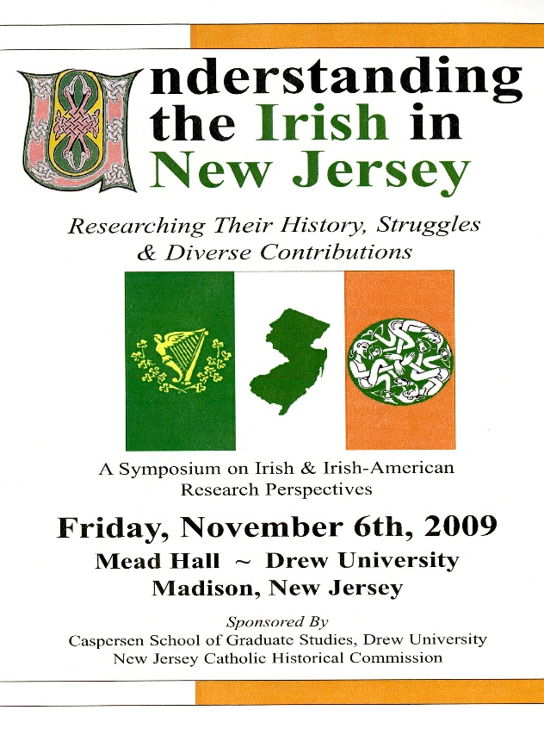
Symposia/Conferences, Local Libraries, Historical Societies, Etc.
Examples include – ACIS, ACHA, Local Historical Societies, Area Libraries, Senior Residences, Schools, etc. Ireland Exhibit at Union Township Public Library, Monmouth County, Newark, Easter Rising, Irish-American Link Conference, South Orange Public Library Event w/ Fintan Mullan, and Many Others . . .

Slide 17
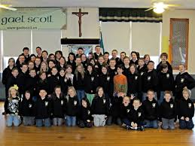
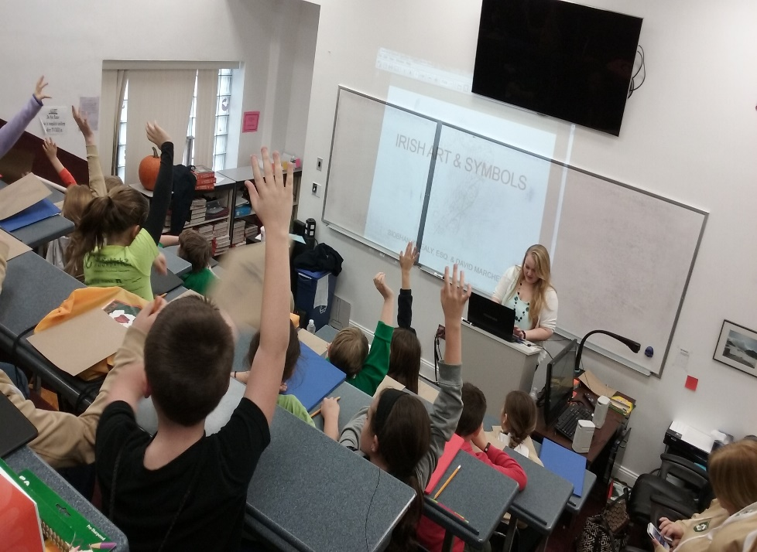
Example - Gael Scoil (K-12 Immersion Weekend)
Gael Scoil - The Gael Scoil is a two day program that teaches children from 6-17 about Ireland. Classes are held on food, history, language, music, dance, sports and much more. Instructors range from range from local volunteers and musicians, to championship dancers, university professors and authors. It is sponsored by the Ancient Order of Hibernians Division 10 in Mercer County New Jersey.

Slide 18
Research Leads, Non-Traditional (Irish Examples)
In the beginning we talked about why Religion and Education. This also combines other institutional types as this range of entities include Athletics (GAA); Political (By Party); Employer (Business Name); Organizations (AOH), even such rituals as Parades (St. Patrick), and Business (IBA), etc. Think about other areas to think about outside of the basic box(es) so to speak and add useful and unique substance.
Education, Logic and even Language (English, Irish, Latin, etc.) are all crucial when it comes to the search and subsequent success achieved. We have bridged the gap from traditional parchment to the Internet and beyond!

Slide 19
Initiative Ideas – Future Objectives
Class Assignment/Special Project Ideas and Resource Suggestions
History of the Book (Various Time Periods and Examples)
History of the United Nations (UNA-USA Collection)
Historical Text Book Collection (Various Subject Areas/Disciplines Represented)
Seton Hall University History (Student Life, History of Departments/Schools, Publications – Student Press, Underground Newspapers, etc., Time Periods, Social Justice, Athletics, Educational History, etc.)
Student Poetry Publications (Literature and Expression)
Oral History and/or Radio Programming/Podcasts (Interviewing techniques and content with community members
Campus History and Development (Architectural Styles, Ecology – Trees/Plants, South Orange-Seton Hall University ties, etc.)
The

Slide 20
New Jersey Catholic Historical Commission
This organization is dedicated to promoting scholarship that focuses on all aspects of Catholic History in New Jersey. We are always looking for individuals to become Friends and supporters of our organization, but also to facilitate research assistance. Please feel free to visit us on Facebook and/or check out our Internet Homepage at:
http://blogs.shu.edu/njchc/

Slide 21
Additional Resources
References & Additional Information Sources
University History Research Guide - https://library.shu.edu/University_History
Archives & Special Collections Homepage – http://library.shu.edu/archives
Seton Hall Traditions Project – http://www13.shu.edu/alumni/traditions.cfm
University Libraries - https://library.shu.edu/library

Slide 22
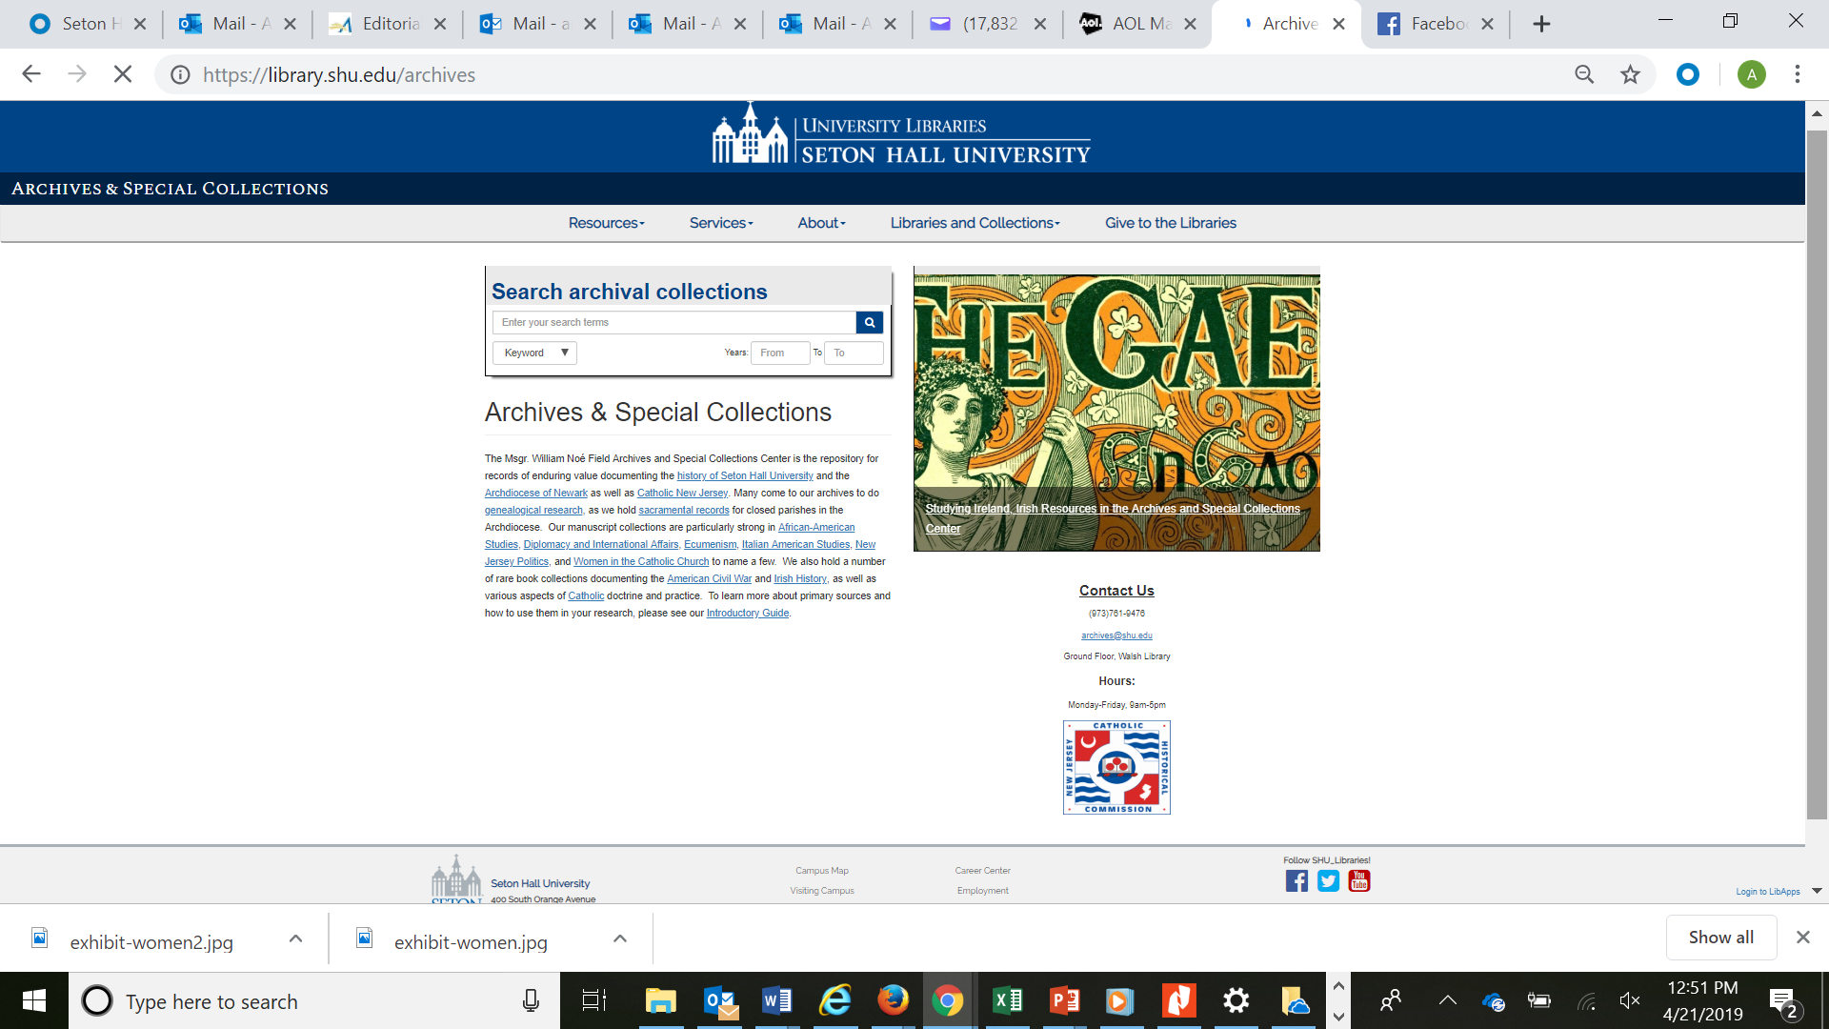
Archives & Special Collections - Homepage
Within

Slide 23
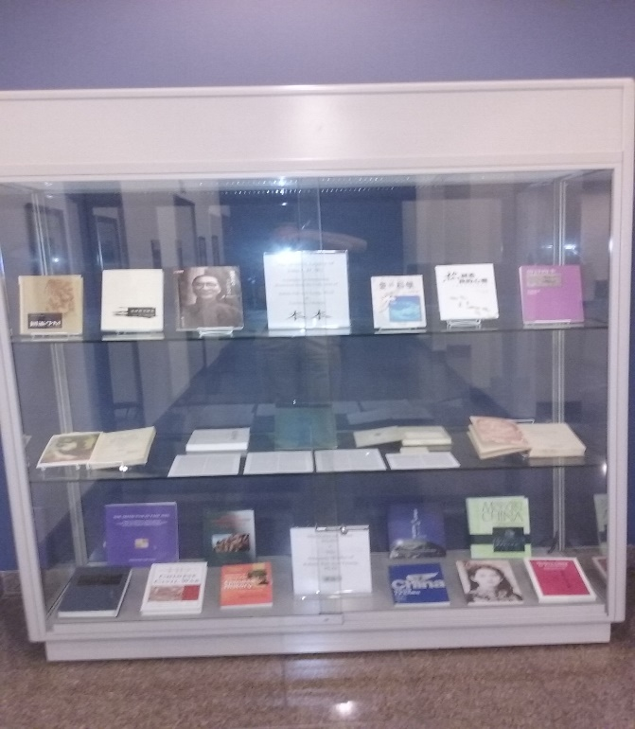
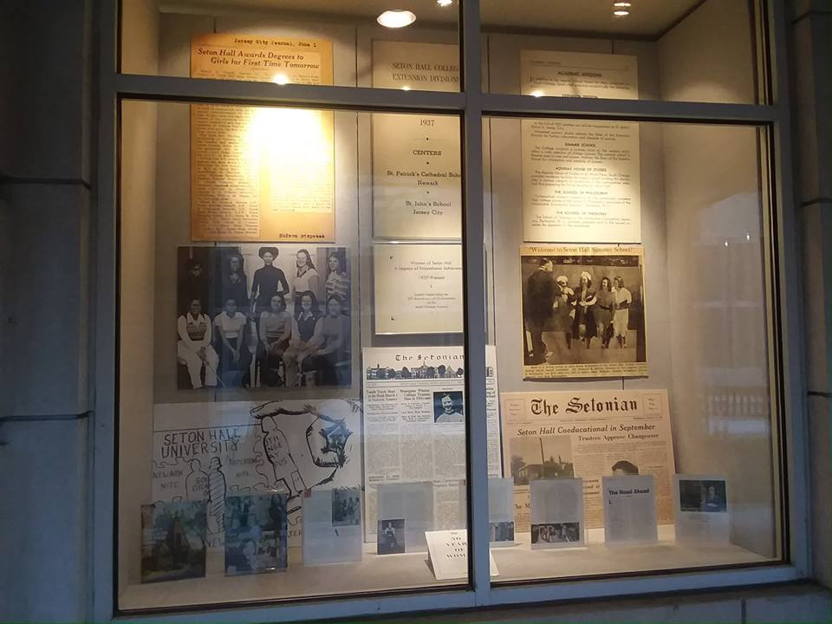
Archives & Gallery – A Valued Collaboration
Aid Provided With Courses, Researchers, Window Displays, Exhibit Case Support, Summer Show etc. More to come from Jeanne in a moment . . .

Slide 24
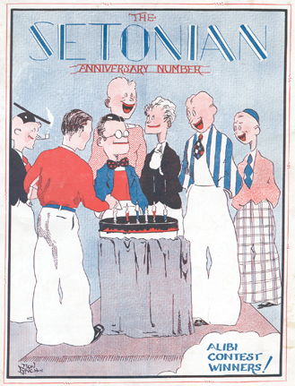
Follow-Up & Contact Details
Alan Delozier
Seton Hall University
E-Mail: Alan.Delozier@shu.edu
Phone: (973) 275-2378
LibGuides - http://shu.libguides.com/cat.php?cid=55869
Homepage – http://www.shu.edu/academics/libraries/archives/index.cfm
Thank You!!!

