Slide 1
Senate Faculty Development Committee
Faculty Survey: Effects of the Pandemic
Spring 2022

Slide 2
Effects of the Pandemic: Faculty Feedback
The survey was sent to all full-time faculty via FDC representatives within each unit.
If there were no representatives on the committee, the chair of the FDC sent the survey request to a recommended faculty member within the unit.
166 completed the survey
The Core and Law School did not have any survey completers. All other units were represented.
No significant differences between groups
43% Male, 52% Female, 5% Prefer not to say
16.25% Faculty of color; 83.75% White
83.3% report having challenges with scholarly production during this time.

Slide 4
Q12 - Which of the following best describes you?
Asian or Pacific Islander
Black or African American
Hispanic or Latino
Native American or Alaskan Native
Multiracial or Biracial
A race/ethnicity not listed here
25 ( 15.72%)
White or Caucasian
134 (84.28%)
N=159

Slide 5
Q7 - Did you experience challenges in completing your research during the pandemic?
# | Answer | % | Count
10 | No, not at all | 16.67% | 27
11 | Somewhat | 32.10% | 52
12 | Yes | 51.23% | 83
 | Total | 100% | 162

Slide 6
# | Answer | % | Count
1 | Time spent focused on new teaching methods versus research | 15.19% | 120
2 | Additional teaching responsibilities that arose during the pandemic that affected time for research | 11.14% | 88
3 | Additional time needed to be dedicated to pandemic-related student needs such as students requiring advising for changes in course delivery, increased absenteeism, physical and mental health concerns, loss of economic stability | 15.06% | 119
Q8 - If you experienced reductions in your scholarly capacity during the pandemic, please select any/all of these options that apply.

Slide 7
# | Answer | % | Count
4 | Increased training and time on hybrid courses | 11.77% | 93
5 | Impact of Covid illness on self or research partner | 4.81% | 38
6 | Conferences cancelled | 10.38% | 82
7 | Limited funds for registering or attending conferences | 8.61% | 68
8 | Funding losses for research projects | 2.91% | 23
9 | Publication delays (months and even years) | 7.97% | 63
Continued:
Q8 - If you experienced reductions in your scholarly capacity during the pandemic, please select any/all of these options that apply

Slide 8
# | Answer | % | Count
10 | Access to online research resources were not always readily available or delayed | 2.03% | 16
11 | Supply chain challenges | 2.41% | 19
13 | Other | 2.53% | 20
14 | Access to data, disruptions and/or limitations | 4.43% | 35
15 | Request for payment from journal if your article is accepted for publication | 0.76% | 6
 | Total | 100% | 790
Continued:
Q8 - If you experienced reductions in your scholarly capacity during the pandemic, please select any/all options that apply.

Slide 9
Qualitative Feedback
3 biggest themes related to effects on research:
Extra time spent on teaching to the detriment of research time;
Lack of access to conferences, networking, and collaborations;
Disruption of research due to lab issues, IRB, research redirection, and journal and press delays.
Other themes related to effects on research:
Burnout due to excess of service, excess of preps, extra meetings, research stress
FDC Qualitative Research Comments Sp 22.docx
FDC Qualitative Support Needs Comments.docx

Slide 10
Interest in shorter, more focused virtual meetings with a break between. Back-to-back, hour-long meetings are exhausting and can eat up entire days.
Meeting Times-Minutes

Slide 11
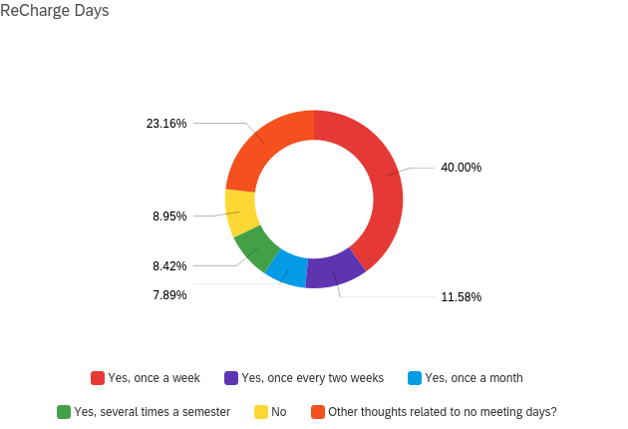
Q13: Some institutions, education and business, have adopted ‘re-charge’ days. A version of this includes ‘no meeting’ days. Would you be in favor of designated ‘no meeting’ days? If yes, how often?
Interest in recharge,no meeting
days is mixed. Sixty-seven percent supported some option of this, but not a singular model. Others were concerned about the intense pressure this might put on the remaining days in that week, and the likelihood of using the day to catch up on all the work that could not get done.

Slide 12
Points for reflection:
Consider extended time to tenure for existing SHU faculty and those newly hired; both groups were affected by the pandemic.
Examination of service should be undertaken. Questions for reflection include can/should service be limited to a maximum number of committees per year? How should service equity be addressed? Much of the service work is being done by the same core people, across the university, across colleges/schools, and across departments.
Related to teaching: Can/should faculty have an officially limited number of class preparations per semester? To support research catch up, would extra course releases be viable?
Related to research, restoration of GA and TAs, along with conference funding, could support some research catch up and collaborative opportunities.
Consider the broad effects on faculty due to fewer administrators, fewer staff, and fewer colleagues, with increased expectation for student service, admissions recruitment, program development, strategic goals, high quality/technology savvy teaching, and research.
“Some might say do less, but how do you say no to students in need? How do you say no to committees that are essential for the well-being of students, faculty, and the institution? There seem to be fewer and fewer people to handle all of this work. Research is something that I would like to do-I have two projects in mind-but I have no energy left at the end of the day or week.”

