Slide 1
Literature is fundamentally entwined with the psyche.
Patricia Waugh

Slide 2
Literature and the Human Psyche
Woman as Temptress

Slide 3
Hamlet 3.1. Freud says that we work out our unfinished business in our dreams. So here is the paradox, in sleep/death/dreams
To be, or not to be? That is the question—
Whether ’tis nobler in the mind to suffer
The slings and arrows of outrageous fortune,
Or to take arms against a sea of troubles,
And, by opposing, end them? To die, to sleep—
No more—and by a sleep to say we end
The heartache and the thousand natural shocks
That flesh is heir to—’tis a consummation
Devoutly to be wished! To die, to sleep.
To sleep, perchance to dream—ay, there’s the rub,
For in that sleep of death what dreams may come
When we have shuffled off this mortal coil,
Must give us pause. There’s the respect
That makes calamity of so long life.
The existential question posed… to live, or not to live
Contemplates suicide
Death brings peace
Death is like sleep
In sleep we dream
And we have bad dreams
There’s the rub, an eternity (death) of nightmares, might as well live

Slide 4
Mini-units
Foundation Texts: Freud, Jung, Campbell
The Temptress in Literature: Prose, Poetry, Mythology
The Temptress in Art: Religious , Romantic, Profane
The Temptress in Film
The Temptress in Music: Opera, Rock

Slide 5
Freud, Jung, Campbell
Totem and Taboo
"Taboo is a very primitive prohibition imposed from without (by an authority) and directed against the strongest desires of man…
Whatever is expressly forbidden must be an object of desire."
Jung's Contributions
Archetypal images include symbols that occur in mythology, fairytales and religions. They are older than mankind and belong to the collective unconscious…They are the 'universal' symbols that are available to us all even though we have no knowledge of them in our waking lives.

Slide 6
Joseph Campbell
The goddess represents material existence. Monotheistic religions look down on the body and elevate the spirit. In the temptress bliss exists beyond the material world, represented by the beautiful woman in myths. She appears as a temptress, not as a virtuous woman.
Woman as Temptress; 2.2.4

Slide 7
“All About Eve”
http://witcombe.sbc.edu/eve-women/7evelilith.html

Slide 8
The Temptress in Literature

Slide 9
The Bible
And the LORD God commanded the man, saying, Of every tree of the garden thou mayest freely eat: but of the tree of the knowledge of good and evil, thou shalt not eat of it: for in the day that thou eatest thereof thou shalt surely die. Gen.2.16-17
And when the woman saw that the tree was good for food, and that it was pleasant to the eyes, and a tree to be desired to make one wise, she took of the fruit thereof, and did eat, and gave also unto her husband with her; and he did eat. Gen.3.6
Cranach the Elder Adam & Eve 1526

Slide 10
Alt. Readings from The Bible
Eve. Genesis 2.16-17 & 3.6
Delilah. Judges 16
Judith. 7-13
Tamar. Genesis 38
Lot’s daughters. Genesis. 19

Slide 11
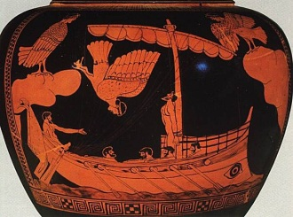
Mythology: Homer’s Odyssey: Book 12 The Sirens
The Sirens were sea-nymphs who charmed by their song all who heard them, so that the unhappy mariners were impelled to cast themselves into the sea to their destruction.
As they approached the Sirens' island, the sea was calm, and over the waters came the notes of music so ravishing and attractive that Ulysses struggled to get loose, and by cries and signs to his people begged to be released;
They held on their course, and the music grew fainter till it ceased to be heard, when with joy Ulysses gave his companions the signal to unseal their ears, and they relieved him from his bonds. Bulfinch’s Mythology

Slide 12
Franz Kafka. The Sirens
Thus Odysseus, if one may so express it, did not hear their silence; he thought they were singing and that he alone did not hear them. For a fleeting moment he saw their throats rising and falling, their breasts lifting, their eyes filled with tears, their lips half-parted, but believed that these were accompaniments to the air which died unheard around him.
But they - lovelier than ever - stretched their necks and turned, letting their awesome hair flutter unbound in the wind, and freely stretched their claws on the rocks. They no longer had any desire to allure; all that they wanted was to hold as long as they could the radiance that fell from Odysseus' great eyes.
Franz Kafka

Slide 13
Fiction
Nathaniel Hawthorne Young Goodman Brown
D. H. Lawrence Rocking Horse Winner
William Carlos Williams. The Use of Force
William Faulkner A Rose for Emily
Frank O’Connor. My Oedipus Complex
James Joyce. Araby

Slide 14
James Joyce. Araby
Her name sprang to my lips at moments in strange prayers and praises which I myself did not understand. My eyes were often full of tears (I could not tell why) and at times a flood from my heart seemed to pour itself out into my bosom. I thought little of the future. I did not know whether I would ever speak to her or not or, if I spoke to her, how I could tell her of my confused adoration.

Slide 15
Poetry (some from DiYanni)
John Donne. To His Mistress Going to Bed
Emily Dickinson. Come slowly—Eden
William Carlos Williams. The Dance
Rita Dove. Canary
Shakespeare. Sonnet 144
Edgar Allan Poe. Annabel Lee

Slide 16
John Donne To His Mistress Going to Bed
Themselves are mystic books, which only we
(Whom their imputed grace will dignify)
Must see revealed. Then, since that I may know,
As liberally as to a midwife, show
Thyself: cast all, yea, this white linen hence,
There is no penance due to innocence:
To teach thee, I am naked first; why than,
What need'st thou have more covering than a man?
last lines

Slide 17
Emily Dickinson Come slowly—Eden
Come slowly—Eden
Lips unused to Thee—
Bashful—sip thy Jessamines
As the fainting Bee—
Reaching late his flower,
Round her chamber hums—
Counts his nectars—
Enters—and is lost in Balms.

Slide 18
Rita Dove Canary (1989)
For Michael S. Harper
Billie Holiday’s burned voice
had as many shadows as lights,
a mournful candelabra against a sleek piano,
the gardenia her signature under that ruined face.
(Now you’re cooking, drummer to bass,
magic spoon, magic needle.
Take all day if you have to
with your mirror and your bracelet of song.)
Fact is, the invention of women under siege
has been to sharpen love in the service of myth.
If you can’t be free, be a mystery.

Slide 19
Philip Appleman: Let There Be Light
When he murmured another refrain of that shimmering promise, “You shall be as gods,” something with wings whispered back in my heart, and I crunched the apple—a taste so good I just had to share it with Adam.

Slide 20
Drama
Tennessee Williams. A Streetcar Named Desire
Jean Racine. Phaedra
David Hwang. M Butterfly
William Shakespeare.
Macbeth
Taming of the Shrew
Othello
Anthony and Cleopatra

Slide 21
The Temptress in Art

Slide 22
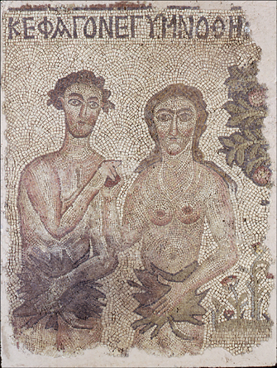
Early Christian Period Syrian Church Mosaic 2nd^{c}

Slide 23
Medieval Representations Lorenzo 1510
“An Angel Brings the Holy Communion to Mary Magdalene”

Slide 24
The Renaissance Michelangelo’s “Temptation and Fall” 1508-1512

Slide 25
Peter Paul Reubens “Samson and Delilah” 1610

Slide 26
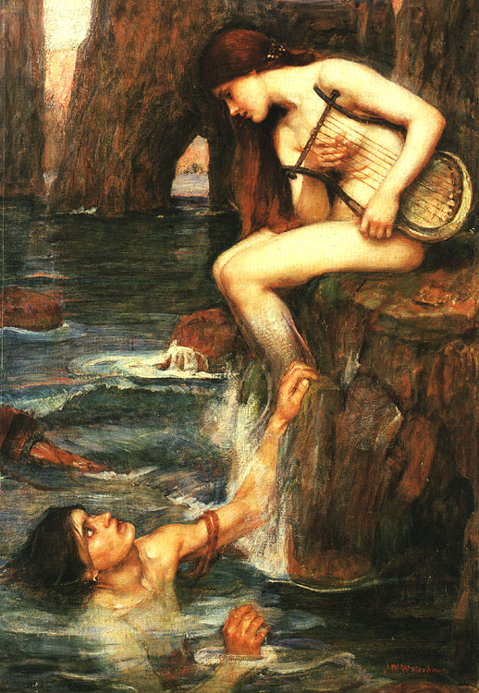
John Waterhouse “The Siren” 1900

Slide 27
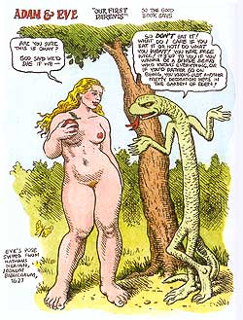
The Graphic Novel R. Crumb. Genesis

Slide 28
The Temptress in Film

Slide 29
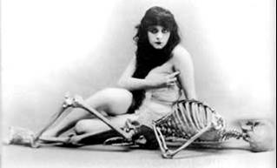
A Persistent Archetype: Woman as Temptress In Film
Theda Bara
Sophia Loren
Brigitte Bardot
Marylin Monroe
Madonna
Halle Berry
… the devil would make us slip through the flesh, just as he made that man Adam to slip, through Eve. St. Augustine

Slide 30
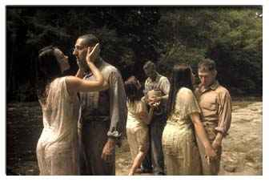
O Brother, Where Art Thou? “The Sirens”

Slide 31
The Temptress in Music

Slide 32
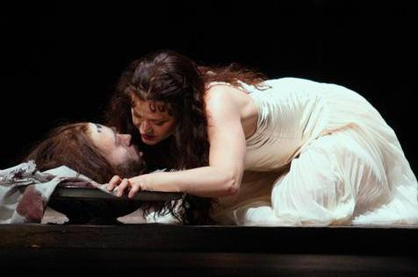
Richard Strauss: Salome
Richard Strauss. Salome
Giacomo Puccini. Tosca
“

Slide 33
Contemporary Poet/Songwriters
Go 'way from my window
Leave at your own chosen speed
I'm not the one you want, babe
I'm not the one you need
You say you're lookin' for someone
Who's never weak but always strong
To protect you an' defend you
Whether you are right or wrong
Someone to open each and every door
But it ain't me, babe
No, no, no, it ain't me babe It ain't me you're lookin' for, babe.

Slide 34
Term Paper Topics
EXPLORE AND ANALYZE: Temptation/Woman as Temptress in
Contemporary American Film
Television drama or comedy
Early religious texts
Three short stories
Poetry
Shakespearean drama
(see Blackboard for detailed instructions)

Slide 35
For Students: The Takeaway

