Slide 1
Working with PolicyMap
Lisa DeLuca, MLIS, MPA
Kyle Downey, MLIS

Slide 2
Agenda
What is PolicyMap
Who uses it
and why
University Access
PolicyMap Features
Maps
Tables
Reports
3-layered maps
Live Demo

Slide 3
What is PolicyMap?
PolicyMap gives users the ability to create online mapping with data.
PolicyMap offers users the access to over 15,000 indicators related to demographics including: housing, crime, health, quality of life, education and more.
You can access all data in interactive maps, tables, charts and reports through their unique analytical tools.
Data is collected on PolicyMap through 85 public sources and is updated when the direct source is updated.

Slide 4
Who uses PolicyMap?
Approximately 40,000 users representing over 12,000 organizations
Government, non-profits, healthcare organizations, financial institutions
Academic Universities

Slide 5
Why?
Mapping data is tricky
Software is needed and is generally expensive and difficult to learn
Finding good data is timely and hard
Putting data on a map is even more confusing
Obtaining Data
Data needs to assessed, cleaned and validated before use
It is located in several different places, with different formats and levels or reliability

Slide 6
University Access

Slide 7
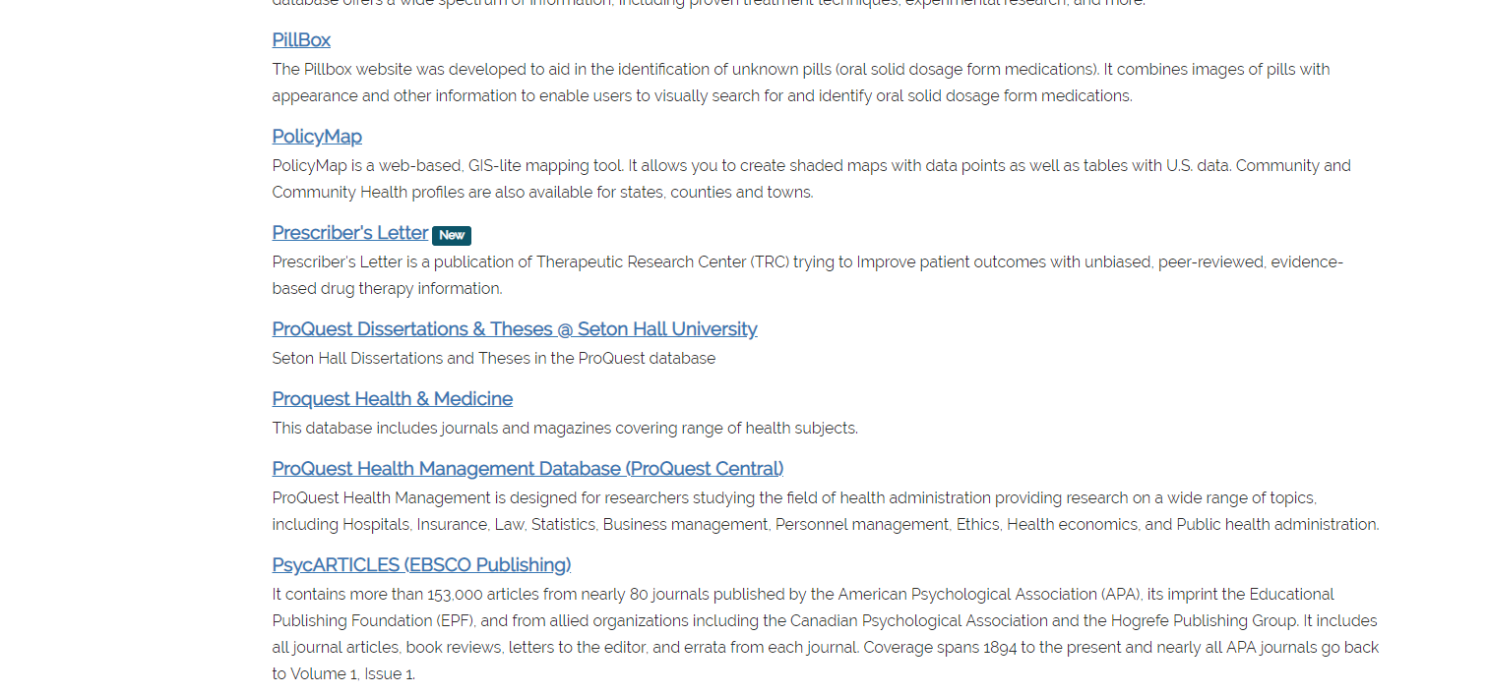
Database A-Z List

Slide 9
PolicyMap Features
PolicyMap allows users to visualize, collect and organize data in several different ways
Shaded Maps (chloropleth)
Shaded maps allow you to look how a data variable differs across a region
Tables
The Tables feature allows you to view data as a bar graph or chart, that can then compare data across multiple geographies.
Reports
The Reports feature allows users to generate a detailed report for a pre-defined location. **Users can generate a Community Health Report here.
3-layer maps
3-Layer Maps is a mapping tool that allows users to find places that match one or up to three (3) criteria of data layers on to a single map

Slide 10
Who is using PolicyMap here at SHU?

Slide 11
Notes:
Professor Anne Hewitt has crafted a course called “Managing Community and Population Health” with an assignment titled, “Vulnerable Populations: Using PolicyMap for Population Health Analysis.”
The project required students to:
identify populations at risk,
develop risk segmentation characteristics and criteria, and
complete a risk stratification in order to integrate care plans and management.
Project Goals:
MHA students (online and on-campus) will complete a vulnerable populations presentation (PowerPoint) focusing on the characteristics and identity of the particular sub-population group.
MHA students will use their vulnerable population overview to identify an at-risk population and complete one PolicyMap per student to illustrate the relationship between an at-risk population and a social determinant or health-status impact factor.
Each MHA group will develop a PowerPoint PolicyMap presentation and synthesize their findings.

Slide 12
Other SHU Student Assignments
CPSY 1001 Diverse Learners and Their Families Part I – PolicyMap: Viewing Educational Disabilities Services within Private Schools in NJ
Students used PolicyMap to develop detailed and layered understanding of who is receiving special education services in NJ private special education schools
POLS 2110 AA: Contemporary Issues in US – Public Policy
Students explored their congressional district and congressional representation and the policy environment in their home district. Using PolicyMap the students conducted a spatial analysis of the social or economic drivers that the felt was critical to public policy within their community

Slide 13
Outside of SHU
University of Minnesota
Researchers at the University of Minnesota looked into how Northfield, Minnesota, might fulfill the need to increase housing stock. The paper uses vacancy and other housing data available at PolicyMap to compare Northfield to other communities in Minnesota
University of Massachusetts Boston
Students analyzed ways to stabilize and revitalize neighborhoods in Boston by increasing access to affordable housing. PolicyMap was listed as a resource in the syllabus

Slide 14
Questions?
kyle.downey@shu.edu
lisa.deluca@shu.edu

