Slide 1
Data Narrative
Interactive, Data-driven story telling Theory and Practice
Or, teaching data when you know nothing about data

Slide 2
Where do you start?
Maybe with a bet?
Maybe even a bet with your brother.
Nothing motivates quite like sibling competition.

Slide 3
What’s next
Immerse
And get moving…
Gain proficiency and stay adaptive. Adapt the attitude that you and your students will be learning together.
Learn on the job: start writing assignments. Give them to students. Let your grading guide what’s missing in your own education.

Slide 4
Make your own content
We are guilty of undervaluing ourselves. Believe it or not, learning the tech is the easy part. Learning to write narratives that engage with that content is far more time consuming. And we have a head start. We have those skills (many of us). It’s hugely valuable.
Make something that shows off your skills. Don’t worry about memorizing, knowing right away. You’re learning!!!

Slide 5
What I did
Certified!
Take a class!
It taught me more about writing than it did about data analysis and python.
Why? Because it forces you to write reports explaining your process.
It challenges you to recognize how crucial creativity, critical thinking, and all of those other humanities skills are to this work.

Slide 6
And hey, you might actually do something cool after two or so years of learning
And you might also have no idea how you did it or what any of it means.
But analyzing and explaining AND TEACHING is where we shine. So then, you get to work.

Slide 7
And the good news: Data and Narrative were made for each other.
“Powerpoint presentations have been banned at Amazon. You can’t use them in meetings. If you don’t provide a written narrative for a meeting, the meeting will be canceled.” –Mark Svenvold about relaying information from an interview with former student and Amazon employee, Erik Hopf.

Slide 8
Jupyter Notebooks sandbox
Using this helps students visually and intentionally see data visualizations and markdown cells. It forces organization.
Text explanation is an integral part of the design.

Slide 9
But you wouldn’t do that with students. Python? That’s crazy
Right.
But before I ever took this course, when I was a data fledgling I immediately began developing ways students could blend data into their writing.
Too much tech will put them to sleep. But focus on Sand Boxes for them to play with and explore.
Build sequence assignments that encourage Data Narrative (This is not necessarily visual analysis. They’re not writing about the visualization but using it as another form of expression.)

Slide 10
Inspiration for instruction
The data narrative of race
13th Netflix documentary
Only in narrative is it revealed that the exodus was not African Americans “as immigrants looking for economic opportunities. They went there as refugees from terror.”
Data is meaningless. Narrative gives it meaning.

Slide 11
Showing students why narrative is important

Slide 12
Analyze what they see: write potential explanations

Slide 13
Curriculum: Proposal and Goals
To develop a syllabus that incorporates digital humanities theory and practice in the instruction of Seton Hall’s First Year Writing Courses, specifically through the theme of Race and Social Justice. The pilot courses will focus on teaching students to create and view their own “Language Landscapes” in the hopes of developing new and innovative ways to teach how language concerning social justice operates and evolves over time and through space. Language Landscapes will be visual representations of large changes, shifts or evolutions of language made possible by the powerful analytics tools that technology offers us. The courses will explore questions of digital literacy. They will allow students to consider themselves as digital citizens, asking that they visualize their source work to view a macro-context of their inquiry that will complement, not replace, close reading and traditional source use. Students will produce a portfolio of visual narrative projects concerning the presence of oppression and inequality in our society.
Major goal: Promoting recursive research and writing based on discovery and evolution of research questions.
Showing injustice in communities and allowing students to explore those issues in a “sandbox.”

Slide 14
Give them the sandbox, and let them play in it
Hathti Trust
PolicyMap
Tableau
Excel
Ngram
ScreenCastify/video ant

Slide 15
Possible tools: Hathi Trust

Slide 16
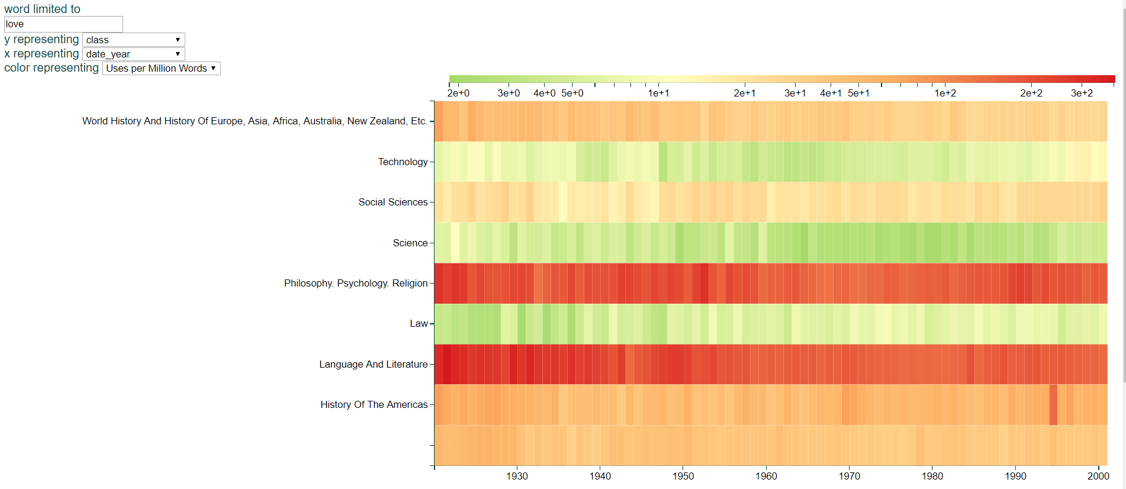
Hathi cont. Heatmap

Slide 17
Hathi cont’ world/word map

Slide 18
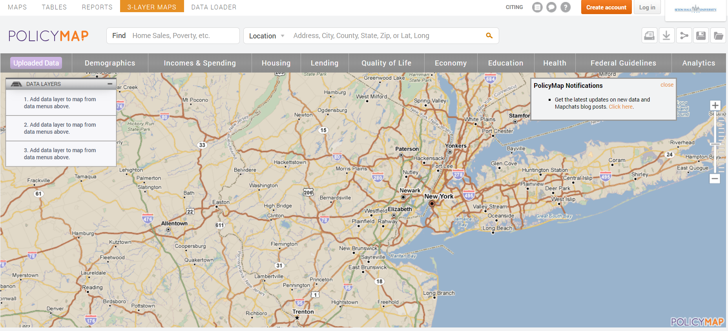
The Sandbox: Policy map

Slide 19
Assignment 1 where students write about visualizations
4 pages
Your Data and You
Data visualization and Data Science play an increasing role in our lives. Because of this, more decisions will be made based on actionable insights found in this data. The challenges lie in who controls this data and who is suffering or benefitting from its use. The goal of this essay will be finding visualized data that is either effective or misleading. Then, you will analyze it in conversation with your own personal experience.
Step 1 (1 page): I want you to find a piece of visualized data. This piece should have some relevance to your life. It should reflect some concern you have that impacts you. This can include race, gender, economy, environment, sexuality, gun violence, etc. Analyze precisely what this visualization shows and what it omits. What is it attempting to communicate?
Step 2 (1.5 pages): I want you to write a narrative that reflects on your personal experience with your political issue and your concern with how the visualization represents it. In this section, you’re telling a story--a story about your life. This should be something that impacts you personally and something that is related to the larger statistic you found in your visualization.
Step 3 (1.5 pages): I want you to propose to your audience a “more full” understanding of the issue. Discuss what you hope they will take away from the conversation between your narrative and your chart or graph. At this time, I want you to use one of the readings from class to help complicate your argument. This can include any part of the Summer reading or the articles on blackboard. (Most students chose climate issues.)

Slide 20
Sample class activity finding bias in visualized data

Slide 21
Assignment 2 where they create their own visualization as part of a recursive research process
Persuasive Essay
Length: 5 pages
Must have Works Cited page
Assignment number #1:
Familiarizing yourself to the issue: for this part of the essay, you should be solely finding sources and information. Then, write a few paragraphs where you put these sources into conversation with one another. Give your reader some idea of the issue, the opposing sides, and their complexities. Think about the They Say, I Say technique. Show us the nuances of the issue.
Use Policy Map to explore your topic, set parameters, and play with how your topic exists geographically.
#2: Develop your own argument. Weigh the pros and cons of each side and then choose which side you wish to support. Pretend you’re writing to the President, what are you going to say to him? What techniques will you use to persuade him one way or another (ethos, pathos, logos.) During this phase, you should develop a thesis statement.
#3: Rough draft. Pull together all of the parts and deliver a well organized, informative, persuasive analysis of the issue.
##Choosing your issue: it must be something specific. You should focus on some political argument: economy, immigration, environment, health care, education, drugs, mental health, affirmative action, foreign policy, bullying. Keep in mind that this assignment hinges on you wanting something. Be clear about exactly what you want, and tell us why it makes sense that we want it too.
As part of your final draft, you will be asked to include your own data visualization that you create through Policy Map or any of the other tools on the Seton Hall Library Website.

Slide 22
Student Generated Visualizations & Writing

Slide 23
Student Visualization and Writing

Slide 24
Student Visualization and Writing

Slide 25
Student Visualization and Writing

Slide 26
Evaluations
Negative:
All the papers were back to back, but the papers weren't difficult, the time we had for all of them made things difficult. Data visualization coming in so early.
The most difficult to learn for me was applying visualization in my writing.
Positive:
Learning about visualization was very interesting to me. I never had to use visuals in my writing, which of course made it very difficult to do so in this class, but the challenge was worth it. More and more articles are using visuals these days and learning about it this year will make it easier for me to understand and even more observe the use of visuals in writings.
Essays could be very difficult to write especially if one does not know which type of writing to do. It has been a while since I've taken an English course, but I thought reviewing the different types of essays were both useful and important. Like the visualization, writing the different types of essays was a challenge, but nonetheless, it was a good challenge.

Slide 27
Looking forward: Developing Curriculum
Creating a curriculum where data fluency/literacy is treated as an integral part of rhetorical strategy.
Possible growth is limitless: Narrative Business Analysis, Narrative Medicine, even Narrative Mathematics are already fields on their own.

Slide 29
Humanities is the next buzz word in tech!
Udacity asked me to be a mentor.
Dataquest featured my project on their blog.
All because they heard I was one of those humanities people.

Slide 30
Resources and links
https://analytics.hathitrust.org/explore
https://www.vox.com/policy-and-politics/2017/10/2/16399418/us-gun-violence-statistics-maps-charts
https://combeyond.bu.edu/wp-content/uploads/2019/04/datastorytelling_ebook_v8_final.pdf
https://combeyond.bu.edu/workshop/data-narrative/
https://eclkc.ohs.acf.hhs.gov/publication/using-data-narrative-tell-story

