Slide 1
Blogs
Rumors of Their Demise Have Been Greatly Exaggerated.

Slide 2
R.I.P. The Blog, 1997-2013
Instead of blogging, people are posting to tumblr, tweeting, pinning things to their board, posting to reddit, snapchatting, updating facebook statuses, instagramming, and publishing on medium. In 1997, wired teens created online diaries, and in 2004 the blog was king. Today, teens are about as likely to start a blog (over instagramming or snapchatting) as they are to buy a music CD. Blogs are for 40-somethings with kids.
Kottke.org, 2014

Slide 3
Those shapeless, formless platforms haven’t earned it and don’t deserve it.
I refuse to let social media take everything.
When I log into Facebook, I see Facebook. When I visit your blog, I see you.
karigee.com

Slide 4
But First.
Some History

Slide 5
Blogging History
http://blogs.shu.edu/tomstest/64540-2/

Slide 6
You've built Facebook into the world's largest integrated content distribution machine, and convincing people of things that aren't true is where the money is.
Imagine you're Rene Descartes, data scientist at Facebook in charge of saying true things. Problem is, your only input is what people say, and everybody lies.
How will you synthesize a truthful news feed about the world from the reports of people who are as likely to be trying to deceive you as not?
blog.rinesi.com

Slide 7
WordPress Plugins
Easy to add functionality

Slide 8
What Are Plugins?
Directories of code, styles and images that you can install
When activated, the functionality is automatically triggered at the right time and in the right places
They can add features in any area of work:
Dashboard
Front-end
New widgets
Security
Examples include:
Connections to other services (authentication, social media, RSS)
User management and roles
New kinds of content

Slide 9
Where Are They?
On your Dashboard->Plugins page
We’ve selected good options for many categories
Is there’s something we missed?
http://www.wordpress.org/plugins

Slide 10
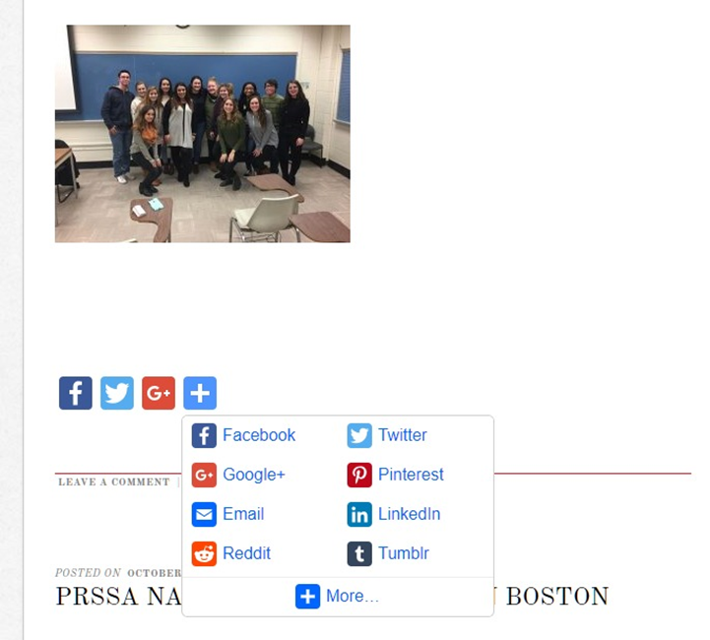
Social Icons
Access Press Social Icons
Create your own set
Customizable colors and spacing
Places the set after the posts
Not many choices for locations
AddToAny Share Buttons
Choose your services
Custom placement all over your site
Custom icons

Slide 11
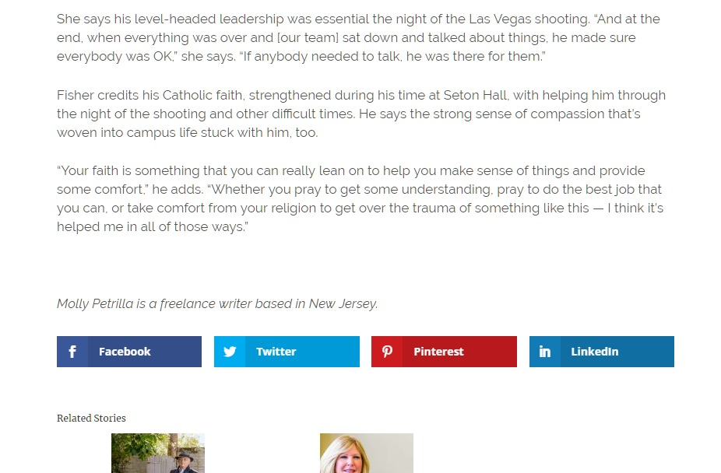
Top Pick
Monarch
Fully customizable, including animations, shapes and colors
Multiple placement options, including fixed/floating
Pages, posts, archive pages, media
Very easy setup

Slide 12
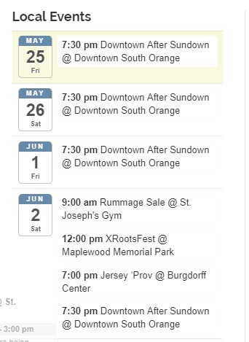
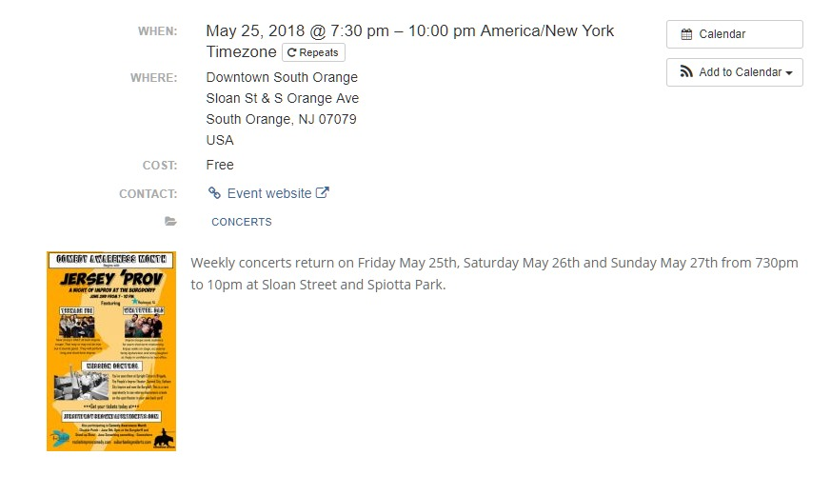
Calendars List and manage events
All-In-One Events Calendar
Quick implementation
Widgets, pages, grids, maps
Copy to Google Calendar or Outlook

Slide 13
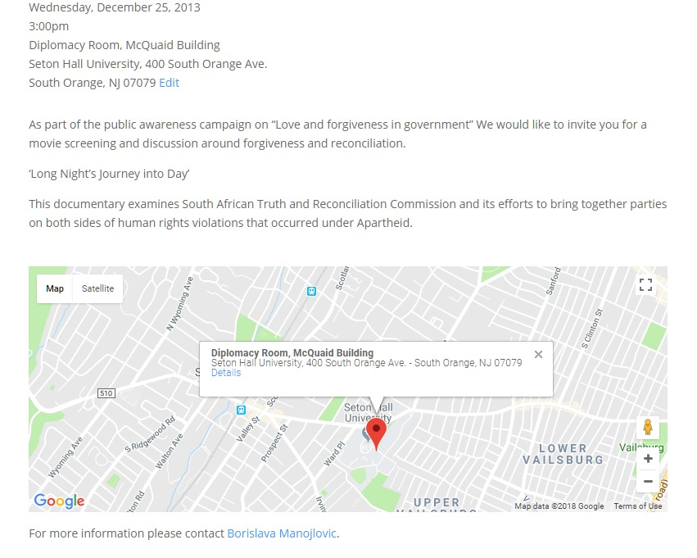
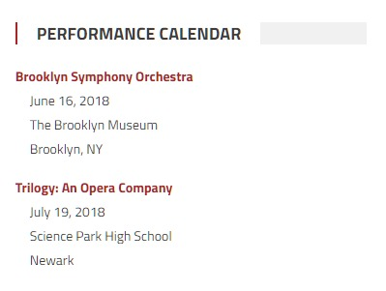
Calendars List and manage events
Events Made Easy
More of a learning curve
Highly customizable with templates and placeholder tags
Handles registrations, follow-ups, attendance … almost anything

Slide 14
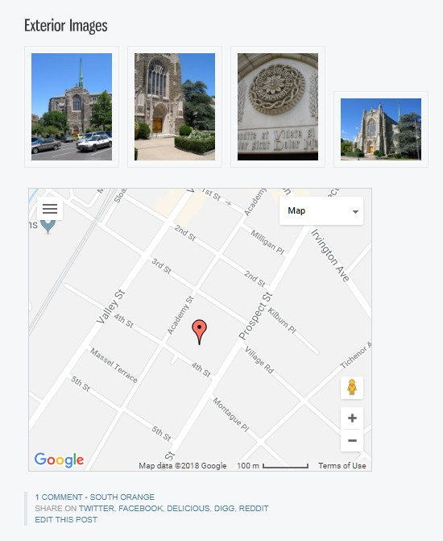
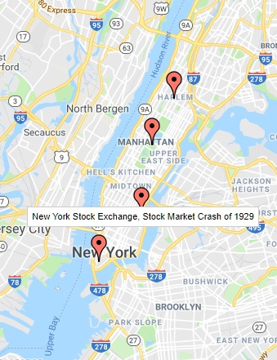
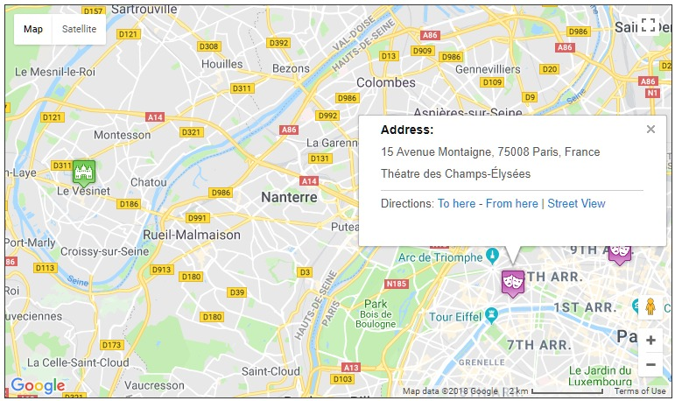
Mapping With Google Maps
WP Geo
Map Press
Slick Google Maps
Combines multiple posts about locations into one common map. Display map or widget.
Simply insert full-featured maps into posts and pages. WP Google Maps is similar.
Multiple locations per map
Distinct icons
Pop-up information

Slide 15
Beginning on June 11, 2018, you’ll need to enable billing with a credit card and have a valid API key for all projects.
Google Maps Platform
But wait a minute…

Slide 16
Alternatives to Google Maps
OpenStreetMap
Leaflet Maps Marker
Others
Wordpress.org/plugins/osm
https://wordpress.org/plugins/leaflet-maps-marker/
“Freemium”
Both support OSM and Bing maps
HTML5 Maps
https://wordpress.org/plugins/html5-maps/
Predefined set of maps
Leaflet Map
https://wordpress.org/plugins/leaflet-map/
OSM and MapQuest
WP Google Maps (not “Map”)
Recently added Open Layers integration
https://wordpress.org/plugins/wp-google-maps/

Slide 17
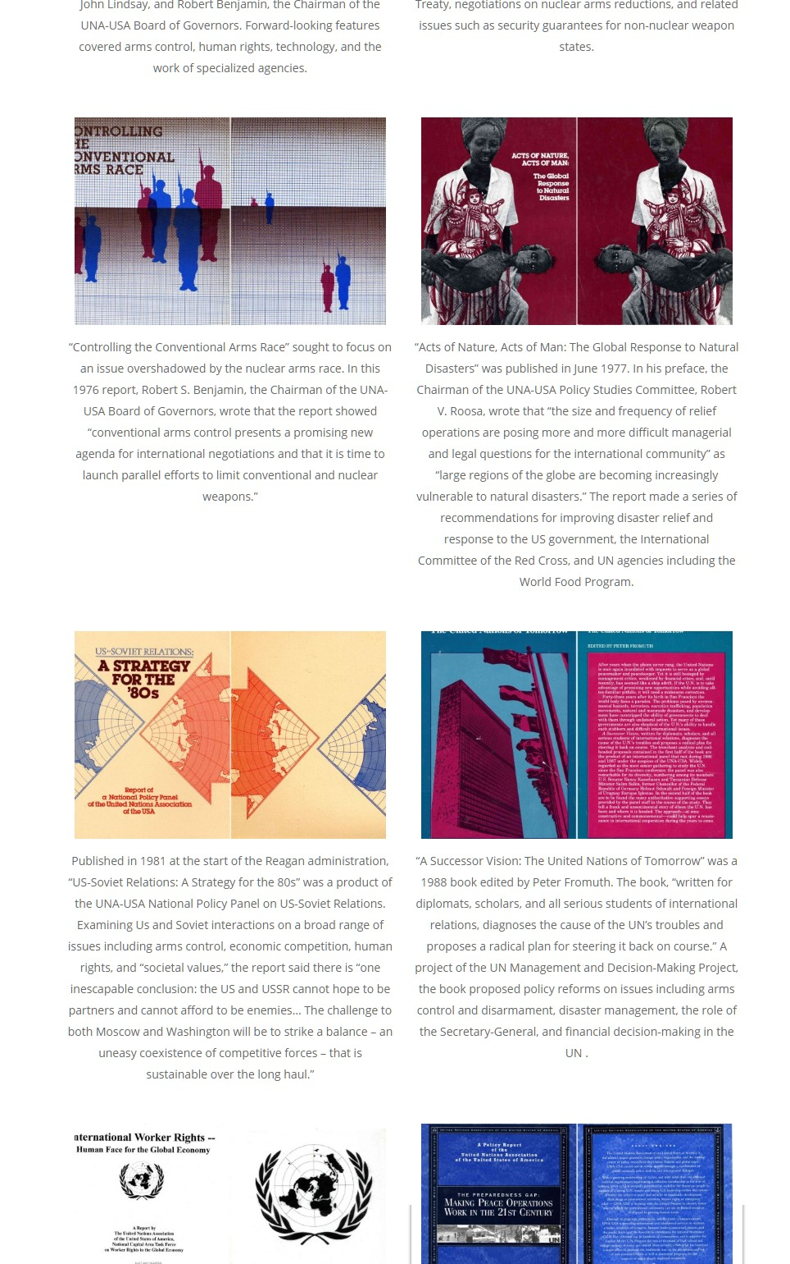
Photos Galleries and tools
Max Galleria
Simple Lightbox
My Eyes Are Up Here
Group photos into galleries.
Detailed display options with titles, captions, columns, order and more.
Easy to set up. Activate, and it just works.
Click on an image and it shows the full-size version.
Helps ensure cropping of photos includes the key parts.

Slide 18
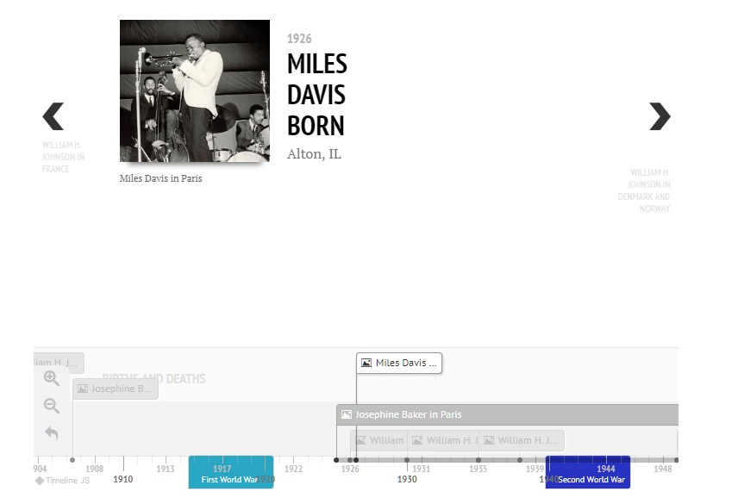
General Scholarship Make your site more professional
Footnoting Footnotes Easy Footnotes
Embeds Google Doc Viewer Slide Share
Data Easy Charts Table Press
Plagiarism Checker
Perfect Pullquotes
Digital Humanities Hypothes.is: crowd-source texts
DH Press and Prospect Full-fledged data visualizations
TimelineJS

Slide 19
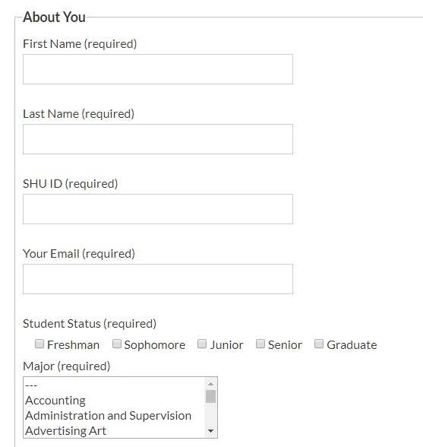
Forms Contact Form 7
Very well-supported and widely used.
Any kind of form field – including signatures, date-picker and CAPTCHA
Customizable, multiple mail responses and messages
Can store responses to a database
Easy to set up

Slide 20
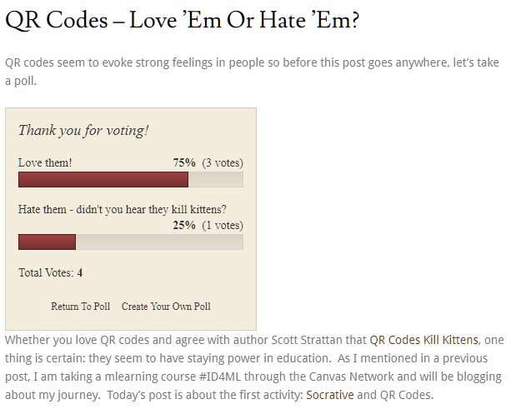
Engagement Get your readers to participate
Comments, of course Keep after them; always respond somehow
WP-Pro-Quiz
Polldaddy Polls
WP Polls

Slide 21
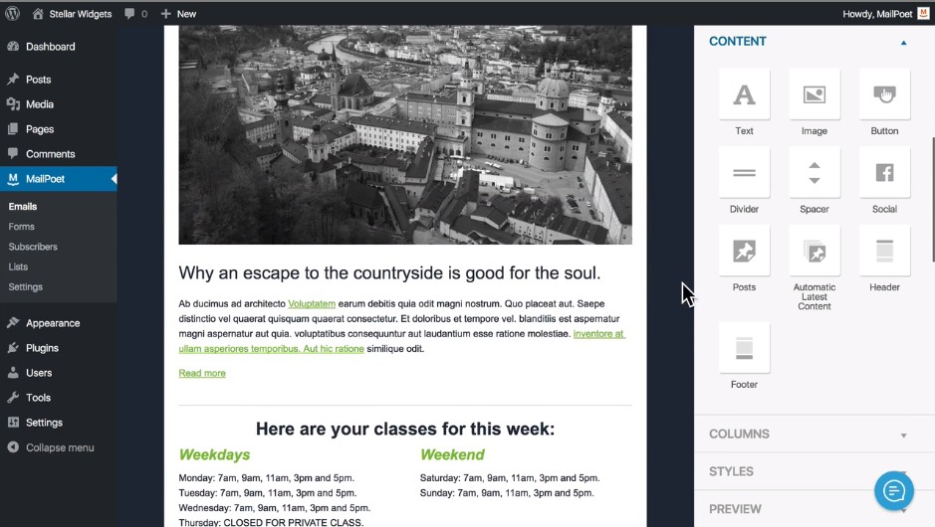
Push Share your content
Mail Poet
Microblog Poster
Better Notifications
Send beautiful email newsletters to subscribers
Drag-and-drop interface to pull in text and images from your posts and pages
Track numbers of clicks, opens, percentages and by reader.
Uses APIs for Facebook, Twitter and others.
Takes some configuration
Can post automatically or on-demand
Full opt-in, opt-out signups
Delivers email automatically when new content goes up
Granular configuration for groups
Mail templates with placeholders

Slide 22
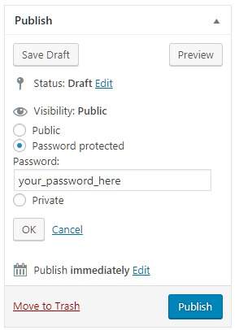
Privacy Control access to your site
Built-in Passwords
Authenticator
Disable Feeds
Lets you password-protect individual posts
Only allows access for accounts with a role on your site.
A handy companion
Information won’t “leak” through /feed URLs.
Download Monitor
Restrict access to PDFs and other files
User and download counts and tracking
Build packages of multiple items.

Slide 23
GDPR

Slide 24
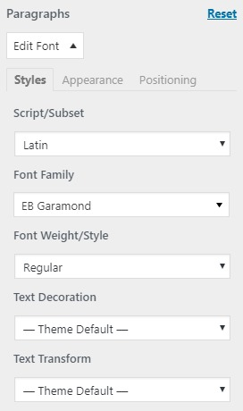
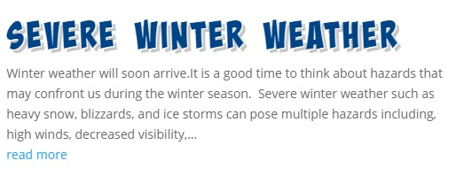
Design Layouts and Fonts
Typography
Use Any Font
Easy Google Fonts
Typekit Fonts
Page Builders
Page Builder by Site Origin Drag-and-drop from a number of ready to use blocks
Divi Builder Like the above, only more customization Enables seamless transition with popular “Divi” theme

Slide 25
What else is out there?
Is there’s something we missed?
http://www.wordpress.org/plugins
Commercial plugins
These cost money
Often a subscription is necessary for updates
Need to be vetted – they’re a vector for infections

Slide 26
WordPress Themes
Form Follows Function

Slide 27
What Are Themes?
Directories of template files, styles and images that you can install
When activated, it replaces your former look-and-feel with a new look.
They include options, such as header images, colors, fonts
They can make your “blog” into something else:
Magazine
Corporate identity site
Portfolio
Storefront
Resume
Usually most things can be done through the WordPress Customizer

Slide 28
Where Are They?
On your Dashboard->Appearance page
Best Practice: Use the Customizer for a live preview
Pick a theme
Work through the available customizations
Colors
Headers
Fonts
Layouts
Widgets
More…
We’ve selected good options to start
Is there’s something we missed?
http://www.wordpress.org/themes

Slide 29
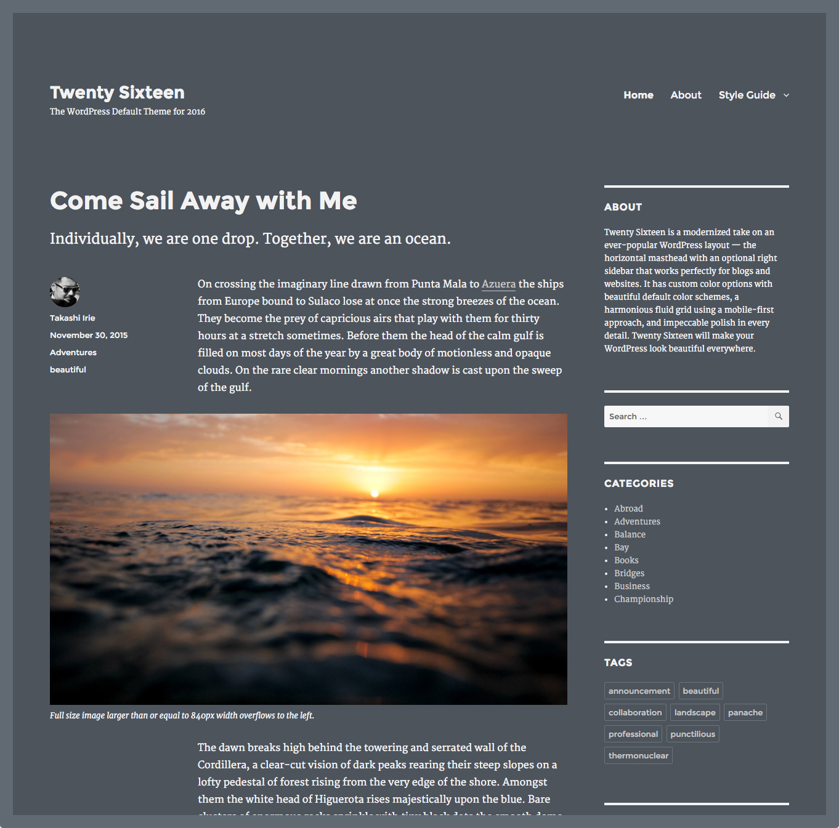
Blogging Themes
WordPress’ own Twenty Something themes
Twenty Eleven
Twenty Twelve
Twenty Thirteen
Twenty Fourteen*
Twenty Fifteen
Twenty Sixteen
Great for bloggy diary-style entries. They tend to look like these…

Slide 30
Other Blogging-Style Themes
Boston
Sixty

Slide 31
Others…
Piedmont
Skirmish
Period

Slide 32
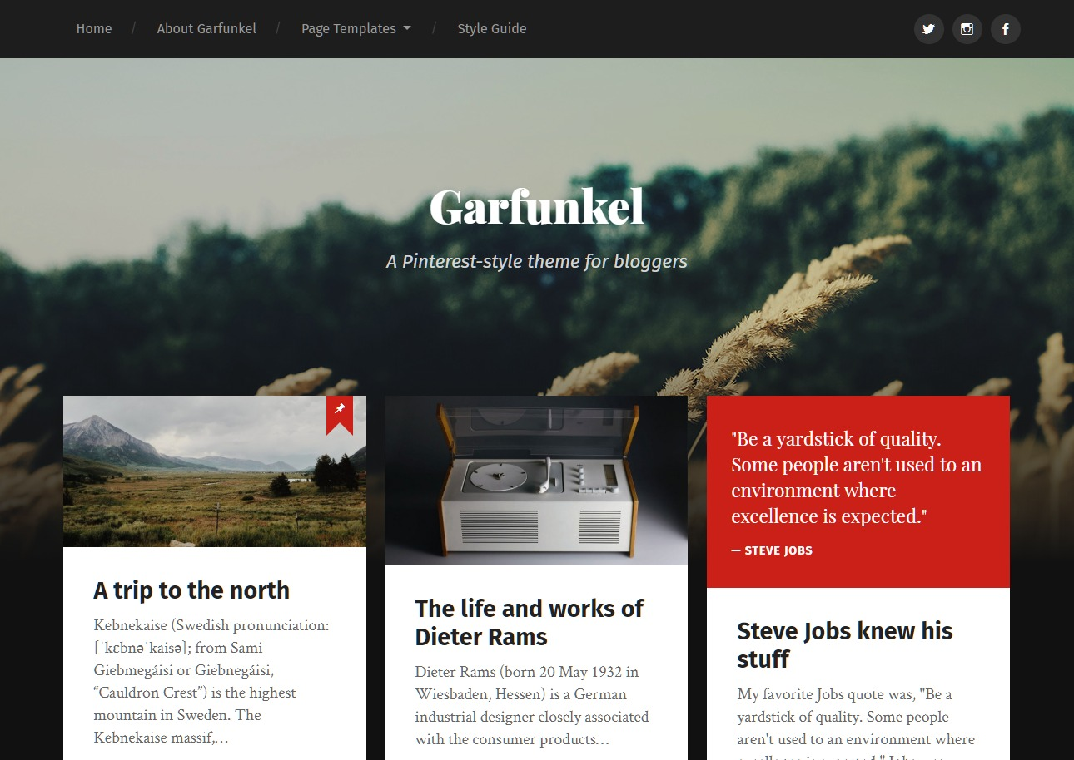
Showcase Themes
Portfolios
Examples of Work
Photo-heavy blogs

Slide 33
Others…
Kale
Shaken Grid
Freedom
Grid Photography

Slide 34
Digital Humanities/Scholarship
Annotum
Comment Press

Slide 35
DH Press or Prospect
Map View
Flowchart

Slide 36
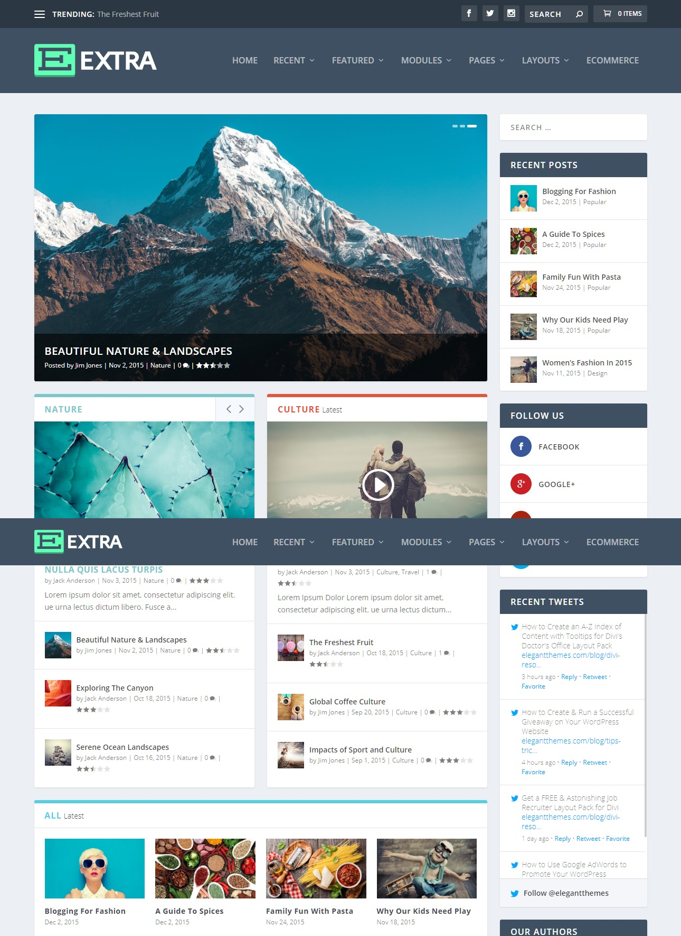
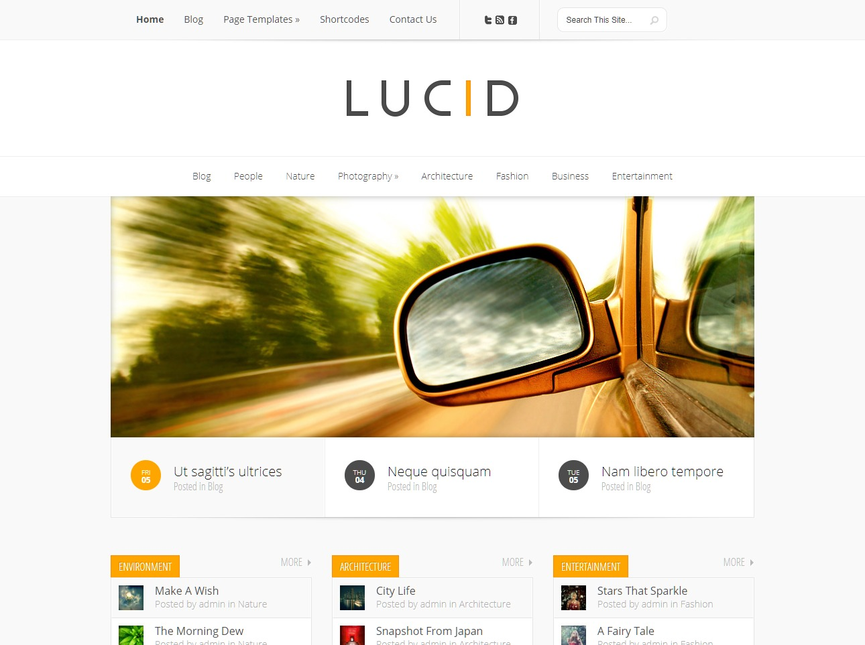
News-y
Magazine Style

Slide 37
Others…
Access Press
Color Mag
Publishable Mag
Digi News
Twenty Fourteen
VT Grid
Divi

Slide 38
Blogging is most certainly not dead
Social media is as compelling as ever, but people are increasingly souring on the surveillance state Skinner boxes like Facebook and Twitter. Decentralized media like blogs and newsletters are looking better and better these days.
Kottke.org, 2018

