Slide 1
MeaningCloud
Language processing for Digital humanities

Slide 2
Getting Started
Visit www.meaningcloud.com
Sign up for a free account
Copy your license key
Read “Text Analytics & MeaningCloud 101”
Try the demos – link on the home page

Slide 3
Main Toolset
Topic Extraction
Used to pull out named entities, concepts, amounts and units, locations, dates, events
Text Classification
Assign text to classification models
What is a text about? Genres, tags…
Sentiment Analysis
Identify subjective information
Expressed in terms of polarity – positive feeling, negative feeling, neutral – , irony, emotional agreement
Text Clustering
Groups similar texts together, discover significant subjects

Slide 4
Main Toolset
Language Identification
Detects a wide range of world languages
Lemmatization, POS and Parsing
Morphosyntactic analysis
Parts of Speech
Tagging
Lemmatization
Corporate Reputation
Semantic tagging of multilingual content

Slide 5
Topics Extraction
Using the test console on news item about Bob Dylan’s Nobel Prize for Literature.
Showing the basic settings for language, etc. You can enter the text, upload a file, link to a URL.

Slide 6
Topics Extraction
Concepts Extraction

Slide 7
Topics Extraction
Entities Extraction –
Ontology

Slide 8
Topics Extraction
Dates, amounts, quantities

Slide 9
Classifications
Texts by subject area, according to an ontology.

Slide 10
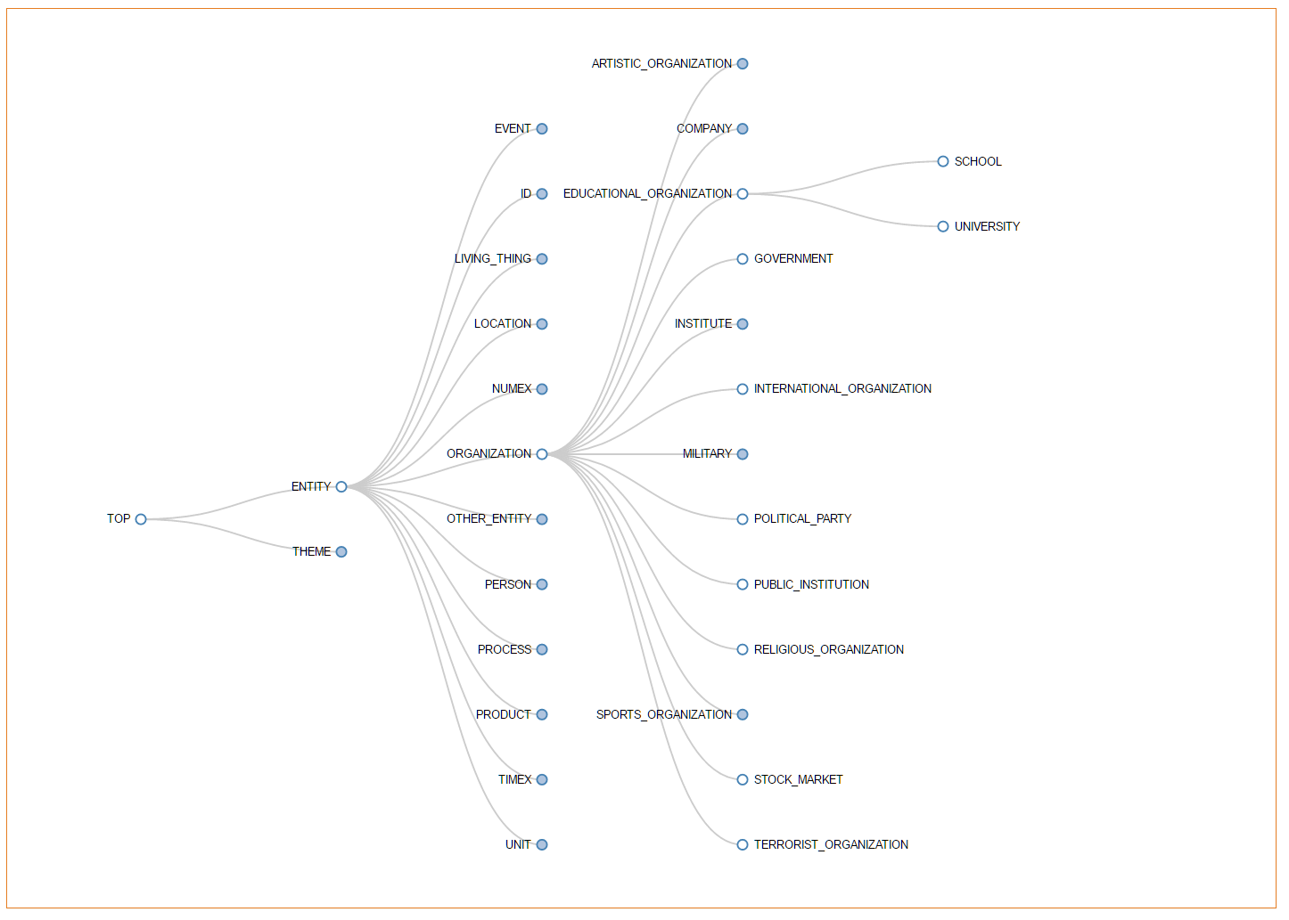
Sample
of an
Ontology

Slide 11
Sentiment Analysis
Positive, negative etc.

Slide 12
Parsing, Lemmatization, Parts of Speech
How We Used It
Our PHP script fed 4,000 text files to the MeaningCloud service one-at-a-time
Believe it or not, this was the #1 song of 1965.
Uno, dos, one, two, tres, quatro
Matty told Hatty about a thing she saw.
Had two big horns and a wooly jaw.
Wooly bully, wooly bully.
Wooly bully, wooly bully, wooly bully.

Slide 13
Parsing, Lemmatization, Parts of Speech
{type: "sentence",
id: "53",
inip: "36",
endp: "74",
style: {
isBold: "no",
isItalics: "no",
isUnderlined: "no",
isTitle: "no"
},
separation: "A",
quote_level: "0",
affected_by_negation: "no",
token_list: [
{
type: "phrase",
form: "Matty told Hatty about a thing she saw",
id: "71",
inip: "36",
endp: "73",
style: {4 items},
separation: "_",
quote_level: "0",
affected_by_negation: "no",
analysis_list: [1 item],
token_list: [
{
type: "phrase",
form: "Matty",
id: "65",
inip: "36",
endp: "40",
How We Used It
MeaningCloud returns a JSON file for each – a parseable array built in Javascript which is easily machine-readable
Important points are token lists, types, sub-token lists, tags

Slide 14
Parsing, Lemmatization, Parts of Speech
{
form: "told",
id: "14",
inip: "42",
endp: "45",
style: {4 items},
separation: "1",
quote_level: "0",
affected_by_negation: "no",
syntactic_tree_relation_list: [2 items],
analysis_list: [
{
tag: "VI-U3ASA-N-N7",
lemma: "tell",
original_form: "told",
sense_id_list: [4 items]
}
],
sense_list: [4 items]
},
How We Used It
Down to the individual word, in context
Important points are tags and lemmas. Important here, because “tell” is an irregular verb.
This tag translates into:
Verb, Indicative, no gender, singular and plural, 3rd person, Past tense, Simple aspect, Active voice, not transitive, Not auxiliary, Not negative, Normal word, high frequency.
Original form – the infinitive, is “tell.”

Slide 15
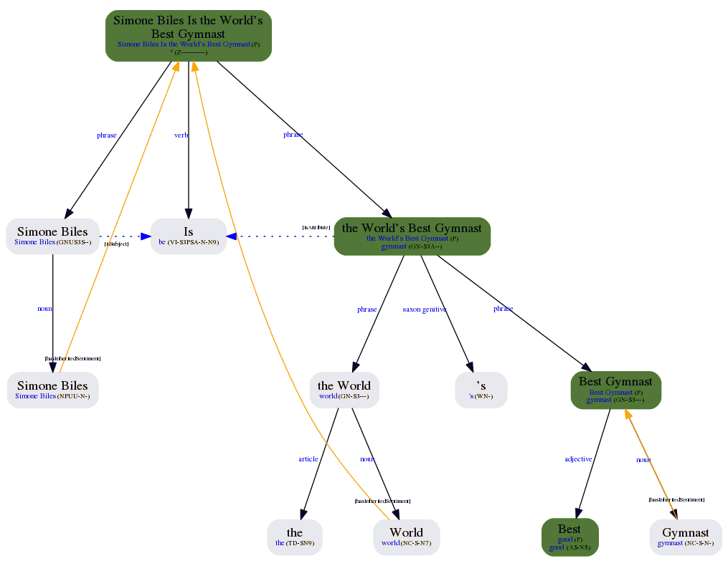
Sample
Morphosyntactical
“tree”

Slide 16
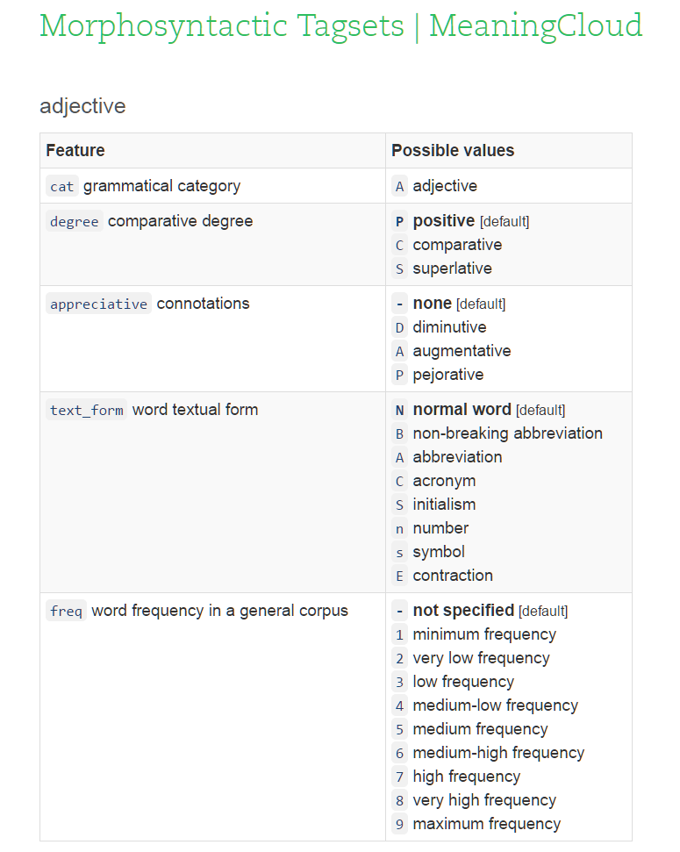
Parsing Tagsets AC- - 7 - - - - Comparative adjective, high-frequency use – “bigger” see: https://www.meaningcloud.com/ developer/documentation/ morphosyntactic-tagsets

Slide 17
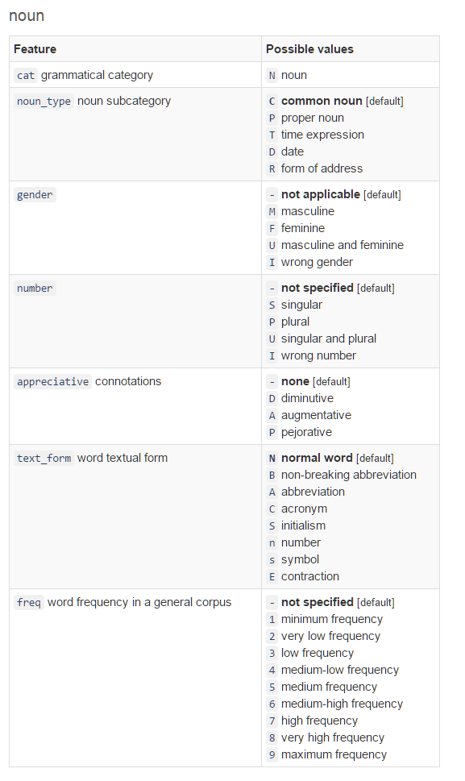
Parsing Tagsets N - - P A – 6 Plural noun , augmentative medium-frequency use – “mansions”

Slide 18
Parsing, Lemmatization, Parts of Speech
How We Used It
Our code parsed the resulting JSON data to find individual words and lemmas
Then added them to a usage count column in the database.
ID | artist | title | year | position
4104 | 1677 | Wooly Bully | 1965 | 1
3046 | 1565 | Word Up! | 1986 | 68
3550 | 1732 | Woodstock | 1970 | 94
ID | word
26674 | told
song | word | count
4104 | 26674 | 6

Slide 19
“Wooly” isn’t all that common
“Wooly Bully” is the only top-100 song in 40 years to use that word. Interesting? Who knows.

Slide 20
“Told,” on the other hand…
Between 1 and 10 songs use the word every year.

Slide 21
“Tell,” on the other other hand…
Many inflections, very prevalent. One form was used in over 70 of the top 100 songs in 1990.

Slide 22
Three Tools for Parsing Text
In Browser
Using MC’s On-Line Toolkit
Paste Text Into Pages
Excel Add-On
Adds functions to Excel
Programming API
PHP, Python, Ruby etc.
Apply them to text in cells
Steep learning curve for very large data sets

Slide 23
Text clustering, language, corporate reputation…
Work similarly, but used for large document sets, social media, bulk analysis of news stories.

Slide 24
How hard can it be?
Putting some of these to real use puts you into the realm of “big data.”

Slide 25
In-Browser “Demo” Screens
https://www.meaningcloud.com/demo
Enter your text, and click “Send.”
Flip through the tabs for different kinds of analyses.

Slide 26
Excel Add-In
https://www.meaningcloud.com/products/excel-addin
Download and follow the instructions.
Excel will offer a new tab of tools, “MeaningCloud.”
Paste your text into cells, then click the button you want to use.

Slide 27
"How many times must a man turn his head
And pretend he just doesn't see?"
In the case of Bob Dylan, he seems to have had a change of heart.
After a long chase, the Swedish Academy has finally reached an arrangement to give the singer his Nobel Prize in Literature.
But it wasn't easy.
First, the academy couldn't reach Dylan after announcing his victory.
Then, Dylan was a no-show at the awards ceremony.
Finally, five months after he was announced as a winner, the singer-songwriter will accept his diploma and medal when he's in Stockholm, Sweden, for two concerts.
The academy will give Dylan his award in a small setting with no media, Sara Danius, permanent secretary of the Swedish Academy, wrote in a blog post.
"Please note that no Nobel Lecture will be held," Danius wrote. "The Academy has reason to believe that a taped version will be sent at a later point."
The taped lecture is important, because without it, Dylan cannot receive his prize money. Although most lectures are given in person, other winners, including Alice Munro in 2013, have sent in a tape, Danius said.
The UK government has formally served divorce papers on the European Union, signaling the beginning of the end of a relationship that has endured for 44 years.
Brexit: What happens after Article 50?
Brexit: What happens after Article 50? 01:29
Theresa May, the British Prime Minister, confirmed that the UK had triggered Article 50 of the Lisbon Treaty, beginning a legal process that must end in two years' time with Britain leaving the EU.
"This is an historic moment for which there can be no turning back. Britain is leaving the European Union," May told the House of Commons in London.
A few minutes earlier in Brussels, the British Permanent Representative to the EU, Sir Tim Barrow, delivered a six-page formal letter of notification to Donald Tusk, the President of the European Council, in Brussels.
"The Article 50 process is now under way, and in accordance with the British people, the United Kingdom is leaving the European Union," May said.At the headquarters of the European Council Wednesday morning, Barrow emerged from a black Jaguar holding a briefcase containing the letter signed by May in Downing Street on Tuesday night. His route had been kept secret in an effort to avoid any attempts to intercept the letter.
"After nine months the UK has delivered," Tusk said on Twitter, moments after the letter was handed over.
This official start to the Brexit process comes nine months after the UK voted in a hotly contested referendum that exposed deep divisions across the country.
The Foreign Secretary, Boris Johnson, one of the leading figures in the referendum campaign, expressed his delight at the outcome. "It's a great day," he said as he left a meeting of the Cabinet in Downing Street.
The split is expected to be bitter -- EU leaders will not want to make leaving their union seem easy, to deter other countries that might be mulling a referendum of their own.
After receiving the letter, Tusk struck a gloomy note. "There is no reason to pretend that this is a happy day, neither in Brussels nor in London. After all, most Europeans, - including almost half the British voters, wished that we would stay together, not drift apart. As for me, I will not pretend that I am happy today," Tusk said.
But he added that Brexit had made the 27 other nations in the EU more determined and united.
"And what can I add to this? We already miss you."In her letter, May tried to strike a conciliatory tone with the EU, reiterating her hopes for Britain and the union to remain the closest of allies and to seek a "deep and special partnership." She also made clear that she wanted to avoid walking away with no deal, and proposed several principles to guide negotiations.

Slide 28
Topic Sentiment Analysis
Each topic or entity is found, analyzed and color coded.
Nobel Prize
Prize
Bob Dylan
Stockholm
Sweden
The Academy
Swedish Academy
Etc.

Slide 29
Topic Sentiment Analysis
Each topic found is analyzed and color coded.
Nobel Prize
Prize
Bob Dylan
Stockholm
Sweden
The Academy
Swedish Academy
Etc.

Slide 30
Global Sentiment Analysis
Broad-stroke analysis of the sense of the entire text.
Is text in agreement or disagreement?
Is it ironic?
Subjective or objective?
Level of confidence

Slide 31
Text Classification
Broad strokes of what a text is about.
Coded to ontology
Graded for relevance

Slide 32
Or You Can Code It
<?php
$curl = curl_init(); curl_setopt_array($curl, array( CURLOPT_URL => "http://api.meaningcloud.com/topics-2.0", CURLOPT_RETURNTRANSFER => true, CURLOPT_ENCODING => "", CURLOPT_MAXREDIRS => 10, CURLOPT_TIMEOUT => 30, CURLOPT_HTTP_VERSION => CURL_HTTP_VERSION_1_1, CURLOPT_CUSTOMREQUEST => "POST", CURLOPT_POSTFIELDS => "key=YOUR_KEY_VALUE& lang=YOUR_LANG_VALUE& txt=YOUR_TXT_VALUE& tt=a", CURLOPT_HTTPHEADER => array( "content-type: application/x-www-form-urlencoded" ), ) ); $response = curl_exec($curl); $err = curl_error($curl); curl_close($curl); if ($err) { echo "cURL Error #:" . $err; } else { echo $response; }
Each tool has a Developer Tools section
PHP
Python
Java (2 flavors)
JavaScript (2 kinds)
Node.js
Ruby
C
C#
Shell scripting

Slide 33
Or JavaScript or Python…
var settings = { "async": true, "crossDomain": true, , "url": "http://api.meaningcloud.com/topics-2.0", , "method": "POST", , "headers": { "content-type": , "application/x-www-form-urlencoded“ }, , "data": { "key": , "YOUR_KEY_VALUE", , "lang":, "YOUR_LANG_VALUE", , "txt": , "YOUR_TXT_VALUE", , "tt": "a" } } , $.ajax(settings).done(function (response) , { console.log(response);
});
import requests
url = "http://api.meaningcloud.com/topics-2.0"
payload = "key=YOUR_KEY_VALUE&lang=YOUR_LANG_ VALUE&txt=YOUR_TXT_VALUE&tt=a"
headers = {'content-type': 'application/x-www- form-urlencoded'}
response = requests.request("POST", url, data=payload, headers=headers)
print(response.text)

Slide 34
Experiment
To find out the right tools for you, spend some time trying out different features.

