Slide 1
Rank & Tenure Services Lisa DeLuca Natalie Lau – Scholarly Communications Librarian
Slides by Natalie Lau
Notes:
Introduction

Slide 2
Scholarly Metrics Reports
Required as of 2024 cycle
Deadline for requests through the Library is September 9th
Questions? Email erepository@shu.edu
https://library.shu.edu/facultymetrics/
Scholarly Metrics Request Form
Notes:
Scholarly metric reports are now required and can be requested now until September 9th for rank and tenure. If you would like a metrics report as a pulse check or for another reason, there is no deadline. Here is a sample metrics report, this is anonymized but gives an idea of what yours may look like. We can include or remove any metrics that you wish. Keep in mind that we are not experts in your discipline, so if there is a metric that we should be considering, please let us know by emailing erepository@shu.edu

Slide 3
Pure by Elsevier
Research Information Management System (RIMS)
https://shu.elsevierpure.com/
Notes:
QR goes to Pure (now live), can briefly explain what a RIMS is (more powerful than SW which was profiles, Pure will connect with other systems that SHU uses in their scholarly environment such as Scopus and ORCID)

Slide 4
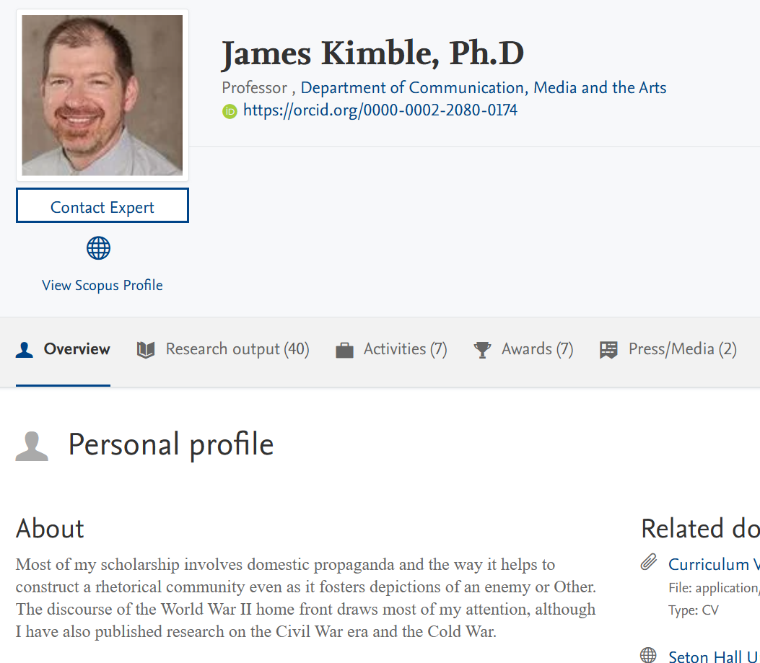
Pure
Displays all profile information on same page
Relational research outputs (ROs), ROs with DOIs will generate PlumX flower and Altmetric wheel.
Notes:
Pure displays all the information from multiples sections of SW into one webpage. Pure also uses relational ROs so if there are multiple SHU authors then one instance of it is created, this helps with imported Ros.

Slide 5
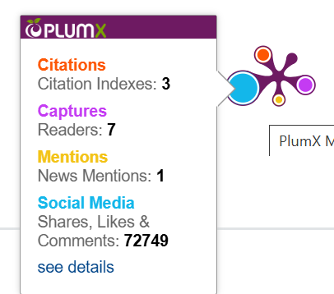
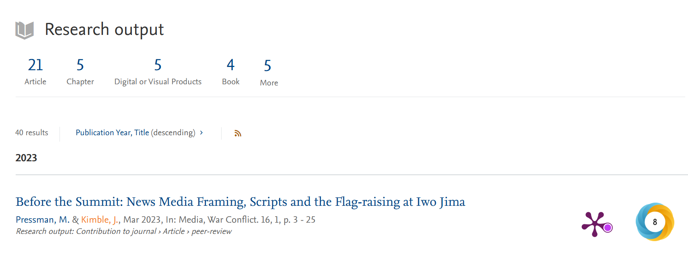
Web Profiles (Faculty Success)
University web profiles are administered through the Provost’s Office.
These are the profiles that were upgraded in 2024.
Notes:
Pure differs from the University web profiles because these should be considered “at a glance” or for laypeople rather than Pure which aims to provide some retrievable metrics and full text accessibility.

Slide 6
Thank you
https://shu.elsevierpure.com/
https://library.shu.edu/facultymetrics/
Natalie Lau
Scholarly Communications Librarian
natalie.lau@shu.edu
erepository@shu.edu

