Slide 1
LinkedIn For Academics
Presented by Kenneth Jones, Member, Stillman School of Business, Seton Hall University
September 27, 2024
Center For Faculty Development

Slide 2
What is LinkedIn
LinkedIn is a social networking site designed for the business community.
LinkedIn is a resource to help professionals to find jobs, conduct research, and learn about industry and business connections
There are an estimated 310 million active users.
LinkedIn Basic is free, there are various premium plans available.

Slide 3
Agenda
Speaker bio
Defining professional goals
Developing useful content
Building a multidimensional network
Creating mutually beneficial relationships
Expanding into targeted areas of interest
LinkedIn Posting Best Practices / Metrics

Slide 4
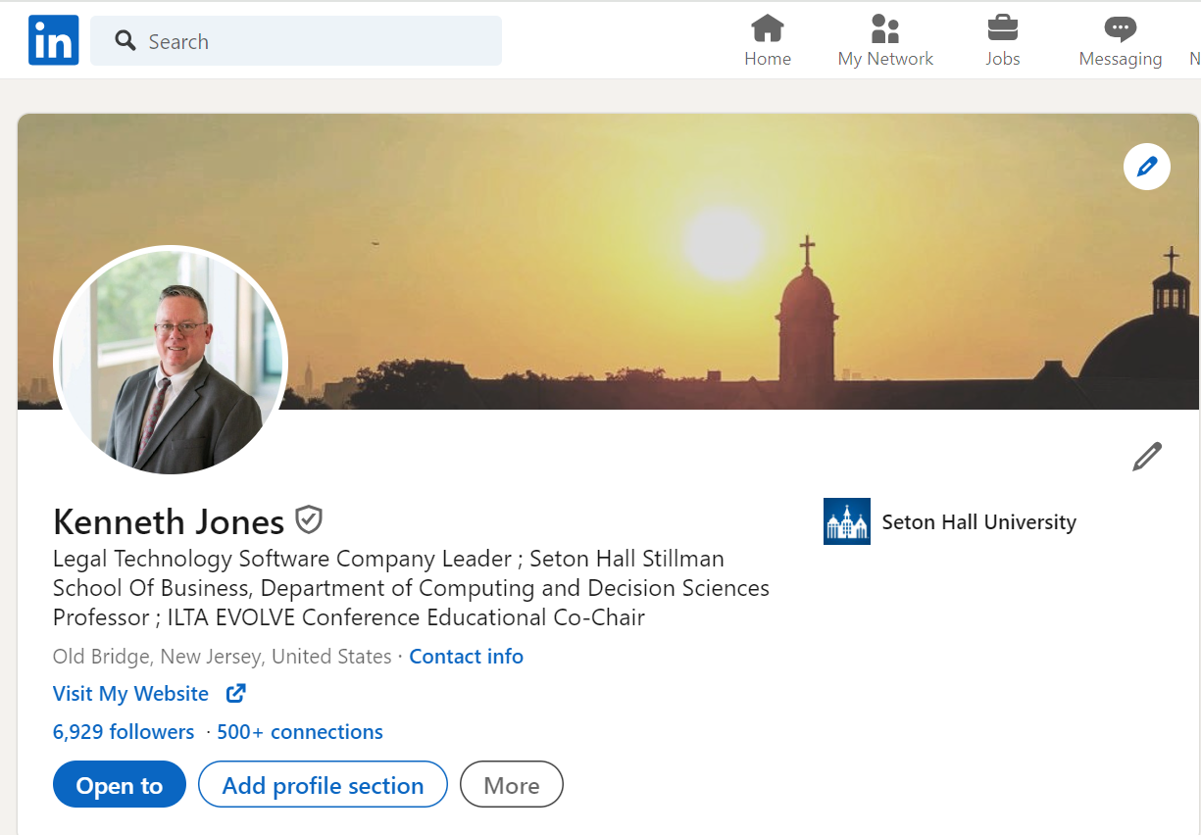
Typical Profile
The typical LinkedIn profile includes a professional photo, summary of one’s capabilities, employment history, list of articles/presentations, skills and links to followers. It is, in essence, an online resume.

Slide 5
Academic Reference
Much of the material for today’s presentation is available in this article on Legal Evolution
Legal Evolution is an online publication that focuses on the changing legal industry. Legal Evolution was founded in 2017 by Bill Henderson, Professor of Law and Stephen F. Burns Chair on the Legal Profession at Indiana University Maurer School of Law.
https://www.legalevolution.org/2021/05/one-legal-professionals-systematic-approach-to-linkedin-234/

Slide 6
Presentation Goals
Exploring Objectives Via Different Prisms
Define benefits to faculty
Professional / Departmental goals
Expand reach of thought leadership / academic materials
Instructional opportunities / Connect with students
Potential classroom benefits
Their professional network
Their brand
Their skills (and the promotion of those skills)

Slide 7
Technology – New Tools
The world is continually changing via new tools and devices:
Cloud computing
Personal computing and communications devices
Artificial Intelligence
Workflow and automation software
Robotics
Many, many more….
LinkedIn is just another one of those tools, reengineering networking and interactive practices

Slide 8
Speaker Bio
Career background (Corporate, Seton Hall, Volunteer)
LinkedIn - 6,800 Contacts
Platform trajectory- slow, steady growth over a period of years in usage/benefits/reach (will review)
Career benefits
Thought leadership
Employment opportunities
Promote organizational objectives
Industry leadership opportunities
Day-to-day opportunities to help others

Slide 9
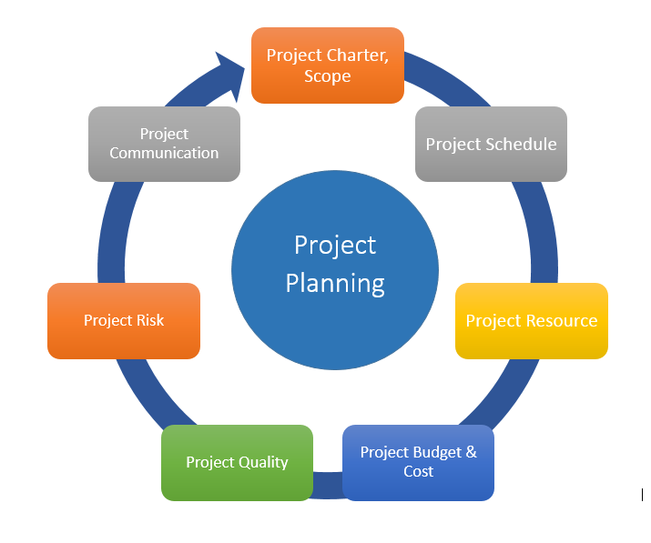
Defining LinkedIn Objectives
Define requirements, goals and objectives
Think about your priorities – professional, departmental, organizational, personal
Short-term / long-term, build content to support both
Interests “Outside Your Lane”?
Social Responsibility / DEI / ESG, etc.
Key takeaway: First develop, then execute, your plan

Slide 10
Developing Useful Content
Written content (published papers/research, self-published, LinkedIn creator tools)
Multimedia - presentations / podcasts
Indirect content
Contributing / commenting on others’ content
Endorsing others
Securing third party endorsements (gold standard)
Start now – building content library takes years
Key Takeaway: LinkedIn can greatly increase the exposure, scope and reach of any content you create.

Slide 11
Building A Network
DEFINE TARGET MARKET – SHORT AND TERM
DEVELOP CONTENT TO ATTRACT CONTACTS
THINK OUTSIDE THE BOX – CONNECT WITH INDUSTRY, ACADEMICS, STUDENTS, OTHER
CONTINUAL FOCUS – MAKE PART OF PROFESSIONAL LIFE

Slide 12
Mutually Beneficial Relationships
What are some key qualities to try and convey on the platform
Humility
Engagement / responsiveness
Teamwork
Be thankful, appreciative, complimentary
Ask what you can do to help others
Key Takeaway. Show the same characteristics on LinkedIn you would in the classroom, meetings, professional life, etc.

Slide 13
Leveraging / Building Content
Expand value of your content whenever possible
LinkedIn Groups (Public and Private)
Re-use / recirculate content, within reasonable amounts of time (e.g. like Facebook memories)
Best practice elements in posts (pictures, links, tags, #hashtags)
Be open, thank and engage with those who comment on your posts
Comment on others’ posts to broaden reach
Contacts can be used for unique purposes – such as recruiting conference speakers

Slide 14
LinkedIn Algorithms
Nothing is known. We can only rely on experts to share what are believed to be best practices
Here is one of many thoughts and articles on the topic (for reference, not in presentation)
https://www.linkedin.com/posts/richardvanderblom_algorithm-insights-2024-report-v10-activity-7160527422398844928-VnlE/

Slide 15
For Faculty
Modern day method to drive personal professional growth / demonstrate subject matter expertise.
Excellent platform for marketing new programs (both for a University, School, Department or Individual)
Raising awareness / reach on Seton Hall programs and activities
Perfect place to publicly support colleagues
Platform for connecting with and supporting students, within reason and with appropriate boundaries, of course.

Slide 16
How Faculty Can Coach Students
Building their network (encourage connections)
Building their brand (encourage participation in school events)
Building skills (LinkedIn Learning, augmenting school programs

Slide 17
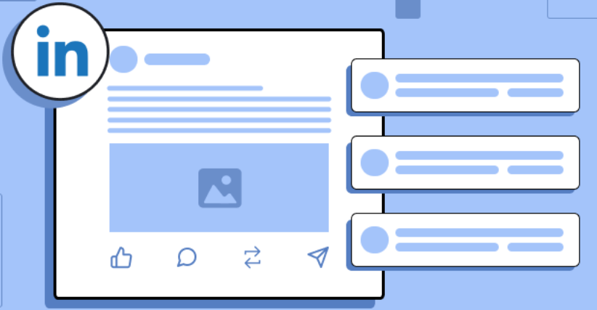
Posting - Best Practices
Posts have initial spam review. Avoid valueless material
Engagement evaluation occurs early on
Surfacing content which shares knowledge or advice
Posts with images or videos do far better than text only
Scheduling matters. Monday 1PM is viewed as optimal
Promotion. Tags, Hashtags, Keywords

Slide 18
Posting - Best Practices, cont.
Encourage interesting engagement – ask questions
Try to be creative and unique
Use analytics and metrics to improve
Be judicial about business vs. personal posts
Join and use LinkedIn Groups

Slide 19
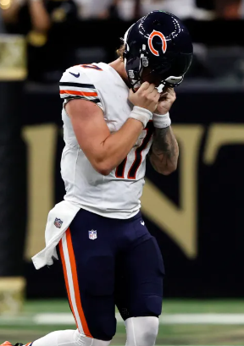
Avoiding Mistakes
Like all social media, avoid inadvertent critical mistakes. Some examples…
Poor grammar
Political / social content (there are times for this, but very careful)
Exposing poor practices (e.g. sharing how you have thirty years of paper to move when relocating an office).
Failing to vet certain content with an employer
Striking a balance between expertise and humility
Key takeaway. Like in email and in meetings, think before you act and exercise caution and restraint

Slide 20
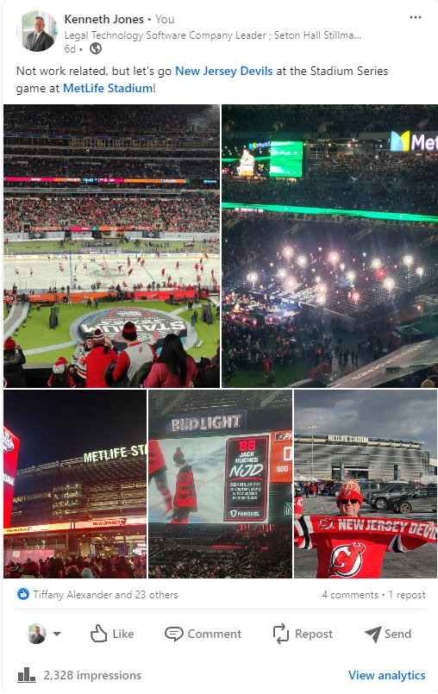
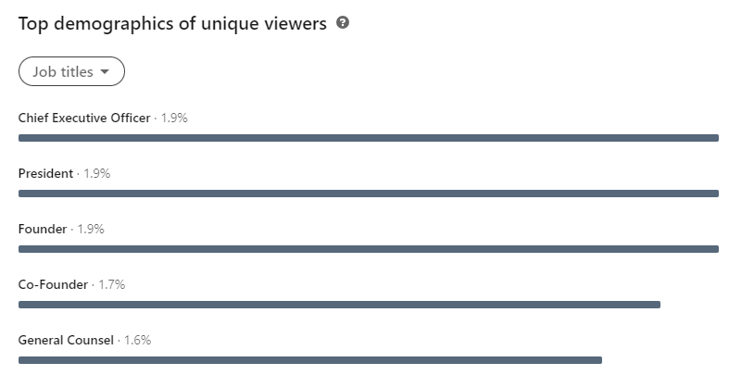
Metrics
Personal Post – Stadium Series Game
2,000+ Impressions, 10% of which are key executives

Slide 21
Repurposed Content
A company and person I have never met, from India, but one I was nice to and made an introduction, republished an article I wrote about my personal development journey and a conference for which I am Educational Co-Chair

Slide 22
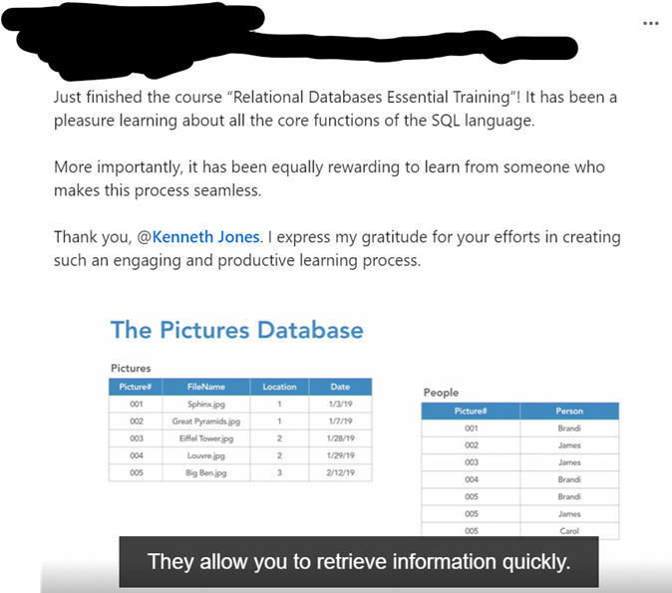
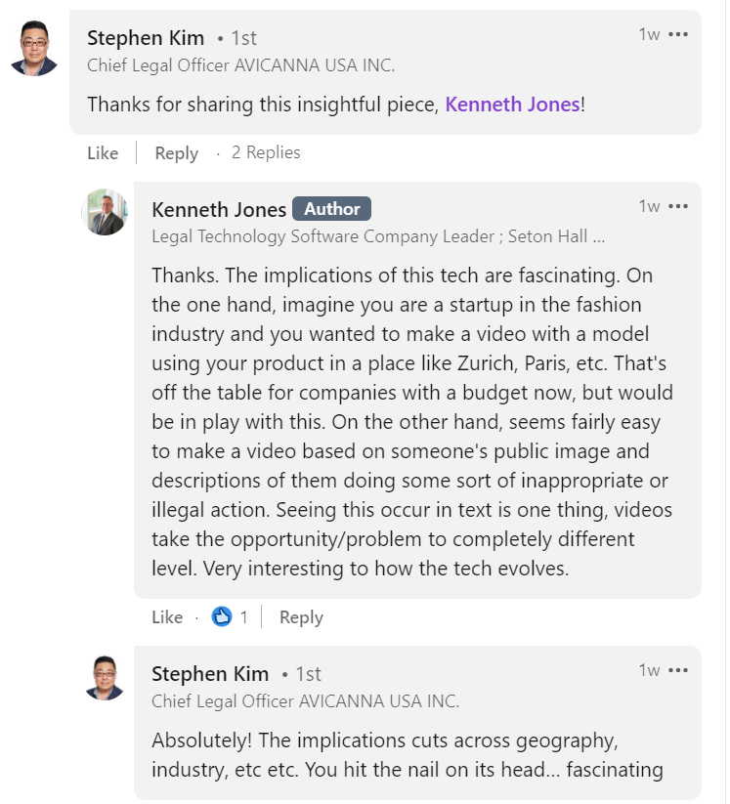
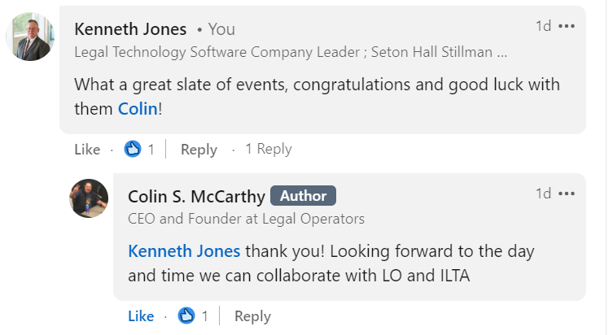
Third Party Endorsements

Slide 23
Questions

