Slide 1
Using Plickers for Just-in-Time Feedback
Dr. Lauren McFadden
Associate Professor in the College of Education and Human Services

Slide 2
FEEDBACK TO PROFESSOR & STUDENTS
REAL TIME
MAKE ADJUSTMENTS
TRACK PROGRESS OVER TIME
ASSESS WHAT WAS LEARNED
PRE-ASSESS FOR UPCOMING CLASSES

Slide 4
BASIC FACTS
One device
Plickers App
Plicker cards
Basic Set- 40 cards Expanded Set- 63 cards
Teacher needs to have a device, not the students.
Free download on Android or iOS
The Plickers mobile app is required to collect student responses.
Can be downloaded for free or purchased from Amazon

Slide 5
Plickers
Let’s Try

Slide 6
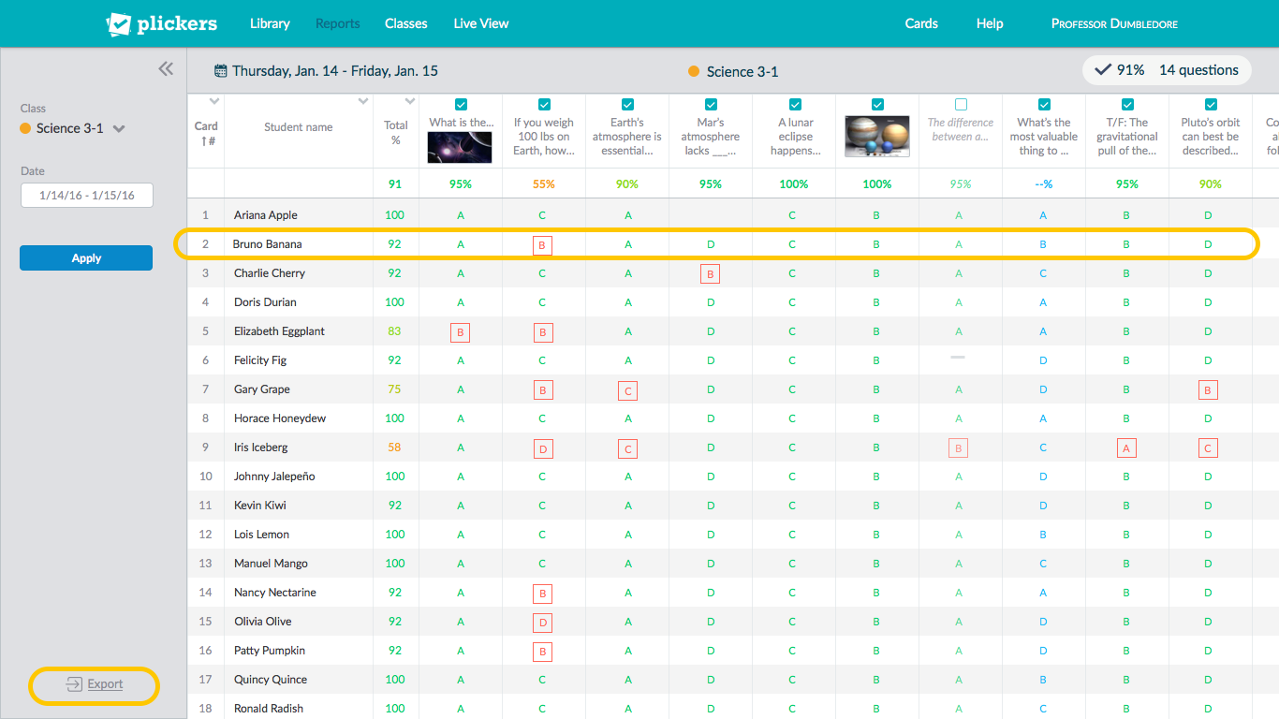
Checking for Understanding

Slide 8
Score Sheet Results
Color Coding
Uses the following color coding system for Question, Set, Student, and Class totals:
Dark Green: 100% - 85%
Light Green: 85% - 70%
Orange: 70% - 60%
Red: 60% - 0%
Blue: Survey
Grey: Absent

Slide 9
Plickers vs. Plickers Pro
Plickers
Free
You'll always be able to create and organize unlimited questions
Print your own cards
Download the app
Access reports and scoresheet
SETS can only have up to 5 questions!
Plickers Pro
$8.99/month (paid monthly) or $5.99/month (paid yearly – save 33%!)
Add as many questions as you like to sets you create
Access custom, unlimited date ranges in Scoresheet
Instantly add images to questions with built-in image search
Use layout templates to customize the look of your questions
Priority support – jump to the front of the line when you have questions

Slide 10
LET’S GET YOU STARTED
www.plickers.com
CLICK GET STARTED
Download the APP to your phone
Get Cards
Plickers.com/liveview
Make sure you have your plickers account open in a browser before your class begins

Slide 11
QUESTIONS

