Slide 1
Teaching Workshop October 19, 2016 Karen E. Boroff

Slide 2
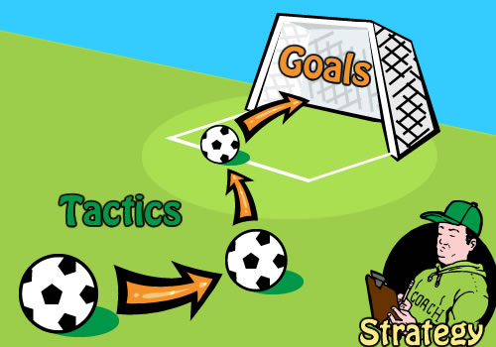
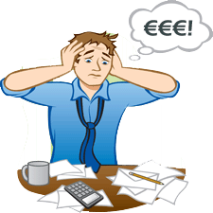
Begin before the Beginning and End after the End
Why?
The Tactics
Unanticipated Events

Slide 3
Why?
Formation over the entire 4-year experience at Seton Hall
Relationship is more than my semester with you
Expectations need time to vest

Slide 4
The Tactics
A series of e-mails
A mailing to the home
Assignments due the first day of class
Reflection of a management style
Post-semester commendation letters

Slide 5
E-mail #1 June 24, 2016
Dear Students in BMGT 2501 AC and AD Sections,
I hope you are enjoying your summer!
While I shall have a more formal communication and mailing to you toward the latter part of the summer, I write to you now to alert you to the textbook that I shall be using for the course so that you can plan ahead and save yourself some money and worry.
The required text is Management, written by John Schermerhorn and published by Wiley. Please make note of the edition—I am using the 11th edition. The book has since been updated with a 12th and a 13th edition, but those newer ones confusingly reconfigure material and drop out other important topics. So, I am going to use an older edition. The Seton Hall bookstore is uncertain how many copies of the 11th edition it may be able to get, but you’ll probably be able to secure one on Amazon for quite a bit less money than if I were to require you to purchase the 13th edition. Please note that Schermerhorn also has a book entitled Introduction to Management; do NOT make the mistake and purchase this.
Let me know if you have any questions.
Talk to you later in the summer! My late summer mailing will be sent to your permanent address in Banner. If you are changing that address or are living somewhere other than that location for the summer, please let me know, so that I can properly direct my August mailing to the correct location.
Regards,
Karen Boroff

Slide 6
E-mail #2 July 27, 2016
Dear Students,
I welcome you to Principles of Management, BMGT 2501 AD. We meet on Tuesdays / Thursdays from 1100 to 1215 and our first day of class is August 30.
Earlier this week, I mailed to your homes, using your permanent address that is in Banner (or the update you gave me), the course syllabus and instructions for assignments due the first day of class. If you do not receive your packet by August 8, please email me or call me immediately. My office phone is 973-761-9597; my home phone is 973-701-1948; my cell is 973-610-0640.
In reading that material, you will see that you have a mandatory class assignment on Friday, November 11 for the late afternoon and into the evening—this is hosting a University-wide Pirate “tailgate” at Seton Hall, in between the women’s basketball game that day and the men’s basketball game thereafter, both being played at Walsh Gym. Mark your calendars now or otherwise alert me to the specific allowable conflict exceptions, as noted in the cover letter that is part of the mailing that was sent to your home.
I look forward to meeting you soon! I am on campus most days, so if you happen to be on campus, stop by and introduce yourself. Enjoy the rest of your summer!
Regards,
Karen Boroff

Slide 7
E-mail #3 August 11, 2016
Dear Students in BMGT 2501,
Beginnings are so important, so I just want to be sure that we all start off the semester in a strong fashion.
By now, you should have acquired your copy of Schermerhorn, 11th edition. This is an older edition of the textbook, and the bookstore, as I indicated in my earlier email on this, is unlikely to be able to stock it. So, you will have to rely on the online purchase of it. So, if you have not acquired the text, do so quickly to save yourself unnecessary stress as the semester begins.
I have checked with our IT personnel, as is my practice, to ensure that all of my emails were delivered and that there were no snags in the SHU network. Delivery has been confirmed.
Thank you to the several of you who indicated that they did not receive the hard-copy mailing. Your notice to me of its nonreceipt was due on August 8, so if you still have not received the mailing, you have to let me know. Be aware that not a single mailing has been returned to me “undeliverable,” so the materials are resting in a mailbox somewhere! Even so, I shall resend the packet to you, but you have to let me know right away. Otherwise, you jeopardize meeting the first day of class assignment. Know that I am on campus daily, so if you want to pick up your packet here on campus, let me know. I’ll tape your packet to my office door (Jubilee 686), and you can get what you need in this way.
Regards,
Karen Boroff

Slide 8
E-mail #4 August 22, 2016
Dear Students in BMGT 2501,
We are about ready to start BMGT 2501!
As you reflect on management styles, you probably can already detect part of my style—I am a big believer in organizing, controlling and setting standards.
To that end, I remind you one more time about:
. the textbook
. the first day of class assignments
. the critical mandatory class assignment in November, about which you have to notify me of your conflict, as highlighted in my prior emails and my cover letter to you.
As I expressed earlier, ALL your emails have been delivered to your mailbox. Whether you opened these is part of your own internal discipline as a manager, working to your own high standards. Since these have been delivered to your inbox, it will not be acceptable to tell me that the reason you do not have your assignment is that “I did not get the email”—this statement can lead to problematic integrity issues. If your laptop has problems, there are still other ways to access one’s email, so “a broken computer since late June” would can cause professionalism issues.
As you will hear from me during the semester, part of my work is to make you the best you can be, which requires no half-measures on my part. I want you to get the best positions and start your careers as strong as you can.
I am on campus all this week, so stop by. If I am away at a meeting, you’ll see a note on my door when I’ll be back. I am very much looking forward to the semester!
Regards,
Karen Boroff

Slide 9
Commendation Letters
Letter to families for students earning an “A”
Letter to families for students earning a grade of “A” in the class preparation / participation dimension, regardless of overall grade

Slide 10
Unanticipated Events
. Churn on registrants after the initial mailing
Banner notice to faculty
Banner notice to new registrant
Daily checking of rosters
. Forum shopping for the late registrants
. Preparation for waitlist students
. Missed assignments; by Day 2, 60 points out of 1000 are gone

