Slide 1
Building Your Project
American History

Slide 2
Log In
https://blogs.shu.edu/americanhistory/wp-admin/
Use your PirateNet credentials
Look under “Projects” and find your project shell

Slide 3
WordPress Concepts for This Project
Projects and Categories
Media
The projects are already set up for you to start working.
Make sure you have the correct categories checked off and tags selected!
After you’ve sorted out what images to use (and they don’t just have to be photos).
Embed IMAGES in your posts using the Media tool.
If you have AUDIO OR VIDEO media, just put the YouTube, SoundCloud or Vimeo URL on a line by itself.

Slide 4
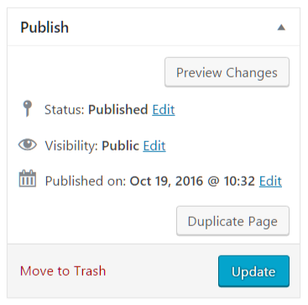
Preview and Save
Use the “Preview Changes” button to see how it’s going
Always remember to save your project by clicking the final blue “Update” button.

Slide 5
Anatomy of a Project
American History

Slide 6
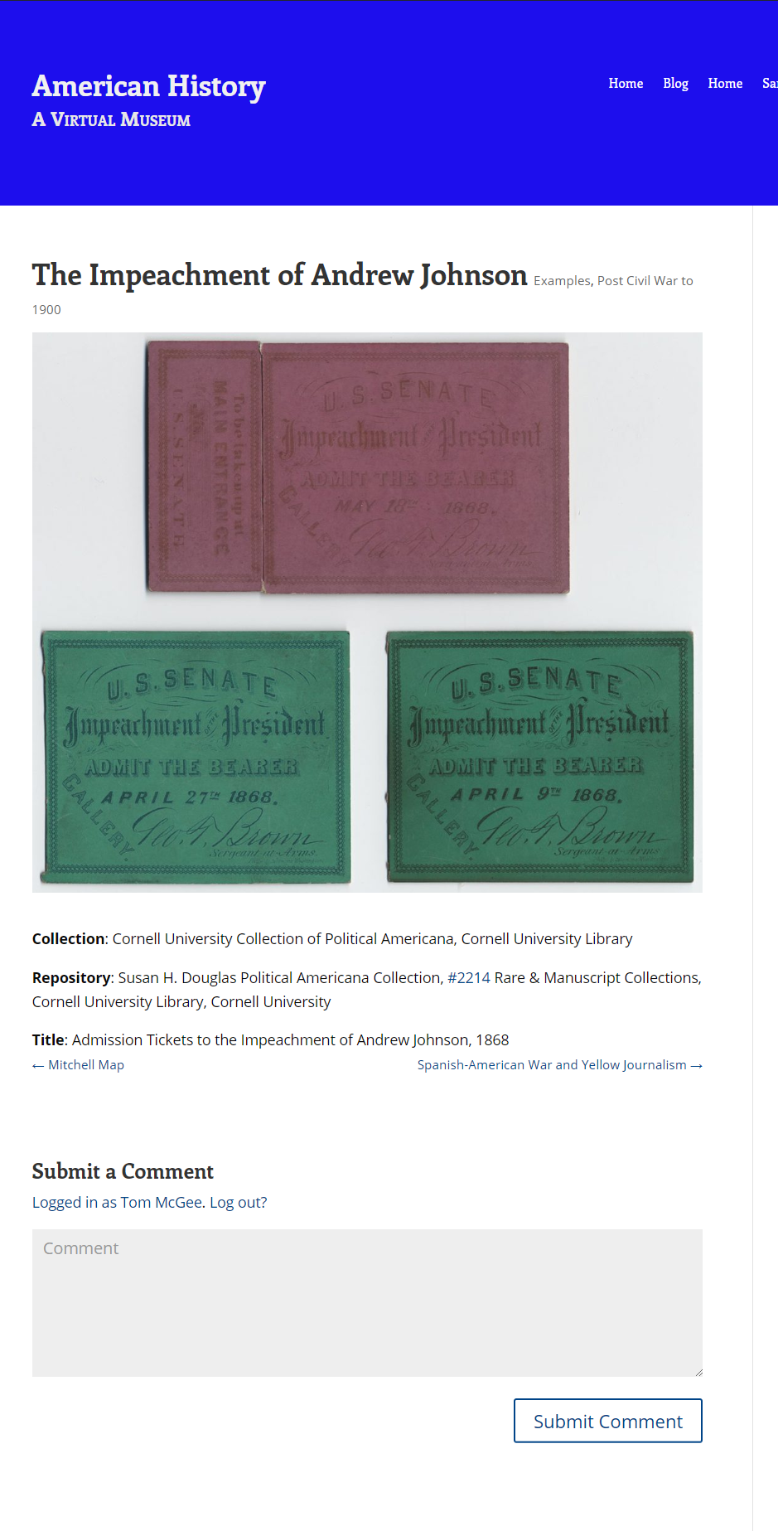
Key components of your page:
Featured Image and Caption
Writing and Embedded Media
Comments

Slide 7
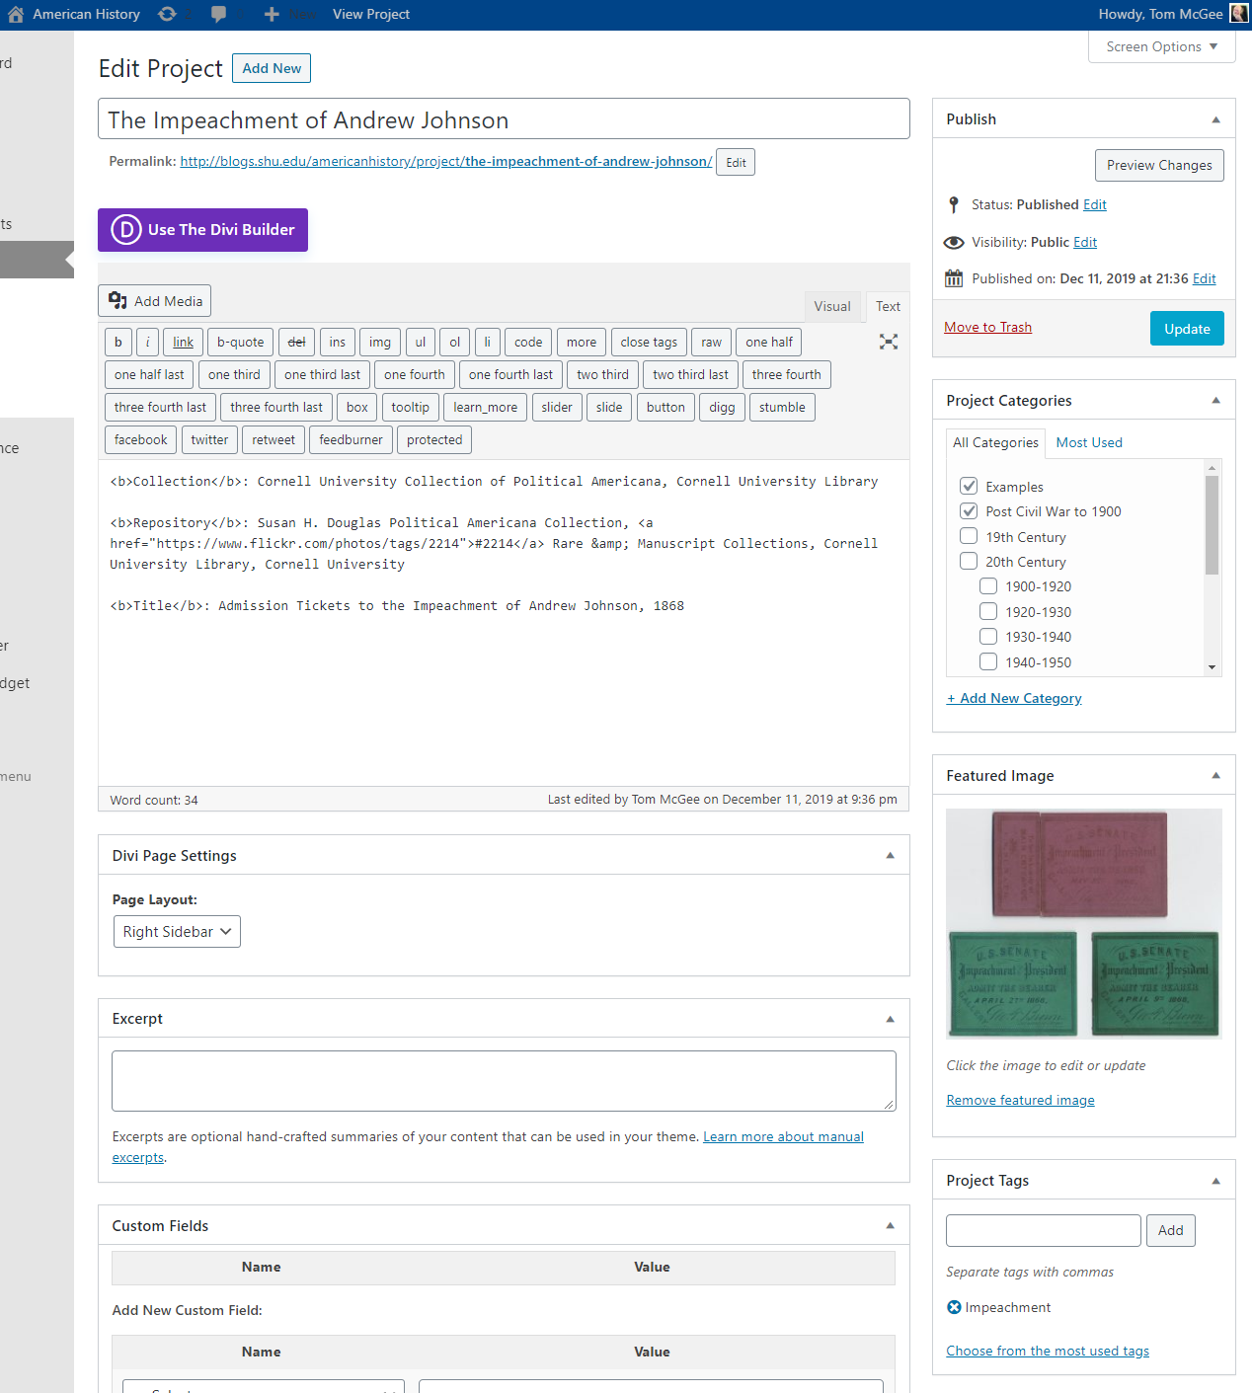
Where You Enter Them
Title
Assignment Entry
Excerpt
Optional: Builder
Categories & Tags
Featured Image
Notes:
If for some reason you don’t see any of the controls indicated, click on the “screen options” tab at the top of your edit screen. You can select which items appear.
The “Featured Image” section is in the right column of your edit screen. You can pick an image you’ve already uploaded, or upload a new one.
The Excerpt is what will appear on the different index pages on the classs site. It’s your short description that leads readers into your project.
The main assignment entry area is where your writing goes. The text that is there is intended to remind you of the components of the assignment.
The “Divi Builder” allows you to add rich media and offers interesting page-formatting tools. Be careful because switching back can make some of your content disappear. Always “preview” before saving!

Slide 8
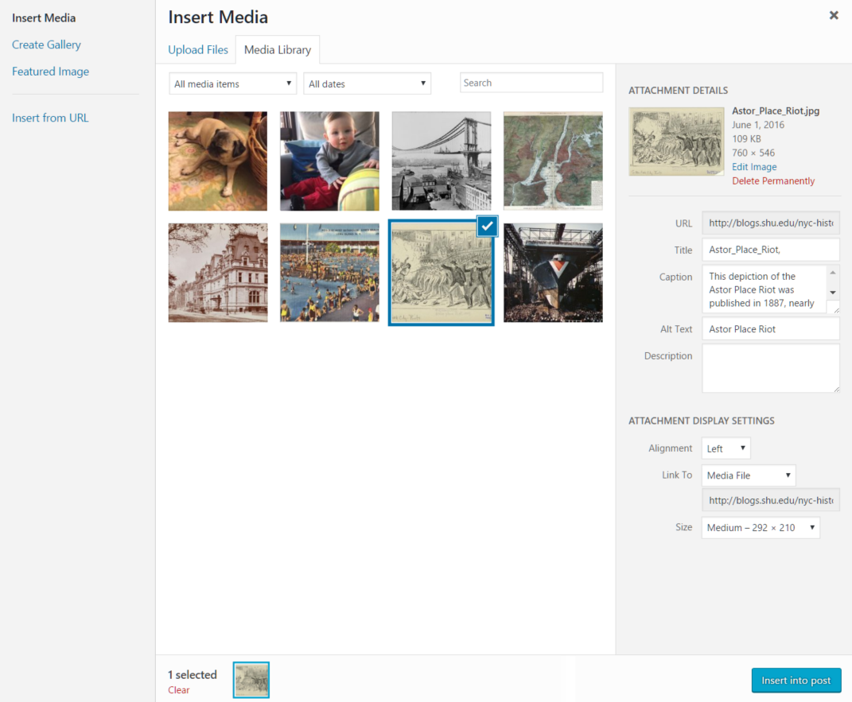
Adding An Image
Upload a new file
You can drag-and-drop
Or do some basic edits like cropping
Give it a title and caption
Pick your alignment and size
Insert it!

Slide 9
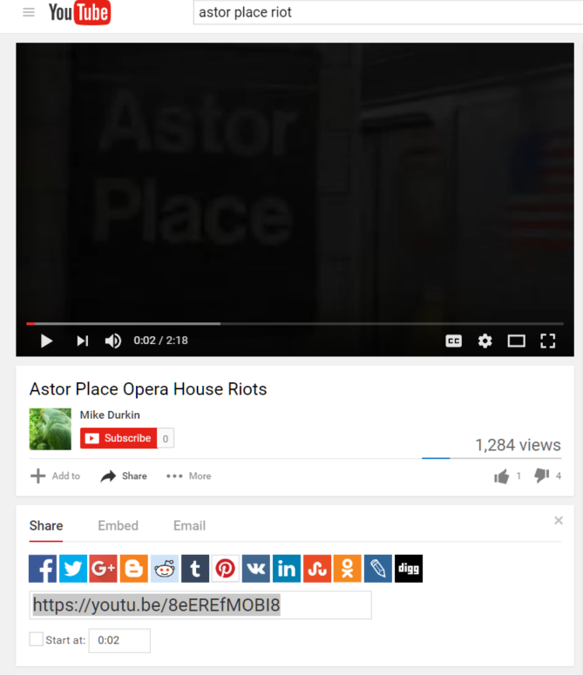
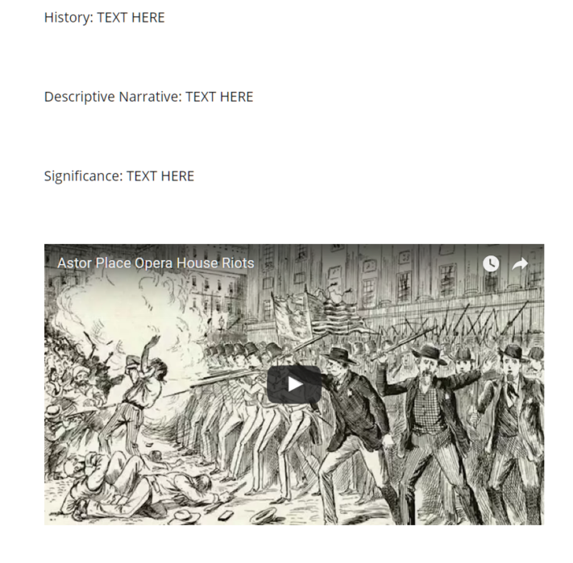
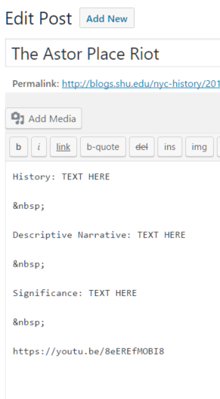
Or a Video
Step 1: Find the “Share” URL
Step 2: Paste It In
Step 3:
There is no step 3

Slide 10
The Importance of Copyright
Anything created after 1923 1924 may be protected by copyright.
Unless it’s been explicitly released into the public domain.
There are some exceptions for “fair use.”
Purpose and character of use: Is it of a commercial nature? For nonprofit educational purposes? A transformative use is more likely to be “fair use.”
Nature of the work: Photos are less likely to be “fair use.”
Amount and substantiality: Using a large proportion of a copyrighted work is less likely to be considered “fair use.”
Effect on the potential market or value: Will it cost the creator in the commercial marketplace?
All these would be weighed together if you were taken to court.
But if you’re in court, you’ve already lost.
Notes:
Every January 1 a new year’s worth of material enters the public domain. As of January 1, 2020, works created in 1924 or earlier are in the public domain. You can find a list of examples here: https://web.law.duke.edu/cspd/publicdomainday/2020/.

Slide 11
Where Do You Go?
Remember that since you’re doing an historical assignment, you might well find that older images are perfect for your use.
But there are also sources for images that have been released to the public domain, or are licensed under licenses such as Creative Commons that allow certain types of free usage.

Slide 12
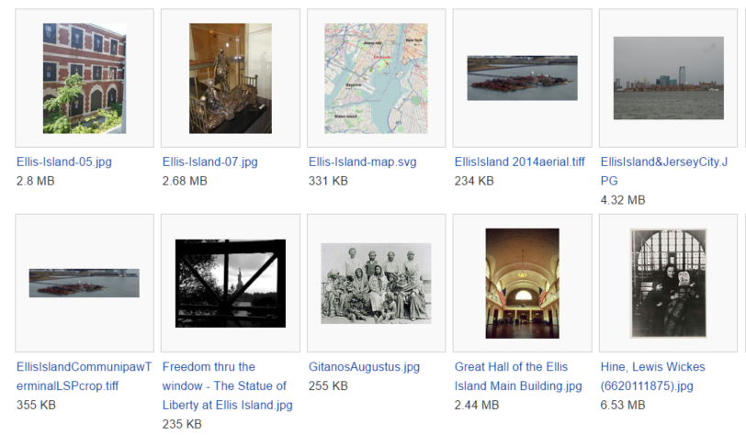
Wikimedia Commons
Over 34 million media files, free to use. https://commons.wikimedia.org/

Slide 13
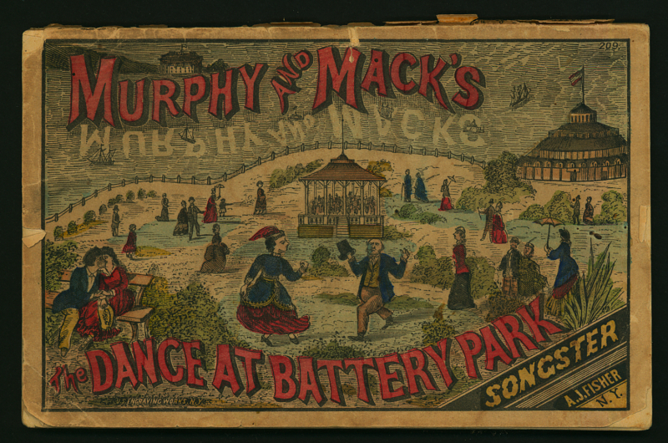
The Smithsonian
The Smithsonian recently released 2.8 million images into the public domain. You can download these and use them freely.
The archive is available here: https://www.si.edu/openaccess

Slide 14
Google Searches
Use the “Images” search.
Then find the usage rights you need
Notes:
You can filter your search results to images that are free to use.

Slide 15
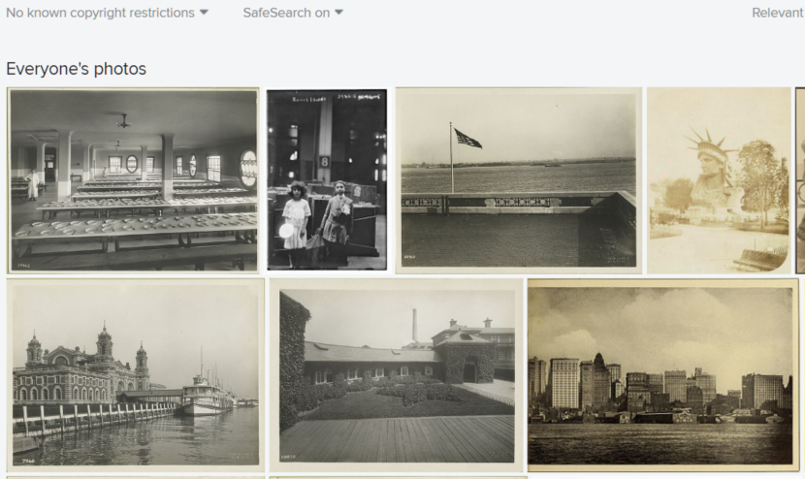
Flickr Commons
https://www.flickr.com/commons

Slide 16
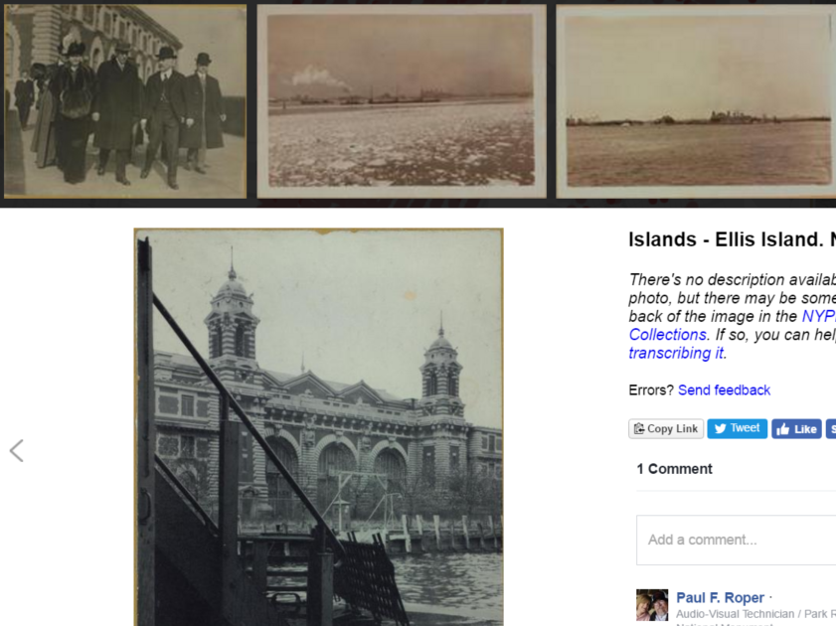
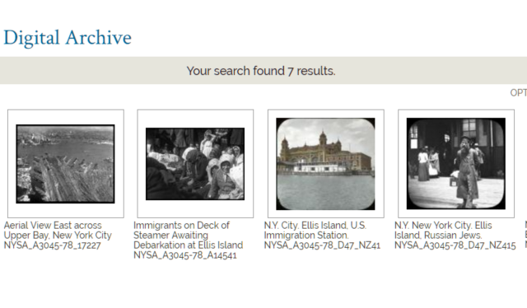
City and State Archives
http://www.oldnyc.org/
http://digitalcollections.archives.nysed.gov/
Non-commercial use of NYPL materials
Non-commercial NYS materials

Slide 17
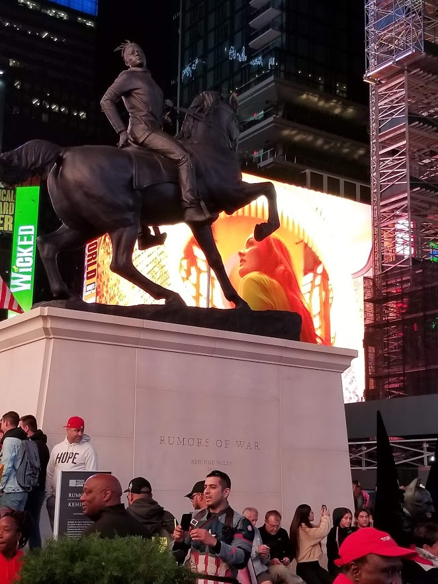
Take Your Own!
Any photo you take , you automatically own the copyright.

Slide 18
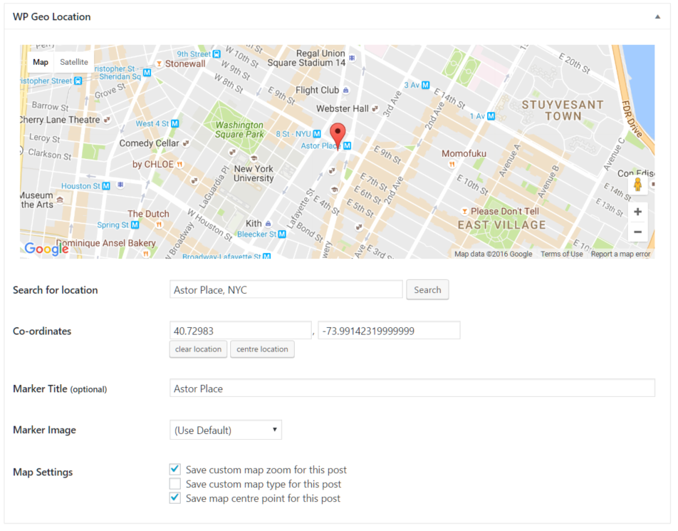
Mapping Your Location
If you use the Divi Builder, one of your options is to include a map.

Slide 19
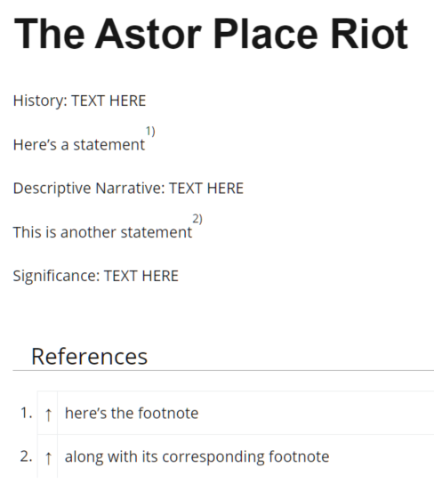
Footnotes
The ‘footnotes’ plugin makes it easy.
Just wrap up the footnote in double parens:
History: TEXT HERE
Here's a statement((here's the footnote))
Descriptive Narrative: TEXT HERE
This is another statement((along with its corresponding footnote))
They’re added and numbered automatically, along with links.

Slide 20
Final Checklist
Does it have the right title?
Is it in the right categories?
All are necessary for your project to appear where it’s supposed to appear!

Slide 21
This and more
https://blogs.shu.edu/americanhistory/instructions

